Slide 1
Estimation of plant cover
Yvonne König & Maja Májeková
Field Course, Dept. Of Botany, JUC

Slide 2
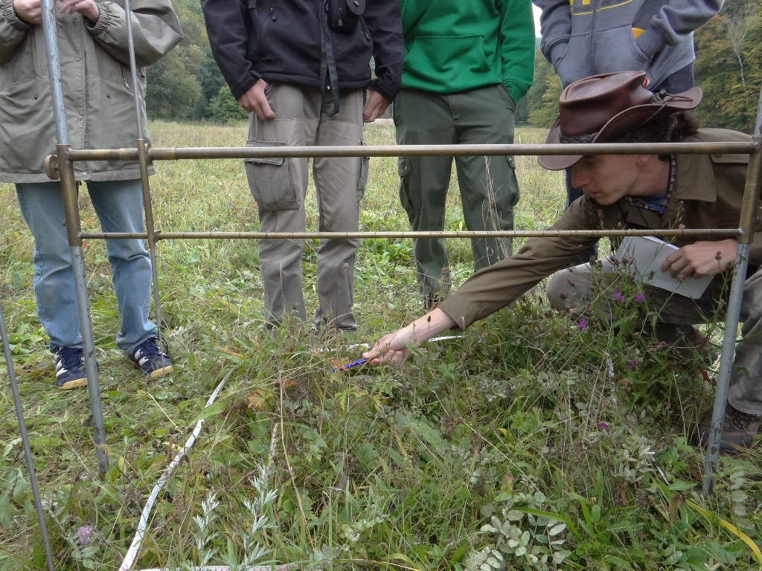
© courtesy of Vera Besnyői
Notes:
Tape measure, framework, vertical pin

Slide 3
Cover estimation methods in quadrats
photographic
visual estimation
percentage
Braun-Blanquet cover-abundance scale
point intercept / pin-point

Slide 4
Cover estimation methods in quadrats
photographic
visual estimation
percentage
Braun-Blanquet cover-abundance scale
point intercept / pin-point
Notes:
Used for elevated plant cover

Slide 5
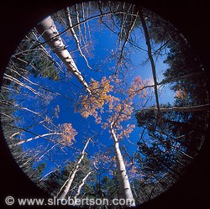
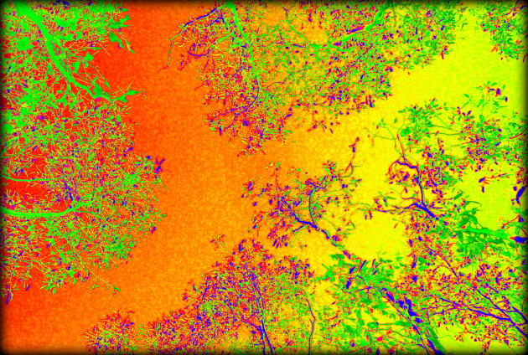
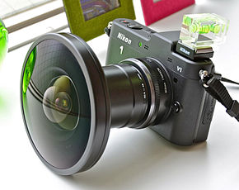
photographic method
Leaf Area - mostly elevated canopy
fish-eye
Notes:
Hemispherical photography
Konvex lens
Primaryproduction / Leaf Area Index ( LAI )

Slide 6
Cover estimation methods in quadrats
photographic
visual estimation
percentage
Braun-Blanquet cover-abundance scale
point intercept / pin-point

Slide 7
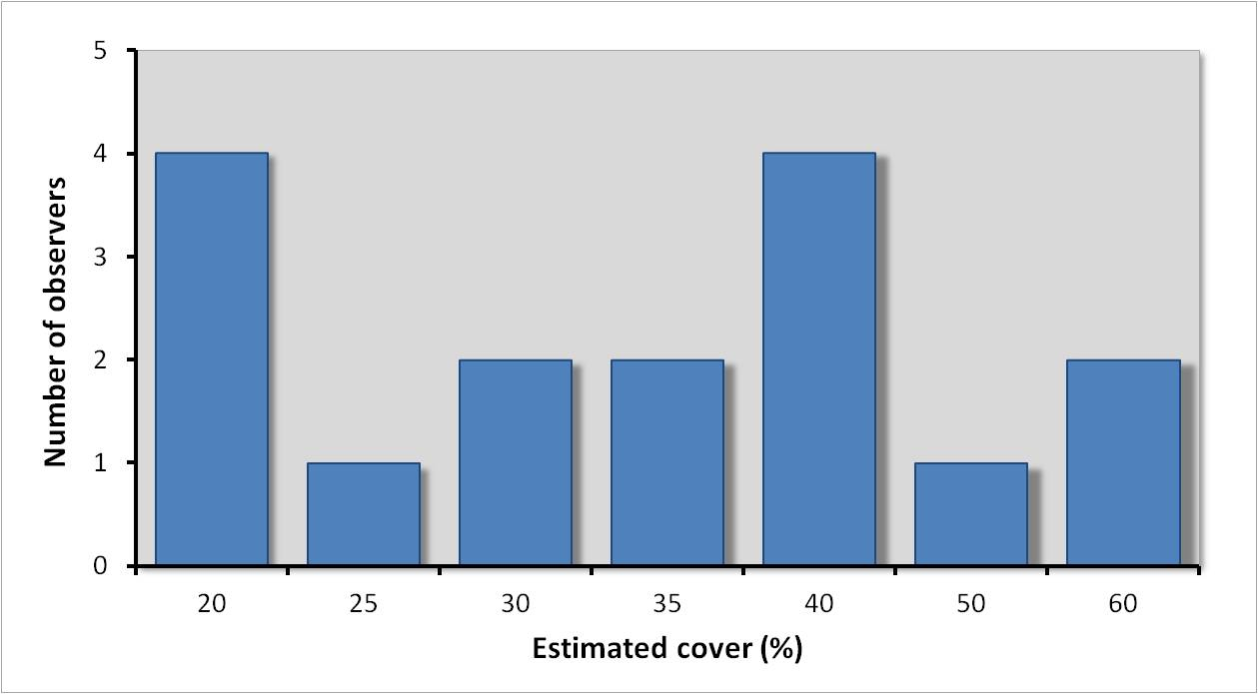
Range in estimation
http://ianluntecology.com/2013/11/03/the-great-vegetation-cover-up/
Notes:
Botanists used same method

Slide 8
visual estimate
…. percentage
fast, convinient...
subjective and differs among people
total cover > 100%
Braun-Blanquet cover-abundance scale
r = very rare
+ = rare
1 = 1-5%
2 = 6-25%
3 = 26-50%
4 = 51-75%
5 = 76-100%
uncomparable
more uniform
Notes:
BB: More agreement about abundance

Slide 9
Cover estimation methods in quadrats
photographic
visual estimation
percentage
Braun-Blanquet
point intercept / pin-point

Slide 10
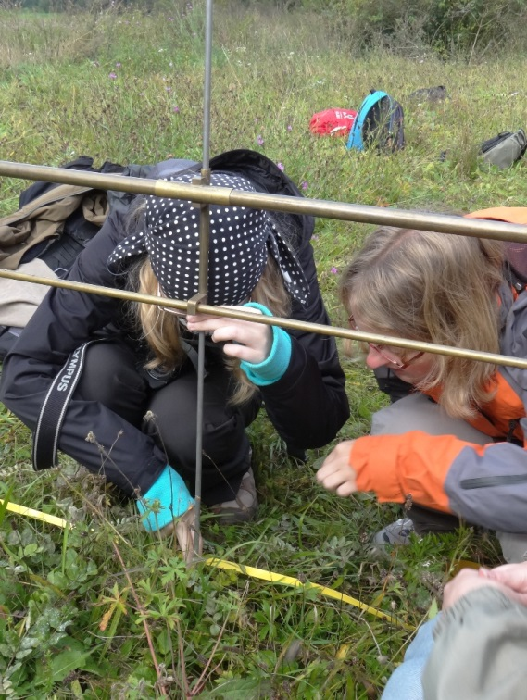
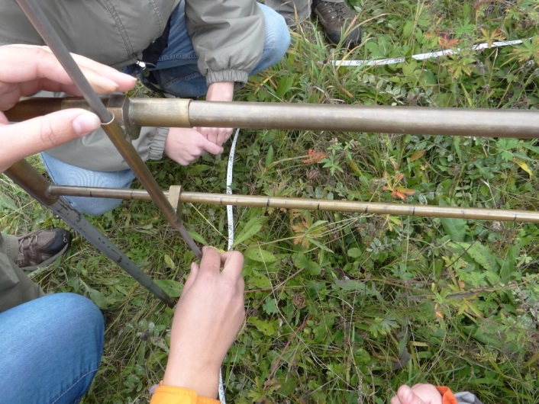
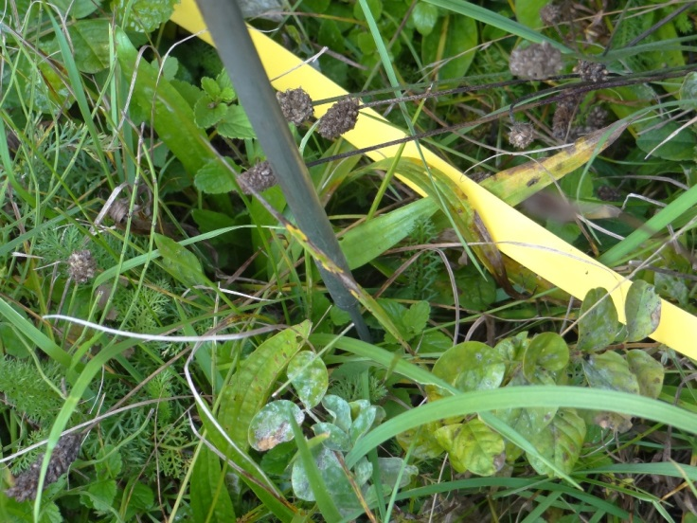
pin-point method
cover layers
100 pt
Notes:
Records several species at a time.
more species overlapping leaves → two or more interceptions at a point
metal frame, measuring tape

Slide 11
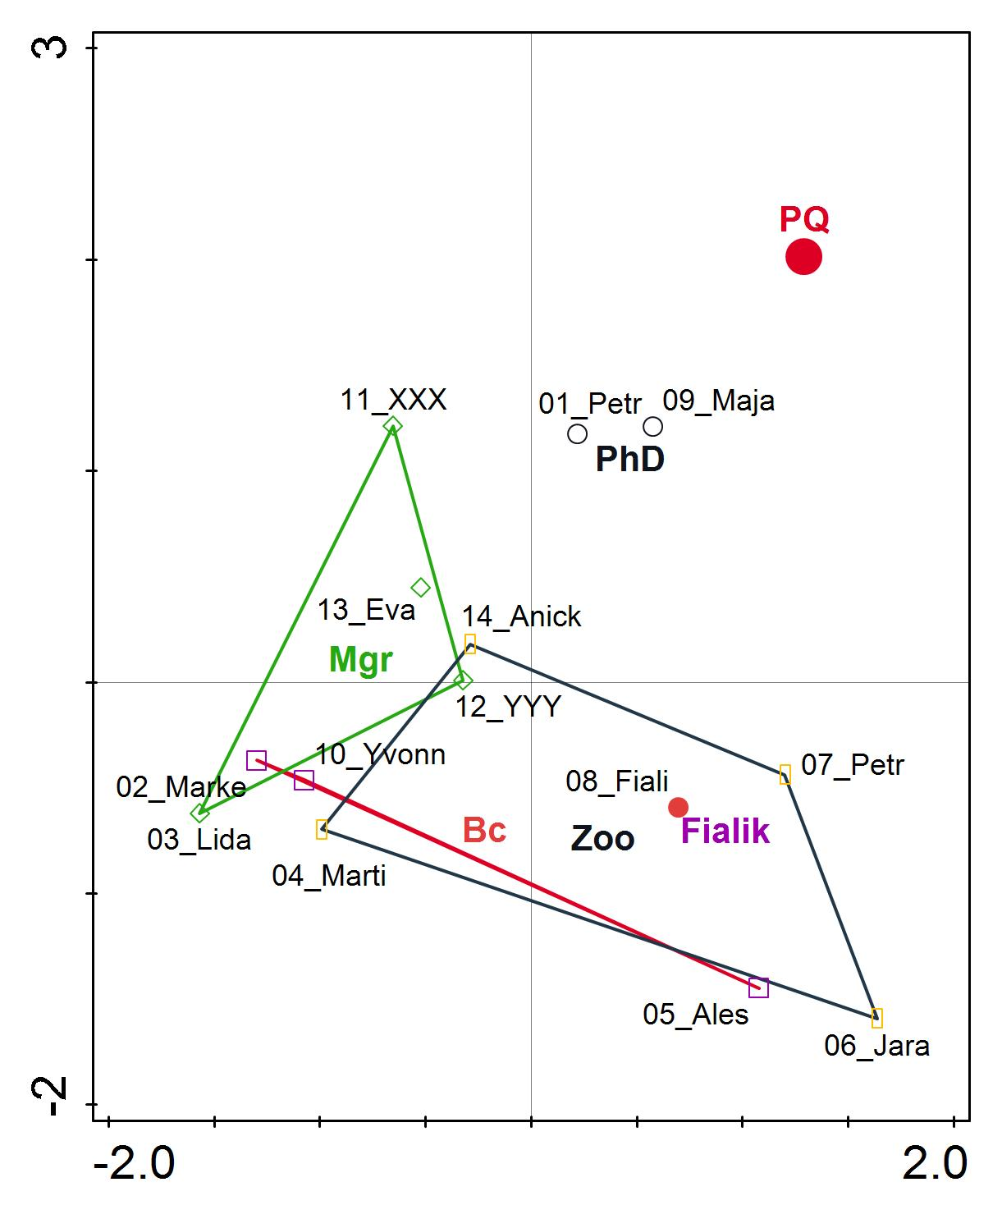

Slide 12
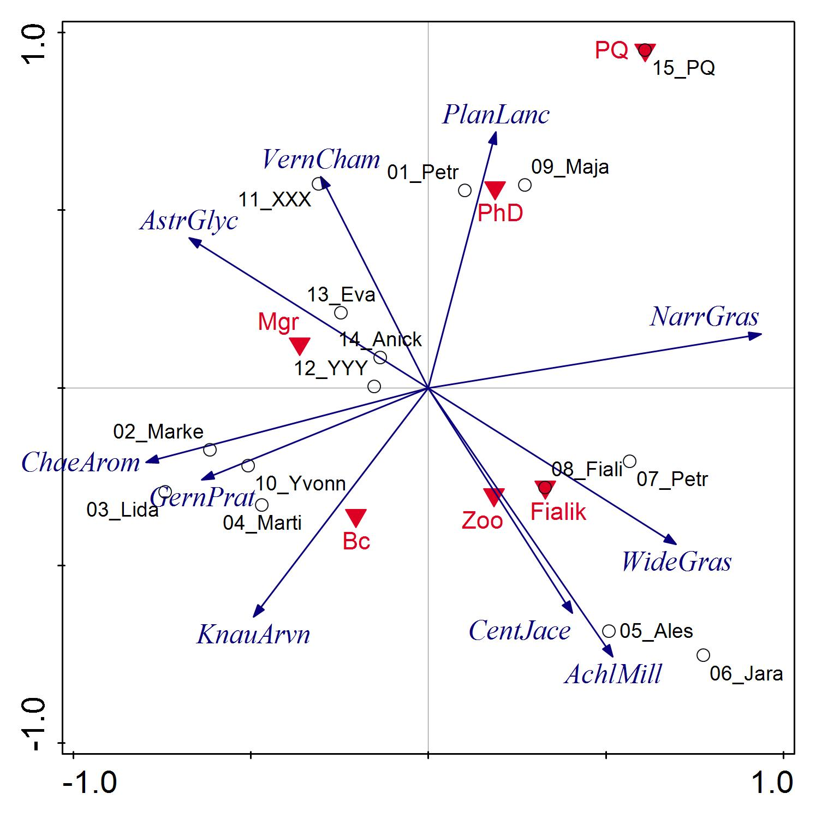
Axis 1 Axis 2 Axis 3 Axis 4
Eigenvalues 0.3991 0.2400 0.1588 0.0730
Explained variation (cumulative) 39.91 63.91 79.79 87.09
Notes:
Ordination graph:
similar species and samples are plotted close together, and dissimilar species and samples are placed far apart.
Pattern of species compositions/distributed on eg. Diff elevation / environmental sites
Analysis 'Copy of Unconstrained-suppl-vars'
Method: PCA with supplementary variables
Total variation is 0.11447, supplementary variables account for 45.6%
(adjusted explained variation is 15.4%)
Summary Table:
Statistic Axis 1 Axis 2 Axis 3 Axis 4
Eigenvalues 0.3991 0.2400 0.1588 0.0730
Explained variation (cumulative) 39.91 63.91 79.79 87.09
Pseudo-canonical correlation (suppl.) 0.6319 0.8516 0.5631 0.6031

Slide 13
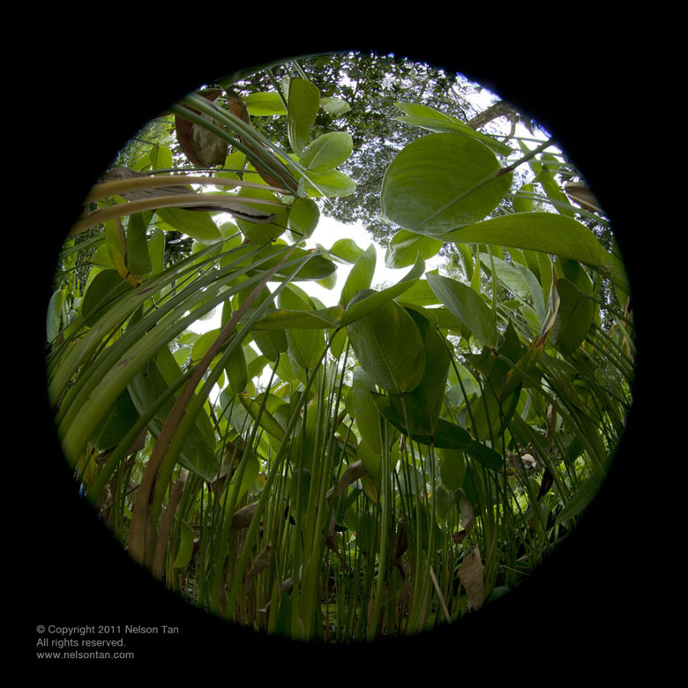
Thanks for your support on this project ☺

