Slide 1
Stability
Ecological stability is a popular topic of research
But what it means?

Slide 2
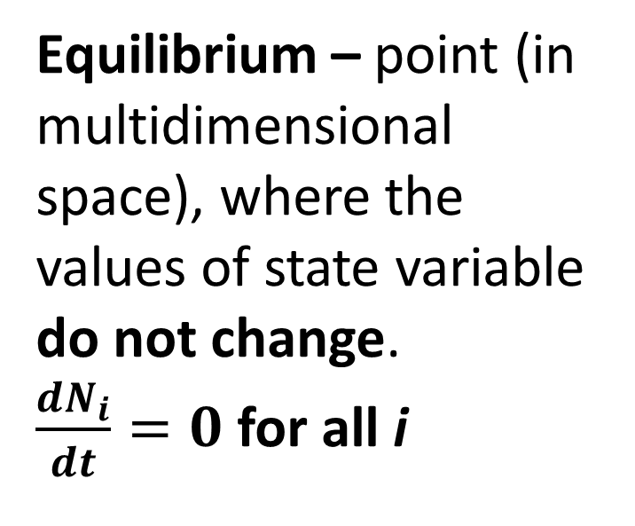
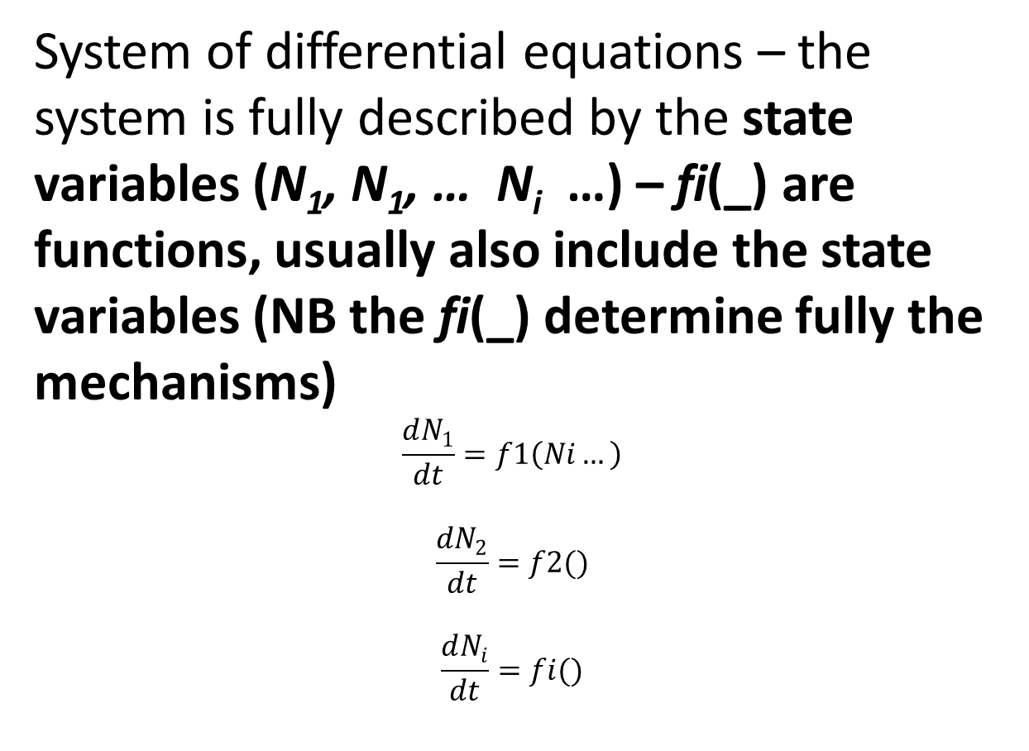
Concepts of stability
1. STABILITY IN MATHEMATICS
Simplified
Kindlmann, P., & Lepš, J. (1985). What is stability? a mathematician's and ecologist's point of view. Annual Review in Automatic Programming, 12, 201-204.
System of differential equations – the system is fully described by the state variables (N₁, N₁, … N_{i} …) – fi(_) are functions, usually also include the state variables (NB the fi(_) determine fully the mechanisms)
$$\frac{dN_{1}}{dt}=f1\left(Ni…\right)$$
$$\frac{dN_{2}}{dt}=f2()$$
$$\frac{dN_{i}}{dt}=fi()$$
Equilibrium – point (in multidimensional space), where the values of state variable do not change.
$\frac{dN_{i}}{dt}=0$ for all i
Solution of a system of differential equations (e.g. dynamic models in ecology) is a continuous trajectory of state variables in the state space

Slide 3

Typical example – system of Lotka – Volterra equations for competing species
$\frac{dN_{1}}{dt}=r_{1}N_{1}\frac{K_{1}−N_{1}−α_{12}N_{2}}{K_{1}}$
$\frac{dN_{2}}{dt}=r_{2}N_{2}\frac{K_{2}−N_{2}−α_{21}N_{1}}{K_{2}}$
Or generalized for n species
$\frac{dN_{i}}{dt}=r_{i}N_{i}\frac{K_{i}−\sum_{j=1}^{NSP}{α_{ij}N_{j}}}{K_{i}}$

Slide 4
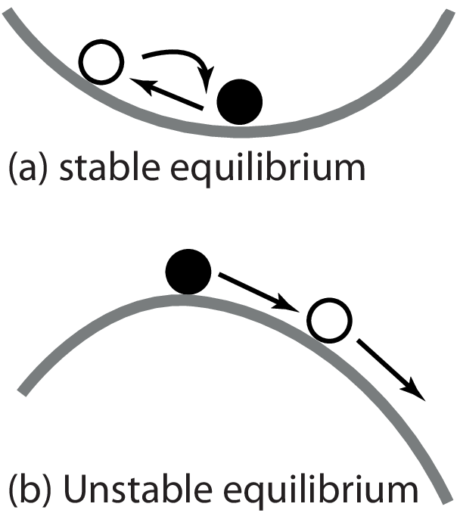
Is equilibrium stable? “Liapunov stability of equilibrium”
Analogy from physics
Does the ball return to “equilibrium state” after (infinitesimally) small displacement?

Slide 5
Useful characteristics of stability of equilibrium (useful analogies for ecology)
How far can we displace the ball to still return to equilibrium?
What force is needed to displace the ball?
How fast will be the return?
Does the system have one or more equilibria?
All these can be solved using mathematical analysis – Liapunov function
There is also Liapunov stability of a trajectory – note that thing are even more complicated

Slide 6
For Lotka Volterra equations
Does equilibrium exist so that all N_{i} are positive?
Is this equilibrium stable?
Interpretation: IF YES to both above questions, the species can coexist

Slide 7
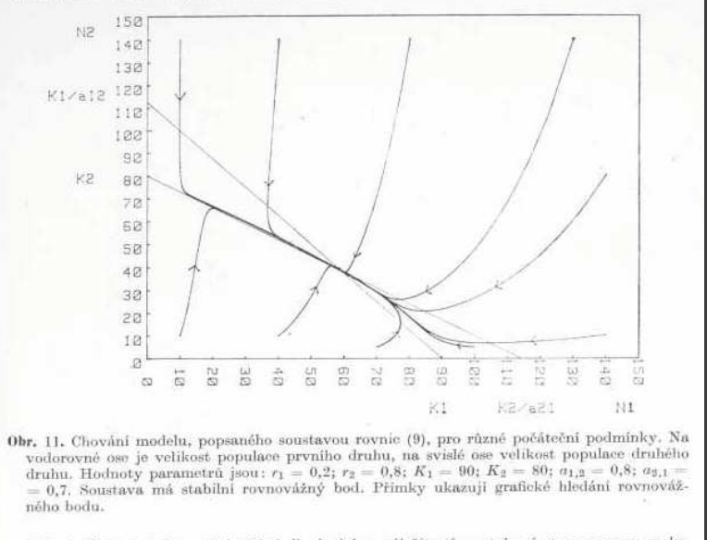
Example of stable equilibrium for Lotka Volterra equations for competing species. Whenever you start in the state space, you end up in this equilibrium.
(from Leps 1981]

Slide 8
Concepts of stability
2. STABILITY IN ECOLOGY
Equilibrium – we just know whether the values of N_{i} change. – This is why I do not like to call any state in real nature “equilibrium” (but people commonly do this)
We have a community (ecosystem, object) and measure variables characterizing it. Note that in models, the state variables (N₁, N₁, … N_{i} …) fully describe the system and fi describe its functioning
In ecology, we know just temporal trajectories (measured in discrete intervals) of measured variables, which we can call N_{i} - but are they state variables?
Kindlmann, P., & Lepš, J. (1985). What is stability? a mathematician's and ecologist's point of view. Annual Review in Automatic Programming, 12, 201-204.

Slide 9
There is nothing like community stability ( even though people love this term, and I use it also ☺), it is only stability of measured variables characterizing [selected properties of] the community
We can have stability of total biomass (often as proxy for some functioning), stability of species composition etc.

Slide 10
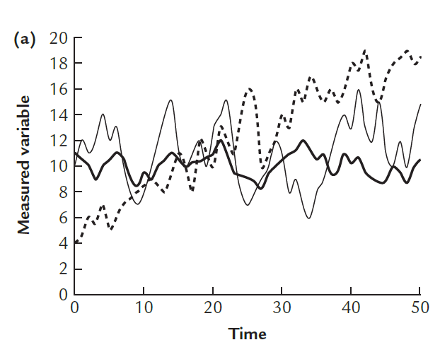
Ecological concepts of stability
[there is a terrible mess in terminology, the most commonly used terms are shown]
1. Under “constant” environment
Measured variable(s)!!! – [State variables] - examples are unidimensional for simplicity
“Equilibrium” concept – borrowed from math (Liapunov stability)
Liapunov stability transfered to ecology: May, R. M. 1974. Stability and Complexity in Model Ecosystems. Princeton Press.
Lepš 2013. Diversity and stability. In Vegetation Ecology.

Slide 11
Ecological concepts of stability
1. Under “constant” environment
Measured variable(s)!!! – [State variables]
“Equilibrium” concept – borrowed from math (Liapunov stability)
Unstable [no “equilibrium”, directional changes] – either successional changes, or gradual change of environment
Liapunov stability transfered to ecology: May, R. M. 1974. Stability and Complexity in Model Ecosystems. Princeton Press.
Lepš 2013. Diversity and stability. In Vegetation Ecology.

Slide 12
Ecological concepts of stability
1. Under “constant” environment
Measured variable(s)!!! – [State variables]
Stable [fluctuating around “equilibrium”, no directional changes] – high variability = low constancy
Lepš 2013. Diversity and stability. In Vegetation Ecology.

Slide 13
Ecological concepts of stability
1. Under “constant” environment
Measured variable(s)!!! – [State variables]
Stable [fluctuating around “equilibrium”, no directional changes] – low variability = high constancy
constancy is sometimes called invariability (typically variability characterized by CV, multivariate counterparts for species composition)
Lepš 2013. Diversity and stability. In Vegetation Ecology.

Slide 14

Concepts of stability
2. Response to “perturbation” or “stress period” (from T1 to T2)
Low resistance, high resilience
Some “equilibrium” or “normal state” expected (generalizable to stability of a trajectory)
Resistance – ability to withstand the “stress”
Resilience - ability to return back after the stress period ends
High resistance, low resilience
IMPORTANT: Resistance and Resilience must always be related to the type of perturbation
Lepš 2013. Diversity and stability. In Vegetation Ecology.
In theory: PULSE and PRESS perturbations

Slide 15
Caveat
The distinction between “normal period” and stress period is arbitrary.
  Observational studies – some customary rules, when the weather is normal, and when extreme
  Easier in experimental studies – Artificial droughts (sheltering roofs), application of pollutants etc.

Slide 16
The Simplest case – under “constant environment” – constancy / invariability / of a univariate characteristics
How to do….

Slide 17
Variability of univariate variable – e.g. population stability, stability of total biomass
Variability (as opposite to constancy = invariability)
Can be used for variability of any univariate, e.g., total biomass, net yearly productivity, etc., and characteristics of individual populations

Slide 18
Measures of variability for individual populations
(there is some analogy with the spatial variability)
Data used: time series of:
- Number of breeding pairs of birds (census)
- Number of moths in a light trap per year (index)
- Plant species biomass at the top of vegetation season
Typically, interannual variability (for seasonal variability, methods of phenology) – discrete time intervals usually available

Slide 19
Methods of the analysis might be similar, but distinguish
Stability / constancy / variability (both for individual populations and the whole community)
Of yearly (aboveground) production
Of standing biomass
For herbs in seasonal climate, both can be similar (but care for underground storage, when assessing aboveground biomass), for trees very different

Slide 20
Measures of variability – variance, resp s.d. (standard deviation)
Both, var and s.d. are usually positively dependent on the mean
2, 3, 2, 5, 4
The same variance (s.d.) as
102,103,102,105,104
The second is clearly more stable
The first is comparable to
20, 30, 20, 50, 40

Slide 21
s.d. is usually linearly dependent on mean
CV= s.d./mean
s.d. log (x) – better but usually not used – problems with zeroes
Value of both is identical for
2, 3, 2, 5, 4
20, 30, 20, 50, 40

Slide 22
But
Some people like to have STABILITY (i.e. constancy) on Y axis – i.e. high values when the community is constant = “stable” and they use 1/CV = mean / s.d. - problematic for mathematical operations
CV most often accepted as a measure of variability

Slide 23
All the above ignore the order of observations
But there might be a trend, cyclic changes etc.
Methods for spatial pattern analysis using transects might be useful (Two term local quadrat variance of Hill = variance estimate based only on differences between the subsequent times)
And also, the difference between extreme positive (dangerous for pest management) and extreme negative (endangered populations) deviations – importance of skewness (very few people consider this)

Slide 24
“Community stability”, i.e. stability (constancy) of total community biomass
Community is formed by its constituent species
Community biomass is sum of biomass values of individual species
What are drivers of the variability of total biomass (CV_{total})?
Segrestin, J., Götzenberger, L., Valencia, E., De Bello, F., & Lepš, J. (2024). A unified framework for partitioning the drivers of stability of ecological communities. Global Ecology and Biogeography, 33(5), e13828. https://doi.org/10.1111/geb.13828

Slide 25
Community variability components
1 Variability of individual populations - If all the populations are absolutely stable (CV=0), community biomass must be also absolutely stable (Cv_{total}=0)
2 Community mechanism that stabilize the community biomass - “compensatory dynamics” decrease of some species is compensated by increase of other species – if individual populations are fluctuating, the total biomass might still be fairly stable

Slide 26
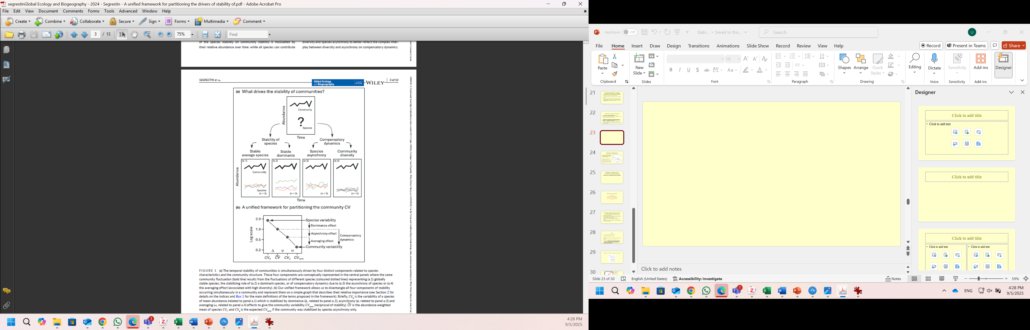

Slide 27
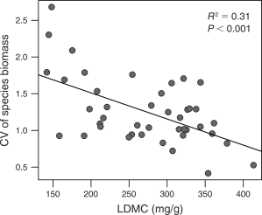
Community variability drivers
1. Variability of individual populations
Species life history strategies (and thus species traits) are determinants of population variability
Majeková, M., de Bello, F., Doležal, J., & Lepš, J. (2014). Plant functional traits as determinants of population stability. Ecology, 95(9), 2369-2374.
Conti, L., Valencia, E., Galland, T., Götzenberger, L., Lepš, J., E-Vojtkó, A., ... & De Bello, F. (2023). Functional trait trade-offs define plant population stability across different biomes. Proceedings of the Royal Society B, 290(2001), 20230344.

Slide 28
Community variability drivers.
1. Variability of individual populations
Taylor power law – dominants are usually more stable

Slide 29
Taylor’s power law (TPL)
var = a . mean^{b}
log(var) = log a + b .log(mean)
Both, var and mean are random variables, and after log transformation will have roughly the same “error” –> classical OLS underestimated the value of b

Slide 30
We use TPL for temporal variation, but the same basic rules apply for temporal and spatial variation
TPL was used to describe relationship of var and mean of the same species in various sites
TPL can be equally well used to describe mean and var of a set of species within a single community
[both can describe spatial and temporal variation]
Can be used for counts of individuals, but also for any other quantity
Generally, there is no theory behind, log – log linearizes quite a lot of various relationships

Slide 31
If b=2
CV (s.d./mean) is independent of mean
var (log(x)) is independent of mean
If 1 < b < 2 (generally, vast majority [more than 90%] of cases)
both CV and var (log(x)) decrease with the mean - in communities, dominant are usually more stable (have lower CV) than subordinate species (biological or mathematical dependence?)

Slide 32
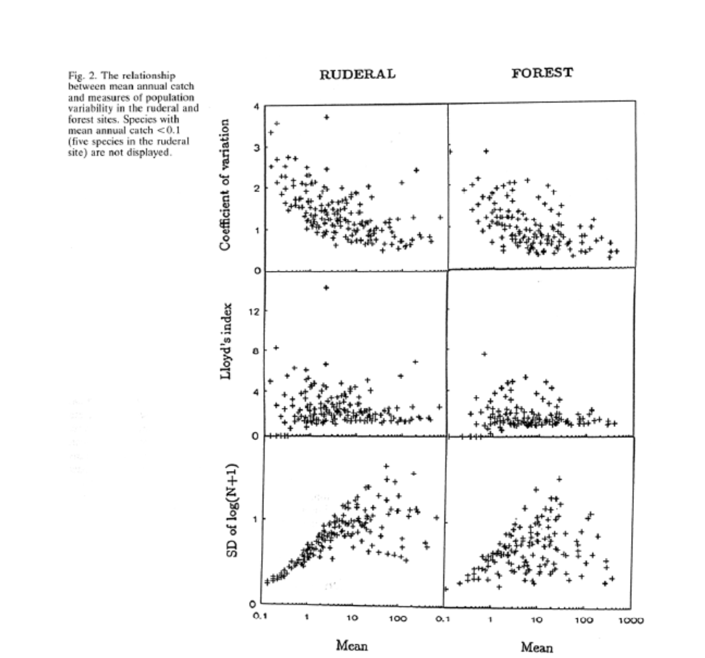
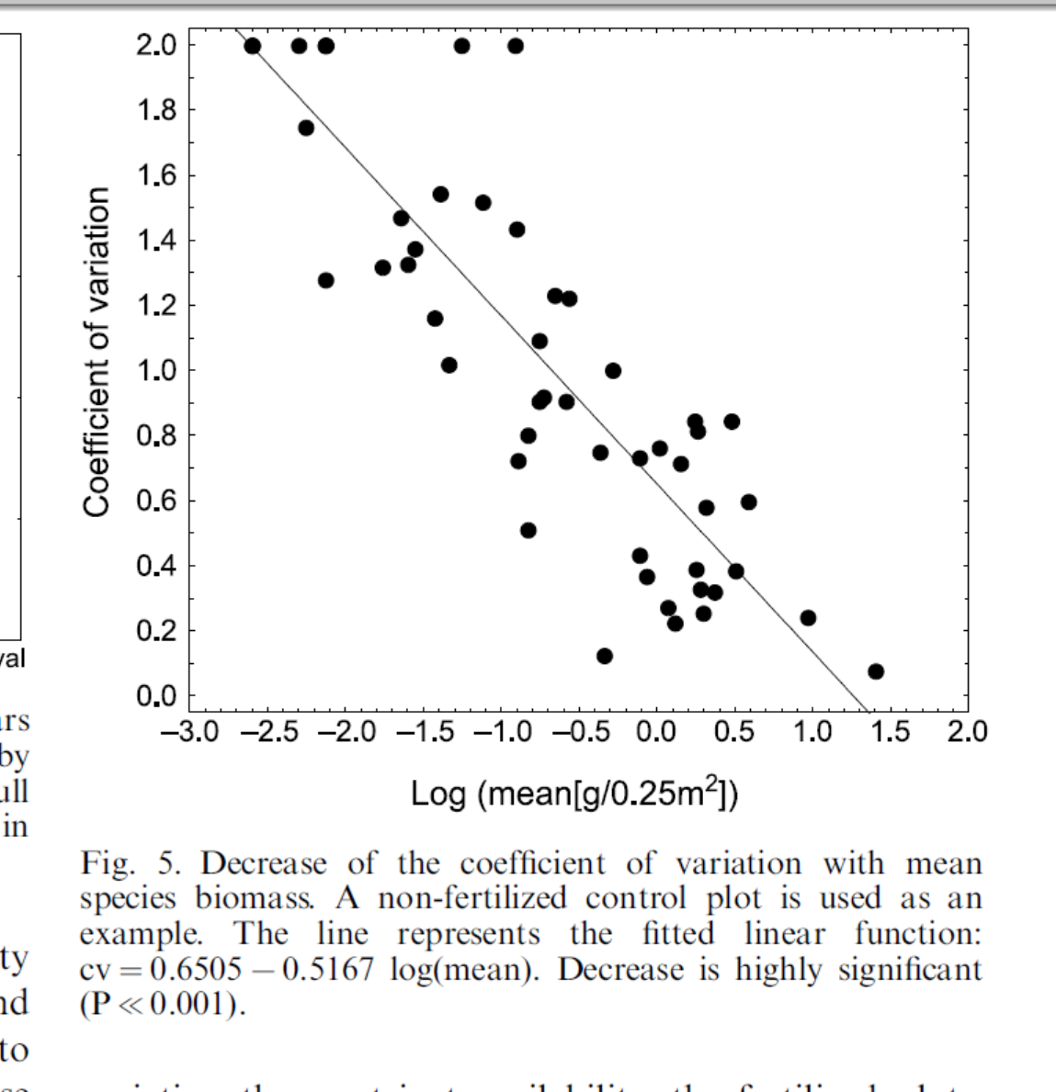
Variability of moths in light traps, Leps (Oikos 1993)
Variability of plant species biomass, Leps (Oikos 2004)

Slide 33
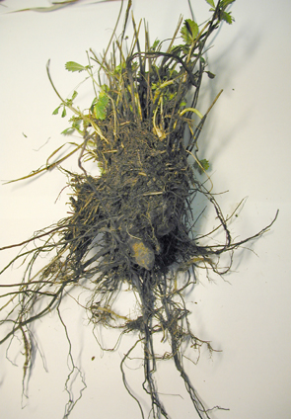
Some species are regularly found below the line, i.e. are less variable:
life history strategies
Unfertilised control plots

Slide 34
Community variability drivers
2. Compensatory dynamics
Effect of asynchrony – again, mess in terminology – for some, asynchrony is and deviation from perfect synchrony. For some, prevailing positive correlation is partial synchrony
Prevailing negative correlation is sometimes called antisynchrony
Stabilizing effect increases with species diversity

Slide 35
Effect of asynchrony (antisynchrony)
Deviation from perfect correlation is called asynchrony, and stabilizes the community biomass fluctuation
Perfect synchrony – no stabilization
CV community is exactly the same as CV of individual species

Slide 36
If the species fluctuate completely independently of each other
The coefficient of variation of biomass of community composed of k species is then

Slide 37
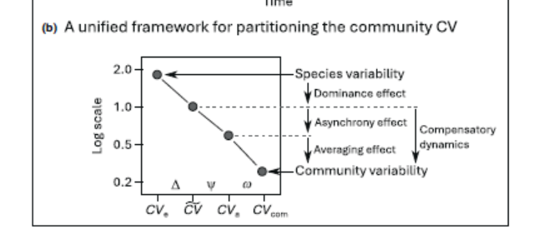
The diagram showing components of community stability

Slide 38
Effects
From CV of average species to weighted average of CV – dominance effect – the dominants are usually more stable – Taylor’s power law
From weighted average of CV to community CV - common (and non-independent) effect of asynchrony and “averaging” due to species diversity
Strong asynchrony of low diversity might have similar effect of weak asynchrony with high diversity
Need for a “yardstick” – we used random fluctuation in community of two equally represented species

Slide 39
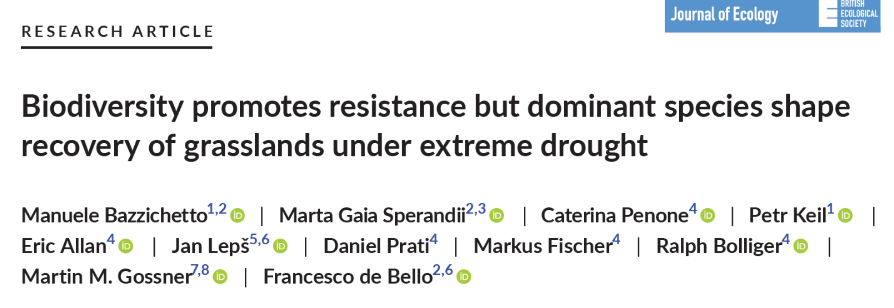
Resistance and resilience
Practical problems – definitions of the stress period in observational studies (usually, using some “meteorological indices, what is not “normal” for definition of the “stress” period”)
Resistance – often “ad hoc” measures – how much the total biomass (or other univariate characteristics) changes of the results of perturbation/stress
Resilience - the speed of return to the pre-perturbation state
Example: DOI: 10.1111/1365-2745.14288

Slide 40
Measures of stability of species composition
Two possibilities
  Reduce dimensionality using ordination methods
  Use the mesures of dissimilarity of species composition

