Slide 1
STUDY SYSTEM
OHRAZENI – a seminatural meadow – long term management experiment
Regular mowing ceased in late eighties

Slide 2
Factorial experiment, 3 replications – since 1994
Mowing (once a year, in June)
Ferilization (65 [50] g of commercial NPK/m² ⁻ 12% N (nitrate and ammonium), 19% P (as P₂O₅) and 19% K (as K₂O))
Dominant (i.e. Molinia caerulea) removal (in spring 1995, but re-weeding necessary time from time)
Yielding 24 plots, 2m × 2m each
Seed bank sampled in 2014 (for the same year, vegetation data are also available)
In each plot, 4 cores divided into upper and lower layer, taken three times Spring, Summer, and Autumn.

Slide 3
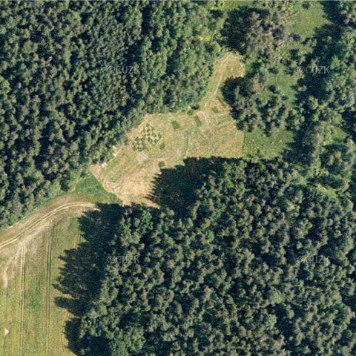
Ohrazení (http://mapy.atlas.cz)

Slide 4
Mown - unfertilized (=traditional) ~ 40 spp./m²

Slide 5
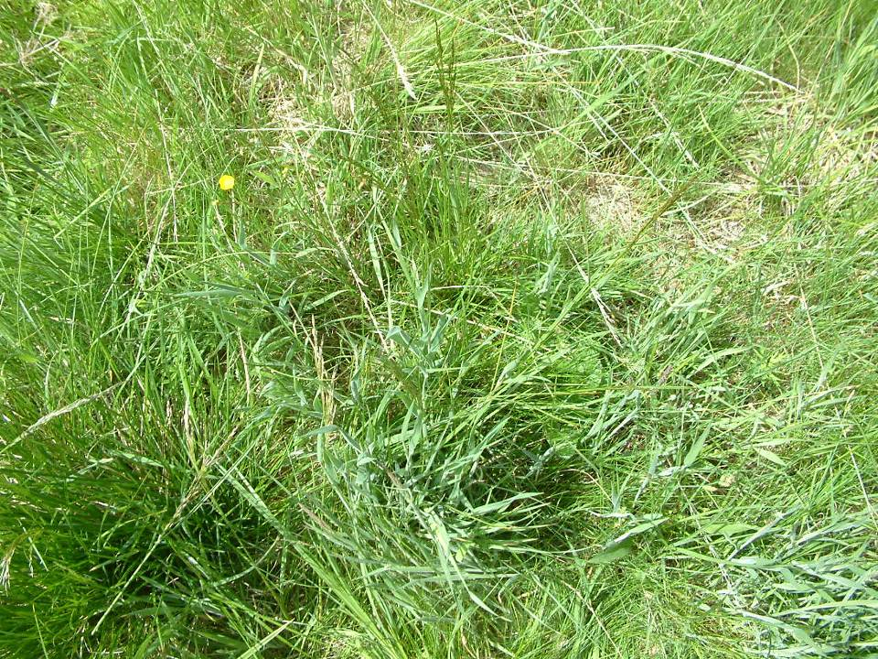
Mown - fertilized (=intensive) ~ 20spp./m²

Slide 6
For seed bank estimation, four soil samples (4.5 cm in diameter, 10 cm depth) were taken with a soil corer in each of the twenty four 2 x 2 m experimental plots. Soil samples were located outside the central 0,5 x 0,5 m square . The soil samples were then divided into the surface layer (0 - 3 cm below soil surface) containing mostly plant bases and roots, and the deeper soil layer (3 - 10 cm below soil surface) containing mainly soil substrate. These „subsamples“ were father processed separately: washed over a sieve (mesh width 1 mm) and seeds were hand sorted and determined directly using binocular microscope. Sampling was repeated three times a season, in spring (March/April), summer (July) and autumn (October).

