Slide 1
Population growth – the basic models

Slide 2
Each (“normal”) individual has a tendency to reproduce (genes of those that had not this tendency, disappeared from the populations)
In theory, for a species to survive (for a population not to decrease), each individual must, before dying, produce on average at least one offspring, which will survive to adulthood and be able to reproduce. (Because of environmental variability etc., it must be in benign conditions more.)
For sexually reproducing organisms, each pair must produce two offspring (or each female must produce at least one female [with expected sex ratio 1:1]) - which will survive to the reproductive age.

Slide 3
Basic equation of population dynamics
N_{t+1} = N_{t} + B - D + I - E
B – number of individuals born (from time t to time t+1)
D – number of individual that died (from time t to time t+1)
I - number of individual that immigrated (from time t to time t+1)
E - number of individual that emigrated (from time t to time t+1)
In most models, I and E are ignored, i.e. the population is considered closed. In many applications, N is considered to be the density (i.e. number of individuals per area). If we adopt this approach, also the B, D, I, E must be expressed for the same area.

Slide 4
Basic models

Slide 5
Parameters are independent of the density (“density independent”)
The simplest case:
then:

Slide 6
Populations with non-overlapping generations
(e.g..: butterflies lay eggs in late spring and after this they die, caterpillars feed and grow during the summer, pupate in autumn, and survive winter as pupae. In the next spring, the new butterflies hatch, and the cycle starts again. N is the number (density) of adults in the time of mating in the year t.
where λ is the “final” growth rate. It states the number of reproductive adults in the next generation (here in the next year) as descendants of the focal individual (often only female offspring of a female, or number of pair offspring/2). If the average biomass of adult is stable, then the relationship work well also for total biomass.

Slide 7
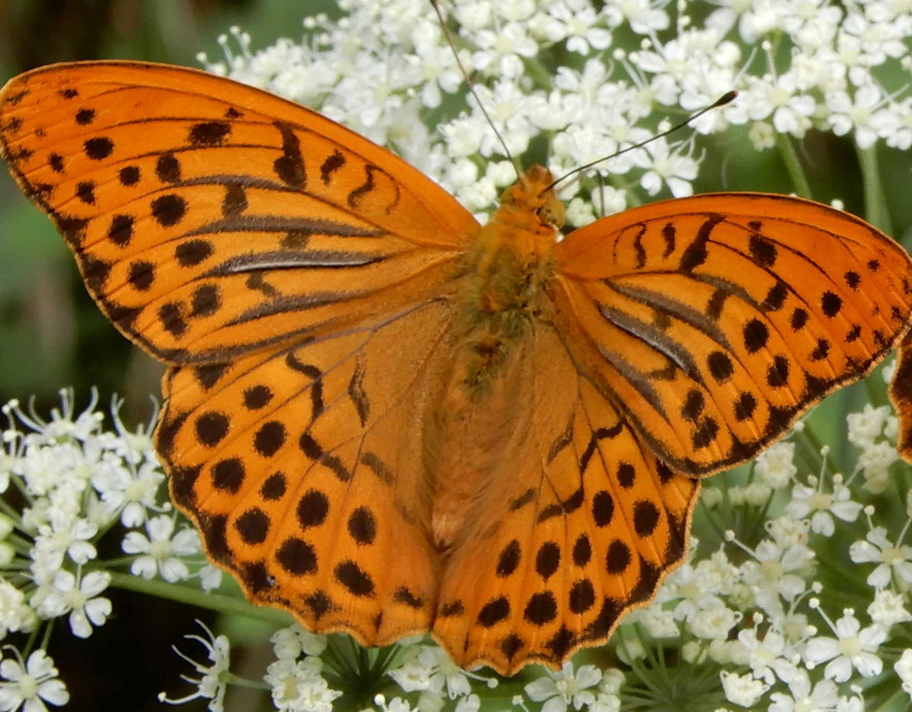
t1
t2
t3
λ=2
Assumed: step – year, the butterfly is considered to be univoltine, and not overwintering as an adult (only pupa overwinters)

Slide 8
The starting condition, the population size in year 0 is N_{0,} the population in year 1 will be
N₁ = λ N₀.
In year 2
N₂ = λ N₁ = λ (λ N₀) = λ² N₀,
In year 3
N₃ = λ N₂ = λ (λ² N₀) = λ³ N₀
And in the year t
N_{t} = λ^{t} N₀.
Important, λ is constant, does not change through time, is independent of the population density. The result is exponential growth (if λ>1), or exponential decline (if λ<1)

Slide 9
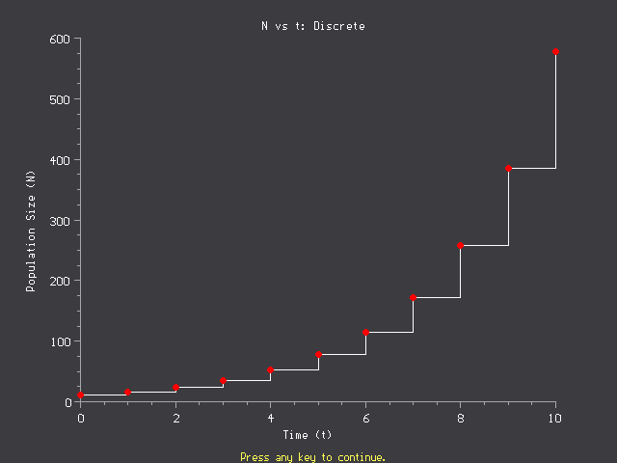
There is a single value, representing a single moment (mating time) in a year - difference equation modelling

Slide 10
The N_{t} = λ^{t} N₀ equation is quite general; for the butterflies (non-overwintering, adults not surviving winter), its application means that
* We describe just one developmental stage (reproductive adult)
* We ignore sex ratio . The simplest way is to consider just females (“males are in [functional] surplus, so we do not need to care”). λ is number of females produced by an average female.
λ is thus “aggregated” result of various processes during one season, estimable as
λ = Eggs/2*P₁*P₂*P₃*P₄,
where Eggs is number of eggs per female (we suppose half of them are females, and P are probabilities that (1) caterpillar will hatch out of the egg, (2) caterpillar will survive and will pupate, (3) pupa will survive the winter and imago will hatch out of it, (4) butterfly will survive, successfully mate, and lay the eggs.

Slide 11
Similarly for plants (annuals without seed bank, monoecious or bisexual flowers)
λ = Seeds * P₁*P₂*P₃
Where Seeds is number of viable seeds produced by a single plant, P are probabilities that (1) seed survives winter(2) will successfully germinate in the spring, and (3) the seedling will survive, flower and produce the seeds
All the parameters are considered to be constant.

Slide 12
Trapa natans - annual that have no seed bank

Slide 13
2. Population with overlapping generations (and reproducing once in a year; for example, hares is April) - census is shortly before the reproduction – important – if there is a one-year step, you need to know, which point of time in the year you consider
N_{t+1}= N_{t}+N_{t.}b - N_{t}d = N_{t}(1+b-d)
N is number of (adult) females in April (adopting here the approach that we model females only)
b (natality, birth rate – but this name is actually misleading) – it is the average number of female offspring per female, which will survive till the next April (thus, it is the real natality (number of female offspring) * probability of their survival till next April
d (mortality, death rate) – proportion of females, which do not survive till the next April

Slide 14
N_{t+1}= N_{t}+N_{t.}b - N_{t}d = N_{t}(1+b-d)
If we introduce
1+b-d = λ
We can write
N_{t+1}= N_{t}+N_{t.}b - N_{t}d = N_{t}(1+b-d) = N_{t} λ
Obtaining again the classical equation for the exponential growth.
(note that this is a general equation for both, overlapping and non-overlapping generations, for non-overlapping, d=1 and thus λ=b)
For population to grow, we need again λ>1, which means b>d
Thus, finally, the same exponential growth - N_{t} = λ^{t} N₀

Slide 15
Continually reproducing population
If the natality and mortality is constant, the result will be again the exponential growth (or exponential decline). The derivation might be a little complicated - within a single season females are continuously reproducing, but also dying (and the dead ones do not reproduce any more). The solution is to shorten the time step (up to the zero length) yielding a differential equation.

Slide 16
Important
λ is a ratio of population size in t+1 to population size in t , r is (relative) size of change. For step size = 1,
r=ln(λ)
Population increases for r>0, decreases for r<0
Or increases for λ>1, decreases for λ<1
One would expect that r = λ – 1, instead of ln(λ). But according to the model, the new individuals immediately contribute to reproduction. Moreover, for small time step,, the difference disappears. For λ close to 1, λ-1 ~ ln(λ).

Slide 17
For λ close to 1, λ-1 is very close to ln(λ).
λ | λ-1 | ln(λ). | (λ-1)/ln(λ).
1 | 0 | 0 | #DIV/0!
2 | 1 | 0.6931472 | 1.44269504
1.5 | 0.5 | 0.4054651 | 1.23315173
1.25 | 0.25 | 0.2231436 | 1.12035503
1.125 | 0.125 | 0.117783 | 1.06127338
1.0625 | 0.0625 | 0.0606246 | 1.03093427
1.03125 | 0.03125 | 0.0307717 | 1.01554487
1.015625 | 0.015625 | 0.0155042 | 1.00779231
1.007813 | 0.0078125 | 0.0077821 | 1.00390118
1.003906 | 0.0039063 | 0.0038986 | 1.00195186
1.001953 | 0.0019531 | 0.0019512 | 1.00097624
1.000977 | 0.0009766 | 0.0009761 | 1.0004882
1.000488 | 0.0004883 | 0.0004882 | 1.00024412
1.000244 | 0.0002441 | 0.0002441 | 1.00012207
1.000122 | 0.0001221 | 0.0001221 | 1.00006103

Slide 18
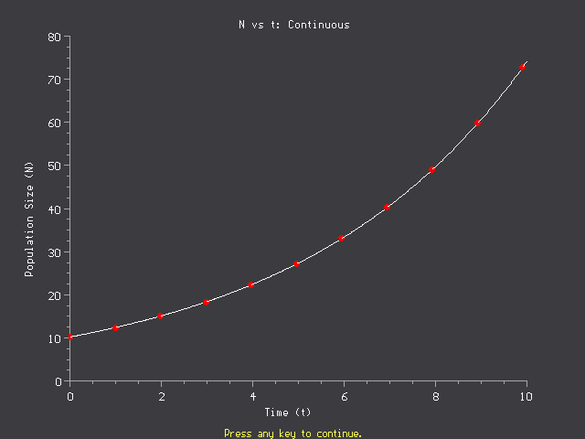
We know the state in each point of time – immediate change in the population is proportional to the population size.

Slide 19
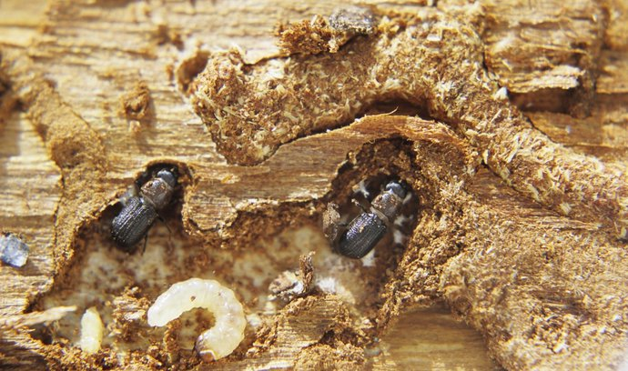
All the models are simplifications, and some populations are difficult to classify in the scheme overlapping/ non-overlapping generations.
For example
Polyvoltine species – more generations per year, then overwintering.

Slide 20
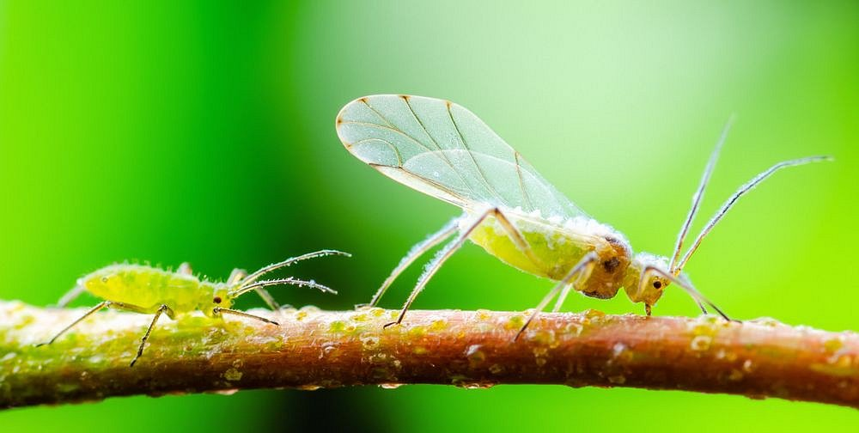
Species with complicated life cycles
Aphids with parthenogenesis and telescoping generations (wingless) and flying males and females at the end of the season – or cycles connected with the alternation of hosts).
For quite a few of these, however, the exponential growth is reasonable approximation, e.g. for the parthenogenetic generations of aphis during the seasons, and in the case of several year of increase for insects with complicated life cycles. .
nechaevkon / Shutterstock.com

Slide 21
Difference vs. Differential equations
Theoretically, continuous processes should be modelled by differential equations and processes discrete in time (typically seasonal) by difference equations. However, in practice, both equation types are some approximations, and selection of the tool depends on many, often practical things. Note, that N – population size, is generally count, and still, we us dN - which is only for continuous variables, etc.

Slide 22
Difference vs. Differential equations
Note, that for some simulations, the differential equations are simulated as difference equations with very short time step.
Nevertheless, differential equations are often used even with yearly periodicity. (Note that then you will get smooth curve, whereas there might be very strong seasonal variations.)

Slide 23
Reality with seasonal dynamics
N
Exponential growth
Time

Slide 24
N as continuous variable
If the population is large (human population on the Earth), this approximation is appropriate (error of the estimate of population size is still much larger than 1 individual).
In small populations, it matters. We can get the population with size 0.1 (in reality, the population would die). In exponential dieback, the population would never get extinct, and when the conditions improve, the population can again start the exponential growth.

Slide 25
Stochastic models
Typically, we get probability that an individual will reproduce (and perhaps distribution of offspring number), that it will survive without reproduction, and that it will die
Result is not a single value, but expected distribution of values in individual times. The results can be quantitatively different from corresponding deterministic model, particularly for small populations. (Remember binomial probability distribution.)

Slide 26
Stochastic model
N₀ = 5
Each individual will
1. Split into 2 – P=0.6
2. Remain unsplitted – P=0.2
3. Die – P=0.2
Expected λ = 1.4 =
0.6 x 2 + 0.2 x 1 + 0.2 x 0
Expected N in the second year = 7
Expected
With P=0.6⁵
^{=0.078}
With P=0.2⁵´=3*10⁻⁴
Note: each individual behaves independently of others

Slide 27
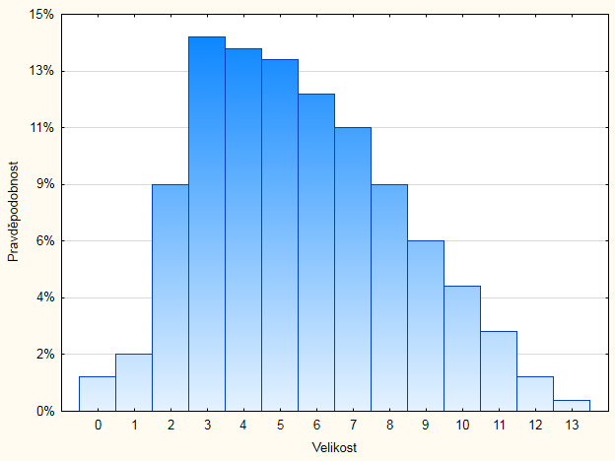
For each time, I get diagram of probability distribution like this (in deterministic model, I get a single number). The result might be presented and the mean and standard deviation as function of time.

Slide 28
Non-zero probability, that the population size will be zero, i.e. the population will get extinct. Even though the probability is small, if this repeats many times, the probability of extinction might be rather high over a long period. The outcome of stochastic and deterministic models with corresponding parameters might be qualitatively different.

Slide 29
Whatever mathematical method is used
We obtain the exponential growth, if the parameters (i.e. natality and mortality, and thus r or λ) are constant (and r>0 or λ>1). In particular they are not dependent on the population density!!!
Seasonality exists (in any population, including humans) but it does not affect the exponential character of the growth (at least, not too much)
When using the model, discriminate
Prediction: what will happen. Projection: what would happen with given values of the parameters

Slide 30
We expect that for each population under favourable conditions, there is potential for growth (i.e. r>0 or λ>1). Thus If a population is limited neither by resources (bottom up regulation), nor by enemies (top down control), it grows exponentially.

Slide 31
In nature, exponential growth is always for a relatively short time
Thus, the basic question for each population is:
What is this particular population limited by?
(Why the population does not grow exponentially?)

Slide 32
Potencial of the exponencial growth
Assumption: A bacteria divides into two each 20 minutes.
A layer of bacteria will cover the whole Earth with 24 hours.
Within half of the next day, the earth will be covered by a layer 80 km thick.
Calculated by Pásztor, L., Botta-Dukát, Z., Magyar, G., Czárán, T., & Meszéna, G. (2016). Theory-based ecology: a Darwinian approach. Oxford University Press. My own calculation suggests it should be some hours more. (in 24 hours, it should be 2⁷² which is 10^{21.7} cells)

Slide 33
Why the infection (very small inoculum) will cause disease in your body?
Single mosquito bites you – very small initial inoculum of Plasmodium
After short time – you will have bilions of germs in your body – they had grown exponentially

Slide 34
Potencial of the growth of the human population (simplified)
Assumption: Generation time 25 years, each pair has 4 children (all will survive to reproduction) - thus the population will double each 25 years – (corresponds to 2.81% yearly increase)
Quite a few African countries have more (e.g. DR Congo 3.19%)

Slide 35
Potencial of the growth of the human population (simplified)
Each century, the population will increase 16-times, each millennium, 2⁴⁰-times, i.e. 10¹²-times, tj
1000000000000-times

Slide 36
Potencial of the growth of the human population (simplified)
10¹² =1000000000000-times
– with this rate, after a millennium, one pair would have more than 100 times more descendants than is the number of living people now (which is roughly 10¹⁰ people [its slightly less].
With this rate of increase, the recent population will need less than 33 generations from a single pair, i.e. roughly since 1200 AD.

Slide 37
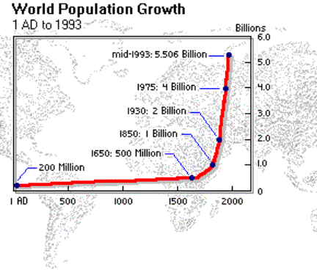
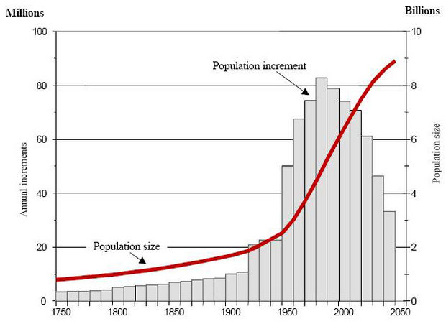
Growth of human population
This is just the prediction from the end of last century

Slide 38
2022 we reached 8 bilions
As a matter of fact, it is not exponential growth, the rate of the growth is not constant, but increases. Looks like a positive density dependence. Guess the explanation!

Slide 39
It is clear that the physiological limits of the human populations (i.e. the potential number of children per pair) would enable even higher rate of increase
If you take into account the number of offspring and generation time of most of the animals, physiological limits would enable rather fast exponential growth – nevertheless, exponential grow usually end very soon
=> Each population is limited/controlled [what is the limiting factor???]
(resources, enemies, disturbances etc.)

Slide 40
Negative density dependence
then:
Individual is negatively affected by the density of its own population (typically, is smaller, and smaller individuals have higher mortality, and/or less progeny – thus lower fitness)

Slide 41
Negative density dependence, causes:
Intraspecific competition for resources (usually food for animals, light, water and nutrients for plants, – probably not for sexual partners if we expect sex ratio 1:1 – but for nesting places yes)
Higher trophic levels – most common increased infection transmission and resulting epidemics [probably parasites are better control agents than predators]
In plants – fire spreads faster in denser population and is probably harming more
Negative density dependence might affect both, natality and mortality
Important: density-dependence need not affect population for majority of time, but for regulation of population size it might be sufficient if it operates just in times of population outbreaks or affects certain life stages.

Slide 42
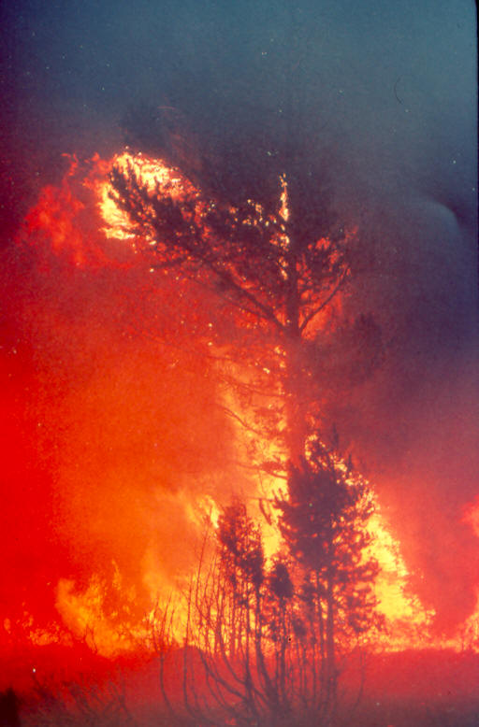
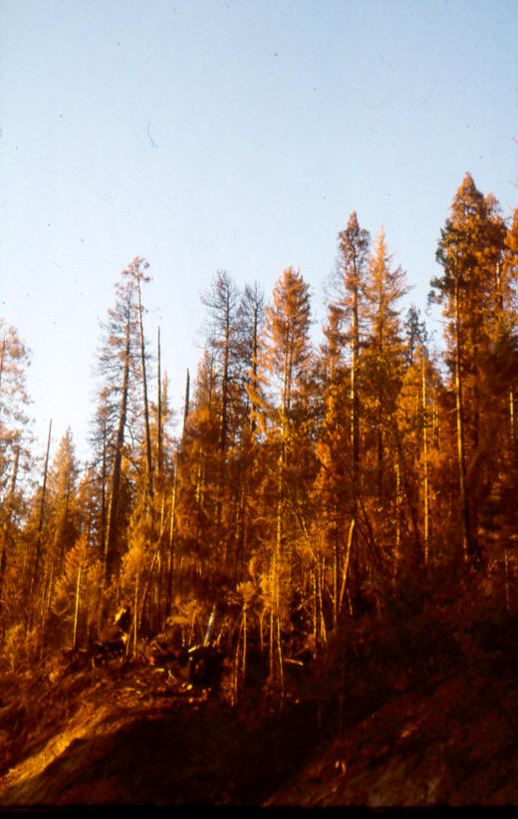
The denser is the population, the higher probability that the fire will reach the crowns and will spread there

Slide 43
Do the relatively sparse individuals compete with each other?
1. Aggregated spatial pattern decreases the distance between neighbours

Slide 44
Overlooked density-dependence in juvenile stages (particularly in plants)
Seed rain is heterogeneous, resulting in clumped distribution of seedlings
Seedling survival and even germination of seeds might be density dependent (e.g. in a dense cover of seedlings, e.g. in gaps, seeds stop to germinate).
The more hatchlings in the nest, the less food for each one

Slide 45
Mudrák, O., & Lepš, J. (2010). Interactions of the hemiparasitic species Rhinanthus minor with its host plant community at two nutrient levels. Folia Geobotanica, 45(4), 407-424.
Numbers of Rhinanthus minor individuals in thinned and control plots (20 cm × 20 cm) at the seedling and flowering stages (results of repeated measures ANOVA, significant interaction between the effects of thinning and time: F _{1,22} = 8.99, P = 0.007). Means and 95% confidence intervals (based on the between plot MS, backtransformed from log) are shown

Slide 46
Methodological note – would something like the thinning experiment be possible for hatchlings in the nest?
Discuss the advantages and dangers of the thinning experiment (removal of hatchling from the nest, vs. comparison of fitness of individuals from nests with 2, 3 and 4 hatchlings?

Slide 47
Logistic equation
Equilibrium
- When the density equals to the carrying capacity - K
N
Čas

Slide 48
Important
In logistic equation, N sometimes means the density – not the total population size. (However, in closed population, the two are directly proportional, so the meaning would be the same for both.)
The carrying capacity (K) is in the same units as N. So, if N is the total population size, then K is number of individuals which the area under consideration (i.e. the area where we study the populations) can support. If N is the density, then also K must be in numbers of individuals/m².

Slide 49
Important
Logistic equation is usually presented in differential form. This is just a custom, it can be expressed as difference equation as well (see later).
If presented as differential equation, we simply ignore the possible seasonality etc.

Slide 50
Negative density dependence is in the formulae represented
K = Carrying capacity
Maximum density (population size) which the environment is able to support
Decreases linearly with N,
for N=K, the population growth stops.
Per capita growth rate
According to this equation, the denser the population, the worse for an individual
N
N=K

Slide 51
In the equation, we have negative effect of density on the per capita growth rate (but what it is? The equation is not very mechanistic)
It can be – we are many, and thus there is lack of food or hiding places for individuals, resulting in:
Lower birth rate – high competition for food, undernoutrished female is less likely to have viable offspring
Higher death rate – Lack of food – starvation - death; competition for places to hide – higher probability to become a prey; high local density – higher chance for epidemics

Slide 52
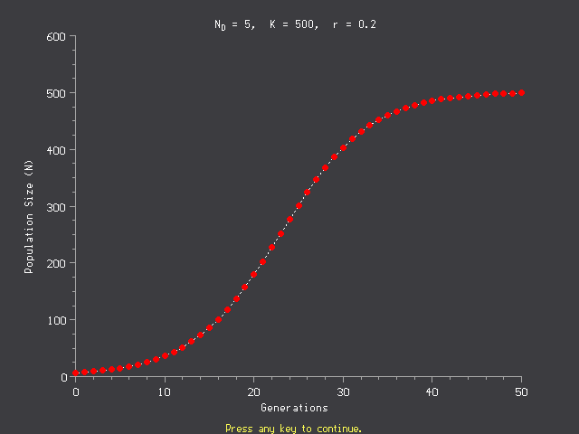

Slide 53
Logistic growth by difference equation
Practically, higher r means (with constant time step) higher delay - the negative feedback with delay usually means some oscillations – the longer delay (or higher r), the more pronounced oscillations

Slide 54
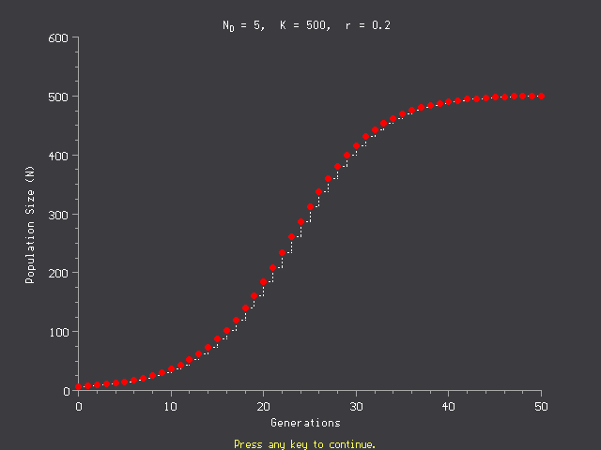
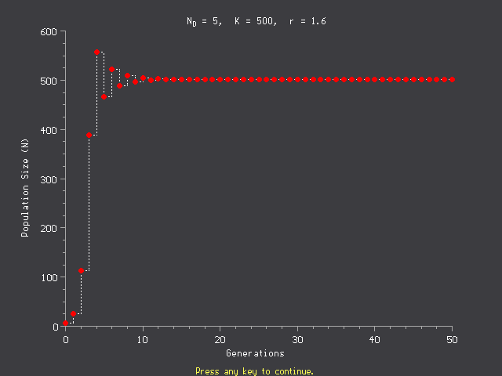
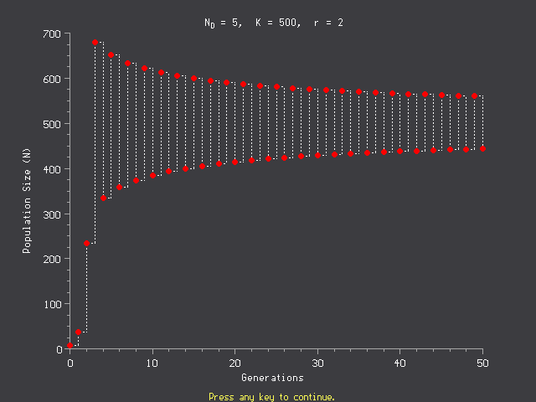
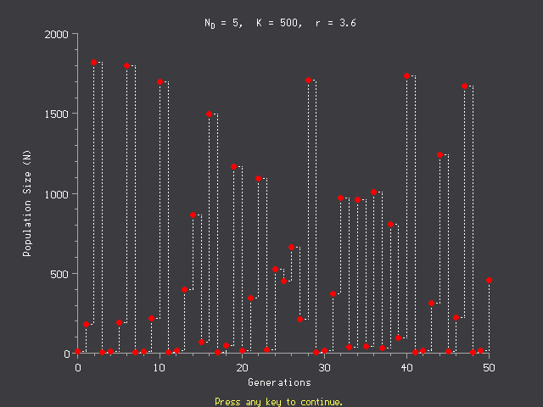
r=0.2
r=1.6
r=3.6
Deterministic chaos
r=2.0

Slide 55
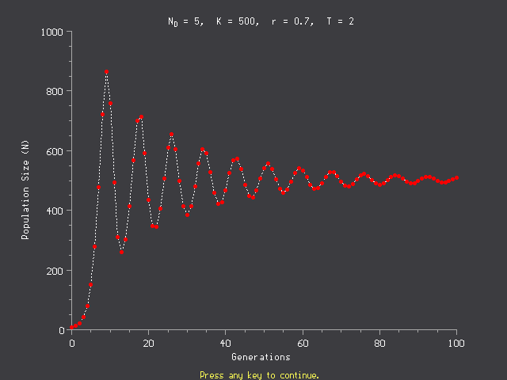
Or we can have similar effect directly as delay in the differential equations
Analogy
Drunk man driving bike – he takes correction of direction with delay and overcompensates (the idea of Maynard Smith)
Concept of negative and positive feedback

Slide 56
Allee effect
Positive density dependence, when population density is low (i.e., the low density harms, and at these low densities, competition for resources is not so important). Animals – at low densities, it might be difficult to find a sexual partner; Plants – solitary individuals are more harmed by, e.g., strong wind. “Facilitation” – popular topic.
For high densities, the competition prevails.
N
As a consequence, the real relationship is seldom linear (as suggested by logistic equation), and often even not monotonous.

Slide 57
Allee effect – might theoretically lead to the situation with negative growth at very low densities
Unstable equilibrium
N
Population toward extinction
Stable equilibrium
For low densities the population might not be able to reproduce, and its growth rate is negative, i.e. the population faces extinction

Slide 58
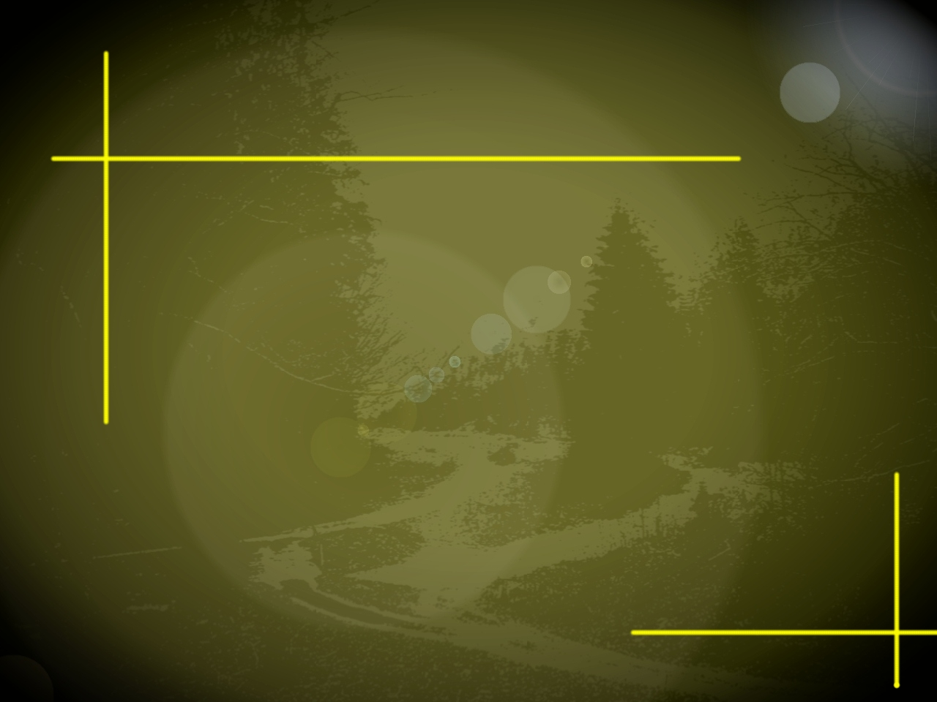
ALLEE EFECT
Useful for prediction of invasions.....
Positive density dependence, usually for low densities.
.....or estimation of appropriate
numbers for introduction

Slide 59
When small population size harms?

Slide 60
Reproduction
Low chance to find sexual partner
Genetic dangers of small populations (inbreeding)
Better selection of partners in large populations

Slide 61
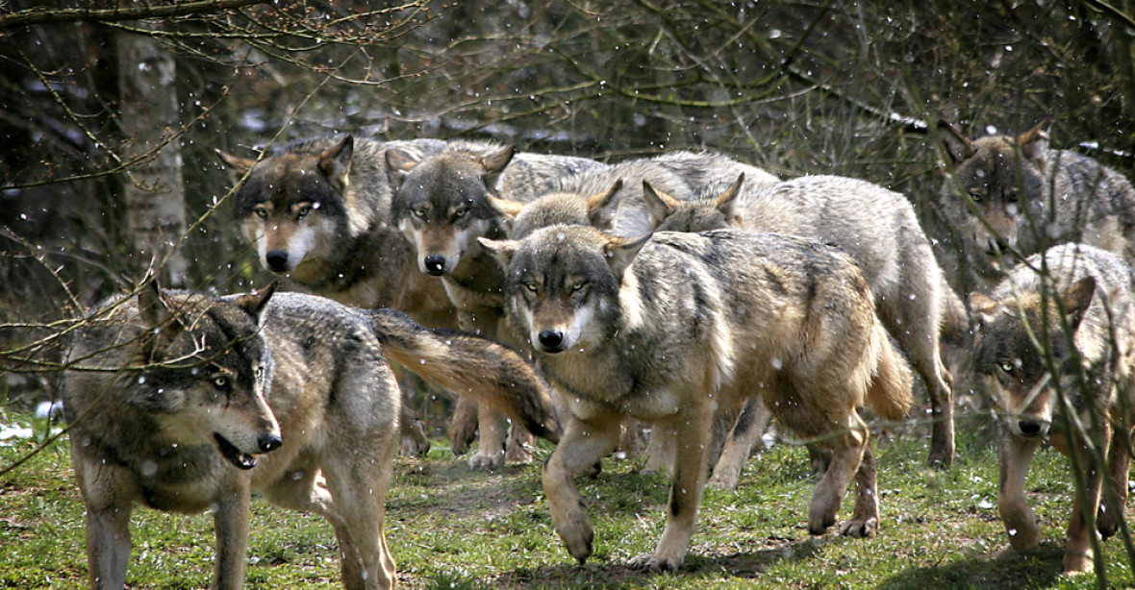
Resource use
Larger pack is able to hunt larger and more valuable prey

Slide 62
Defense
Against predation – the more individuals in a group, the less often I will guard: gees, meerkat (=suricate)
Against predation – nest colonies, muskox (phalanx)
Defense of territory – area (and thus also resources) increases with the square of circumference

Slide 64
Catastrophic events
Small population is more likely to become extinct after disasters, or due to demographic stochasticity

Slide 65
It is expected that the positive relationships are more common under stressful environment
Important – there are both positive (facilitation) and negative (competition) relationships among individuals in most populations, and their relations change in time (for example, plants compete for most of their time even within the same species, but in a short period of extremely hot dry day, shading of neighbours might save live).

Slide 66
Basic facts to remember
Without limitation (by resources [bottom up] or by enemies [top down]), the population in favourable environment will grow exponentially (i.e. without any control)
To control a population (to reach an equilibrium) we need negative density dependence. The growth might then roughly correspond to logistic growth.
The use of difference vs. differential equations is methodological decision, which mostly do not affect the basic patterns of system behaviour.

Slide 67
We neglected
Age/size structure (some approached focus only on adults, but this works only under some assumptions) – see matrix models in the next lectures
Spatial structure (important for sedentary organisms )
Effect of other species

