Slide 1
Plants are different (in their population ecology)
How plants differ (from?)

Slide 2
Most of population ecology done on vascular plants, vertebrates and arthropods
Plants are sedentary (thus, functionally corals are more similar to plants than to animals ) – differing from animals (not all, but most of vertebrates and arthropods)
Modular organisms - Frequent ability of clonal growth – [genet, ramet, „operational definition of an individual]

Slide 3
Consequences of sedentary life style?
(Harper: Plants sit and wait to be counted.)
Large differences among individuals within a population (=> phenotypic plasticity)
Usually, they stay for their whole life where they germinate and establish (=> regeneration niche [Grubb 1977])
Interact with neighbours only (particularly competition)
mating nonrandom (effective population size for genetics) – need to transfer pollen and seeds - > Pollination ecology, Dispersal ecology

Slide 4
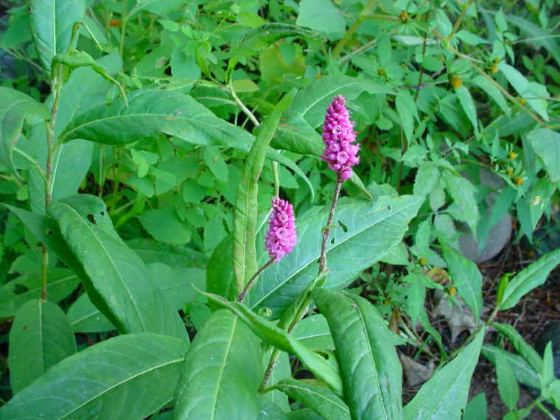
Phenotypic plasticity
Polygonum amphibium
All-creatures.org
Chenopodium album can produce tens of thousands seeds on a plant 1.5m tall, but in unfavourable conditions, 10 seeds on 10cm tall plant. Annual - they either produce seeds and die, or just die!

Slide 5
Grubb 1977 – regeneration niche
P. J. GRUBB (1977): THE MAINTENANCE OF SPECIES-RICHNESS IN PLANT COMMUNITIES: THE IMPORTANCE OF THE REGENERATION NICHE. - Biological Reviews 52: 107-145.
Plants differ more in their requirements for germination and seedling establishments, than in needs of adult plants.

Slide 6
Seed Science Research 2003

Slide 7
Grubb 1977

Slide 10
Animals – fixed number of organs, change of conditions reflected by change in their size
Plants – size of organs relatively constant, change of conditions reflected by the change in their number

Slide 11
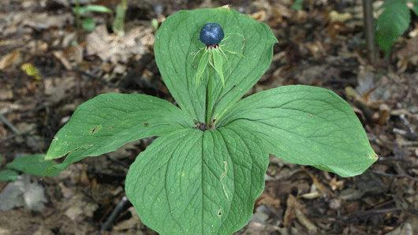
Exceptions are relatively rare

Slide 12
Clonality
Difficulty to define an individual
Advantages of clonality
The daughter ramet might be supported by the mather ramet - (to overcome the initial disadvantage of being of small size ) - but also vice versa – daughter might support the mother
Mutual support in heterogeneous environment (orig. Stuefer JF, During HJ & de Kroon H (1994) High benefits of clonal integration in two stoloniferous species, in response to heterogeneous light environments. Journal of Ecology 82:511-518 & Stuefer JF, de Kroon H & During HJ (1996). Exploitation of environmental heterogeneity by spatial division of labour in a clonal plant. Functional Ecology 10:328-334)

Slide 14
Plants and „foraging“
Foraging is activity typical for animals; can plants forage?
Clonal growth – „spacer“ (e.g. stolon connecting the mother and daughter rosette) as a mean of directed movement of resource capturing organ (i.e. root and leaves)
Faster grows of spacer under the shortage of resources is considered to be foraging

Slide 15
Clonality disadvantages – mostly dispersal to limited distance
Infection spreads throughout the whole clone
Does not generate the genetic variability

Slide 16
„Optimal“ use of resources – the flowering stem, after flowering, lays down, and forms a stolon, rooting in nodes.
Agrostis canina

Slide 17
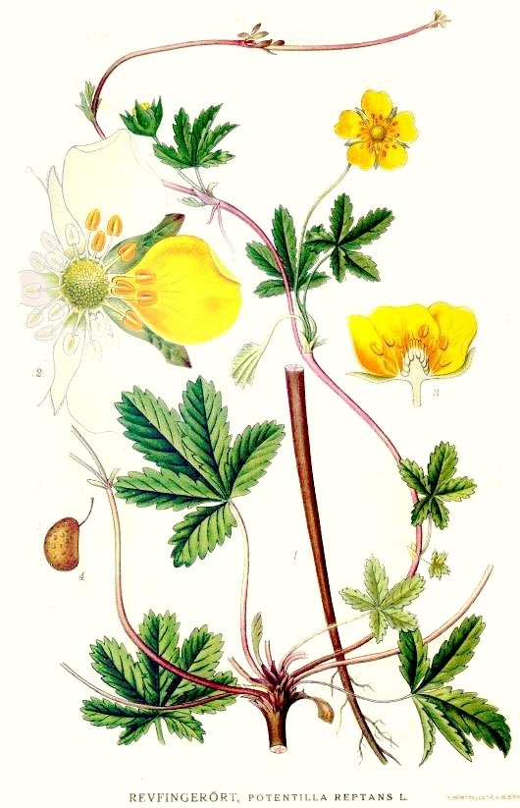
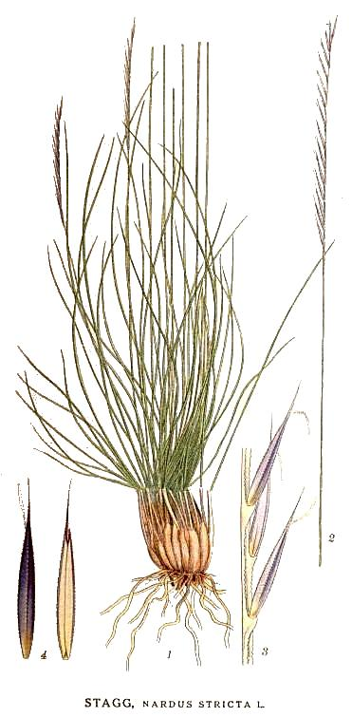
Phallanx a guerilla

Slide 18
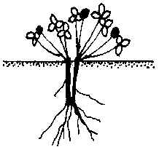
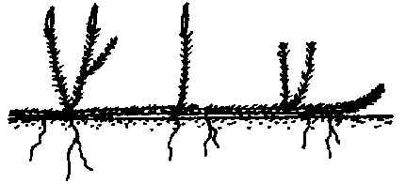
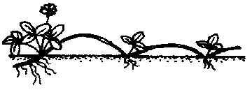
Klimešova and Klimeš - 27 clonal growth types
type Fragaria vesca
type Trifolium pratense
type Lycopodium annotinum
Database CLOPLA - clopla.butbn.cas.cz

Slide 19
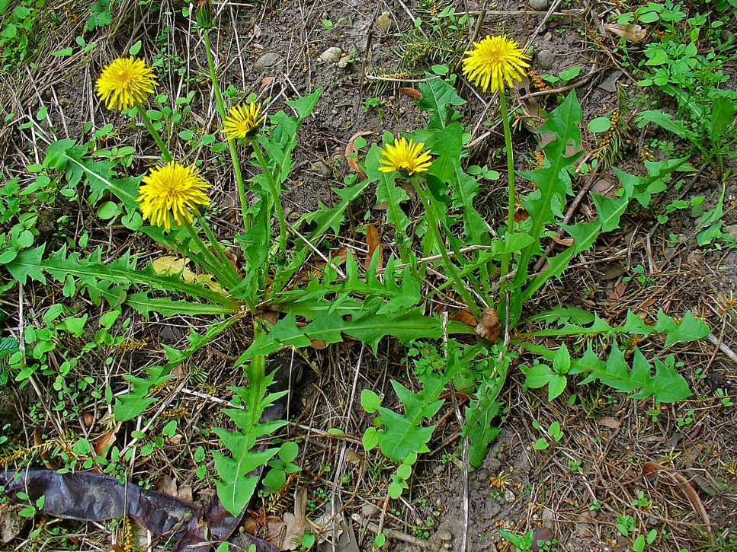
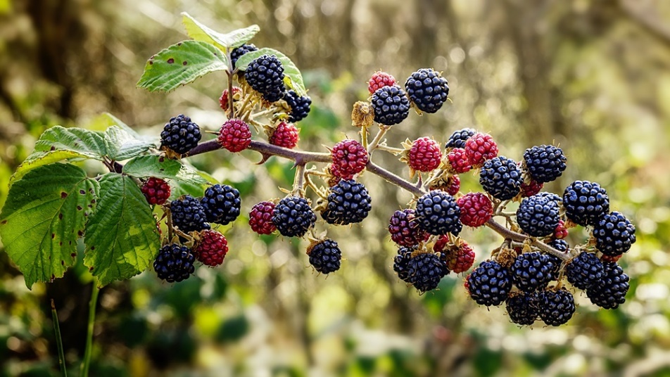
Apomictic flowers (Taraxacum officinale) Rubus fruticosus agg.

Slide 20
Sexual reproduction
To get a partner for mating is costly – for plants (e.g. large production of pollen grains – or reward for pollinators)
(selfpollination (selfing) is cheaper - but has disadvantages – lower genetic variability – but still better than asexual multiplication
Variability of plant mating systems:
Semelparity = Monocarpic plants (annuals, biennials, monocarpic perennials)
Iteroparity = Polykarpic plants
Bisexual (contains both the stamens AND the carpels) and unisexual (staminate or carpellate) flowers. Unisexual either monoetious or dietious. Plethora of combinations.
Mechanisms preventing selfing - on the other side, cleistogamy

Slide 21
„Biennials“ are often monocarpic perennials
Cirsium palustre

Slide 22
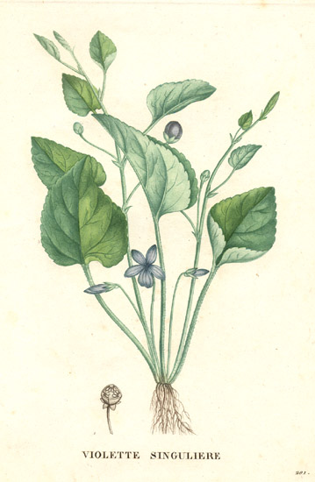
Viola mirabilis – combination of cleistogamic and chasmogamic flowers
Chasmogamic flowers in spring [from the base of rosette]. Later on, cleistogamic flowers appear (to never open), on the stem

