Slide 1
The sweaping of the daylight invertebrates in different habitats
Mohelno 2013: Jiří Mastný, Jan Fiala, Jan Kolross, Petr Hůla and Markéta Tahadlová

Slide 2
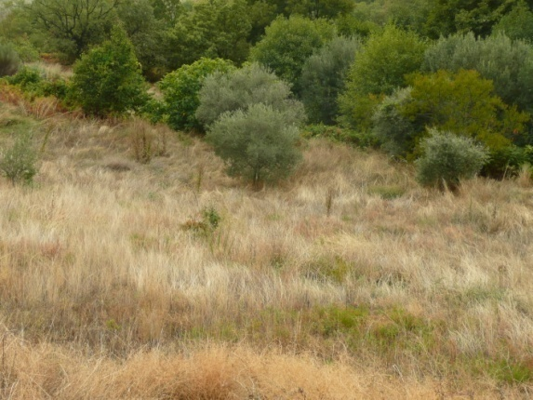
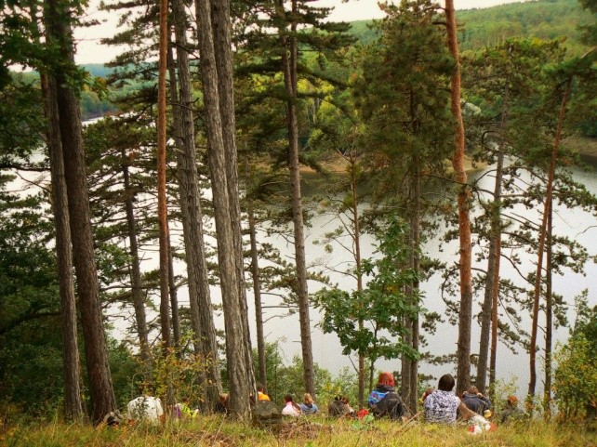
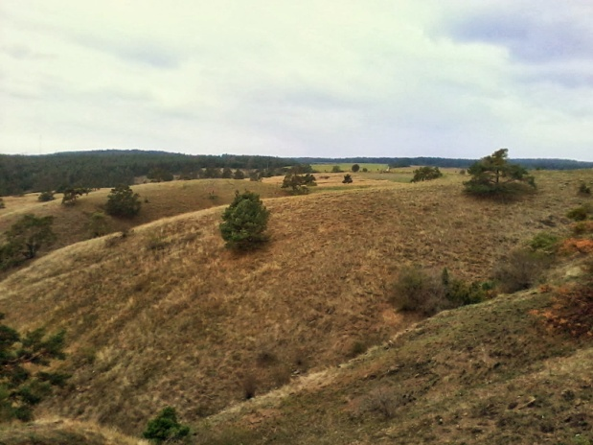
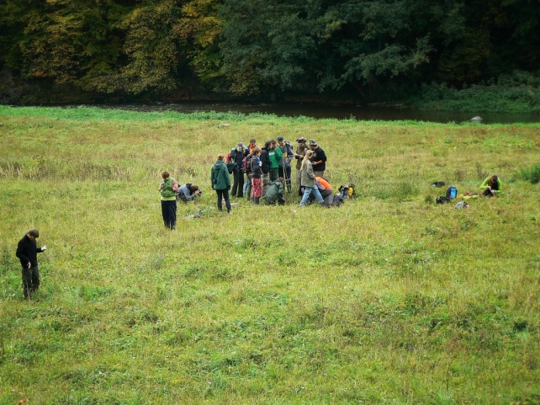
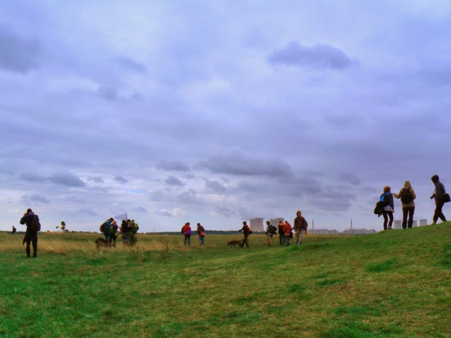
Comparison of 5 different habitats
Flowering meadow
Pinetree slope
Wet flowering meadow
Mohelno stepe
Stepe slope

Slide 3
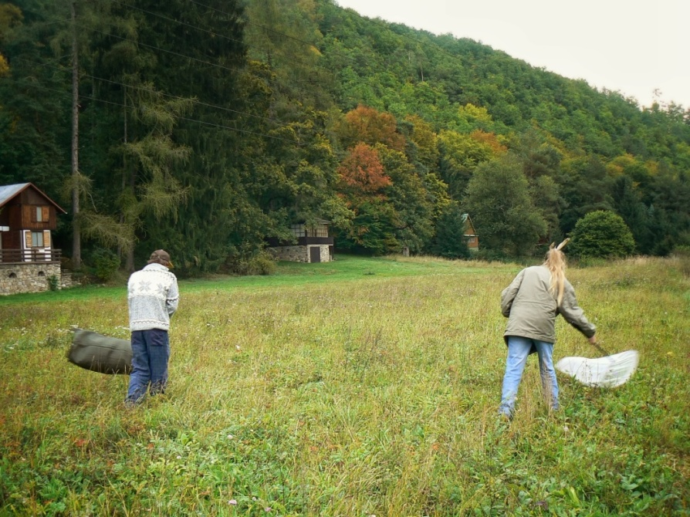
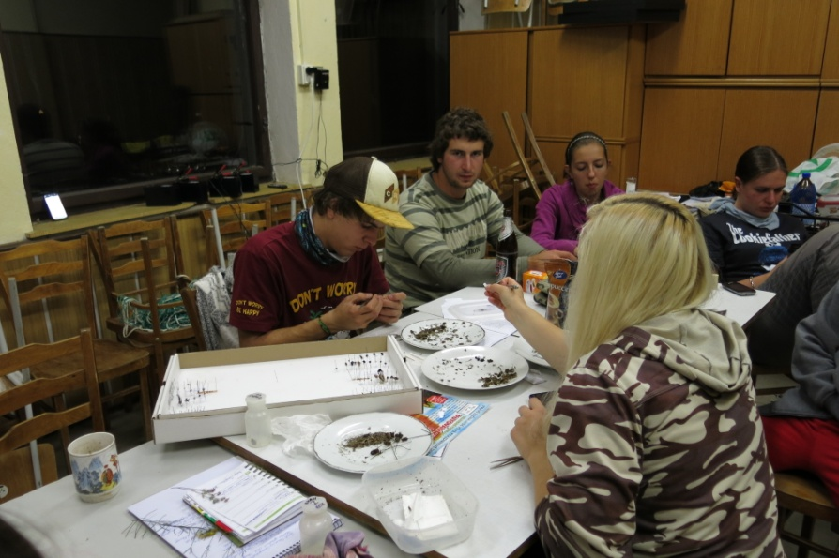
Methods
Sweaping
100 per each habitat
Insects exterminated by the formaldehyde
Separating and identifying to morphotypes
Statistical analyses
Canoco 5
Estimate S 9.01

Slide 4
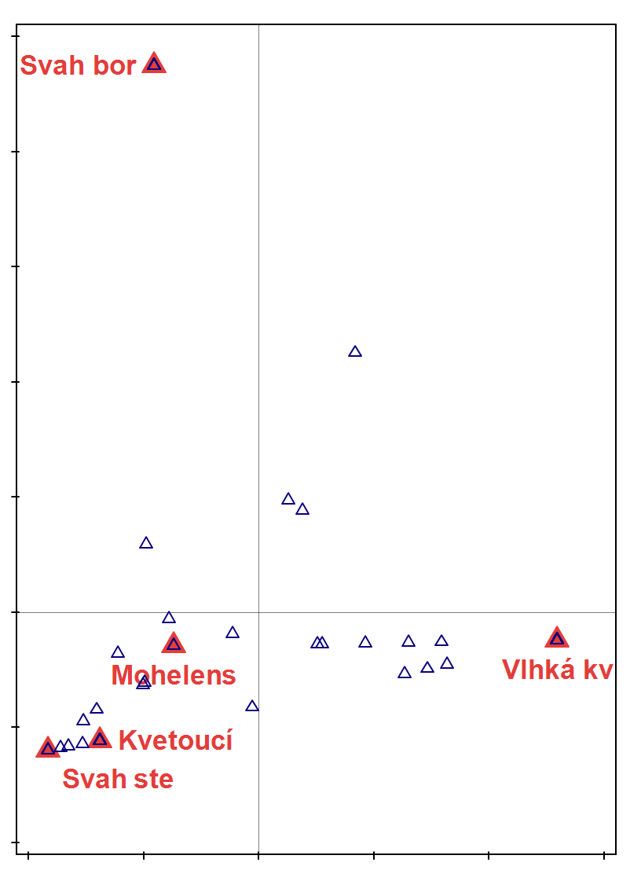
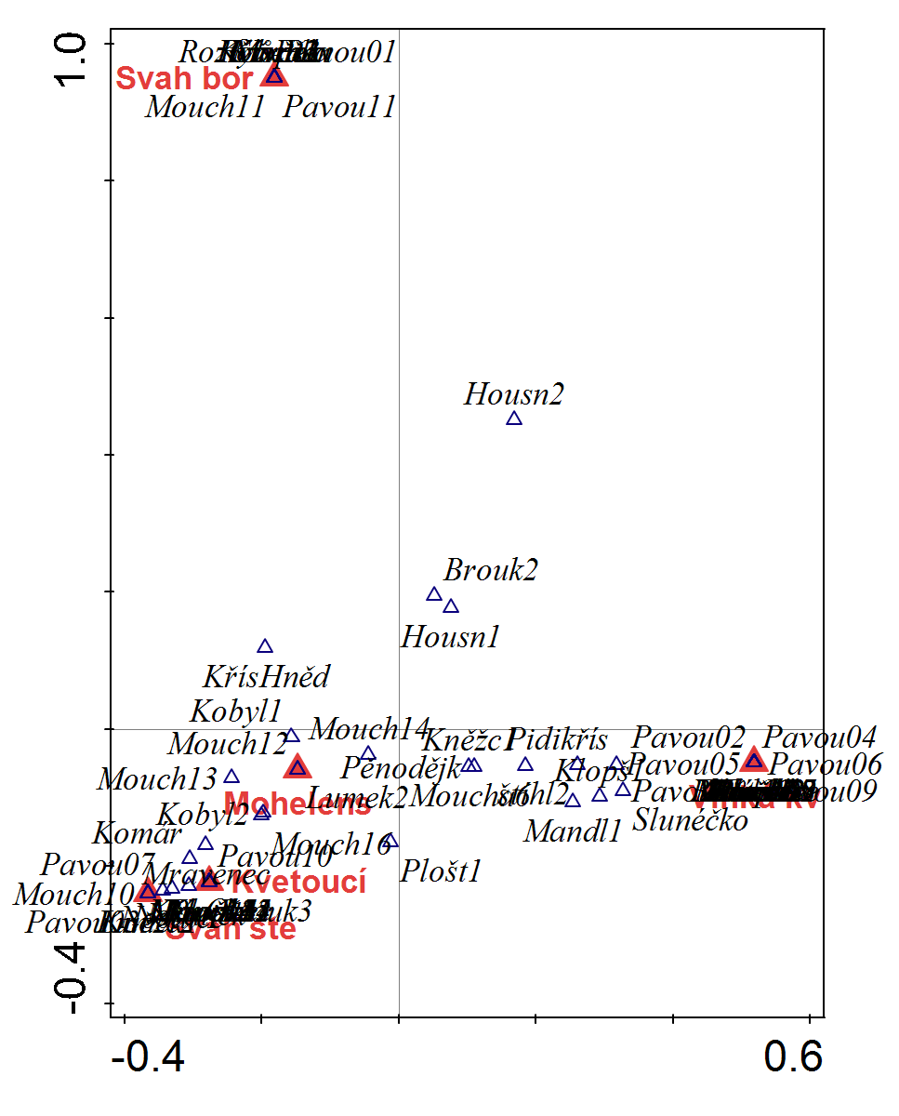
Results - Morphotype comparison among habitats
Fig. 1: A comparison of morphotypes among habitats
Notes:
We can see the difference among habitats, e.g. (if we look at) Spider morphotype 4 which was found only in the wet flowering meadow in comparison with a catterpillar 2 which is common for most of sweaped habitats.

Slide 5
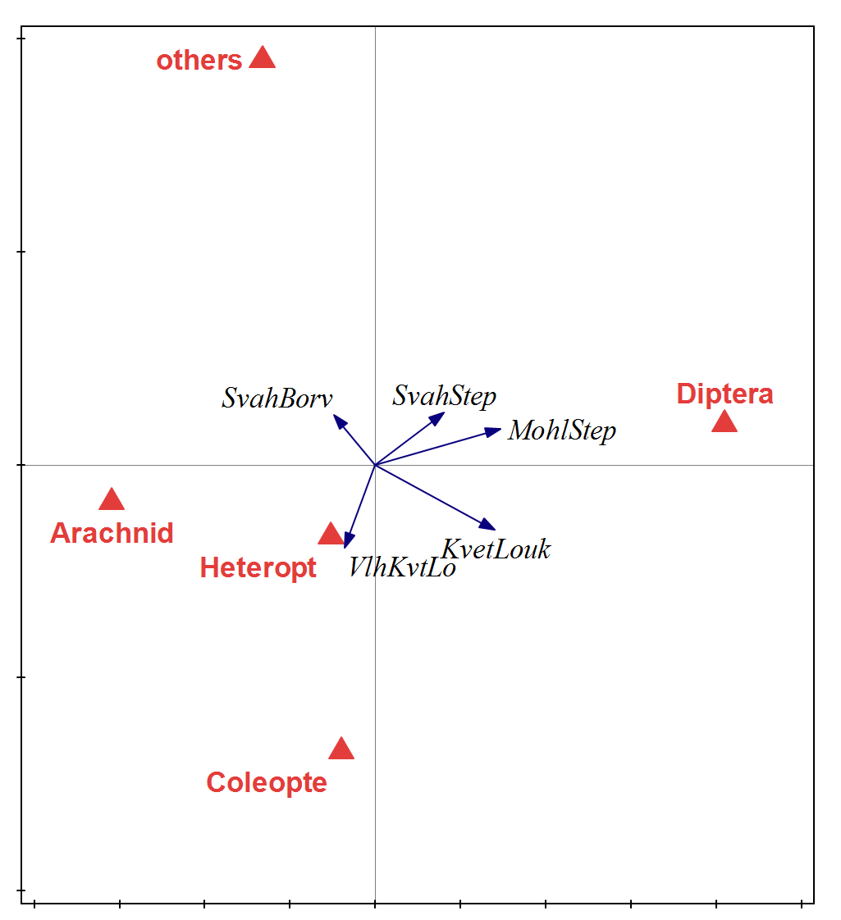
Results – Preferences of higher taxons among habitats
Fig. 2: Prefereces of higher taxons among habitats
Notes:
Others are very strange but it could be caused by variability of this group

Slide 6
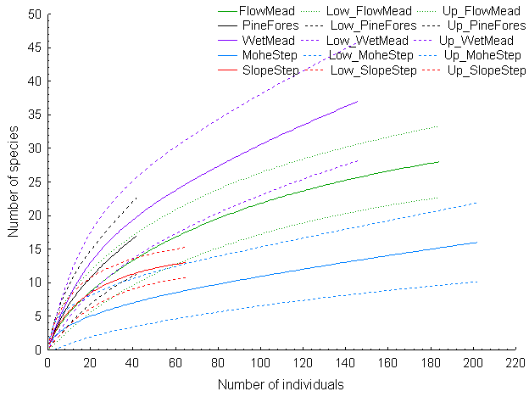
Resluts - cumulative curves
Notes:
???

Slide 7
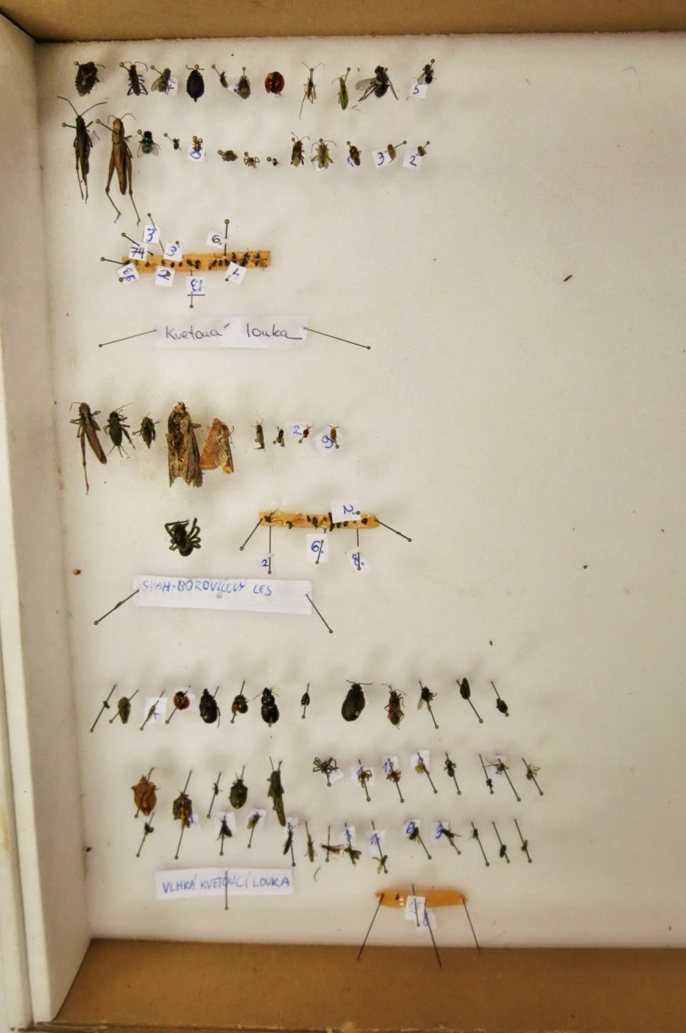
Dataset
4 main orders
Coleoptera
Heteroptera
Diptera
Arachnida
Others
(Orthoptera, Lepidoptera, Hymenoptera, Zygentoma)
Notes:
We collected…But our sampling was highly dependent on weather

Slide 8
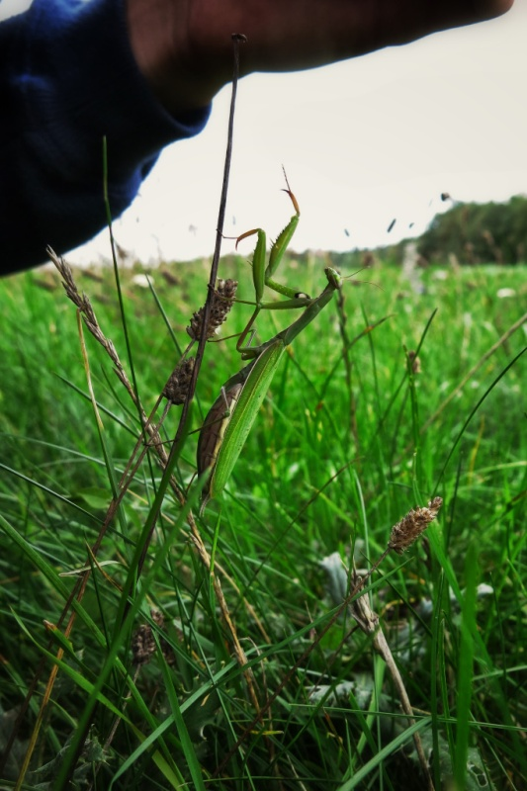
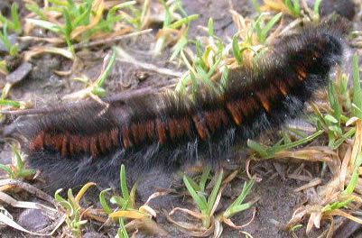
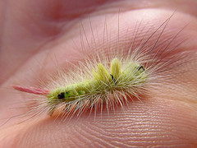
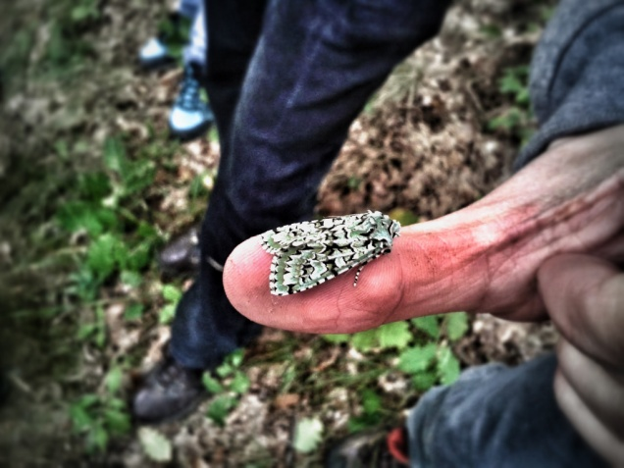
Special species
Mantis religiosa
Eresus kollari
Calliteara pudibunda
Macrothylacia rubi
Dichonia aprilina

Slide 9
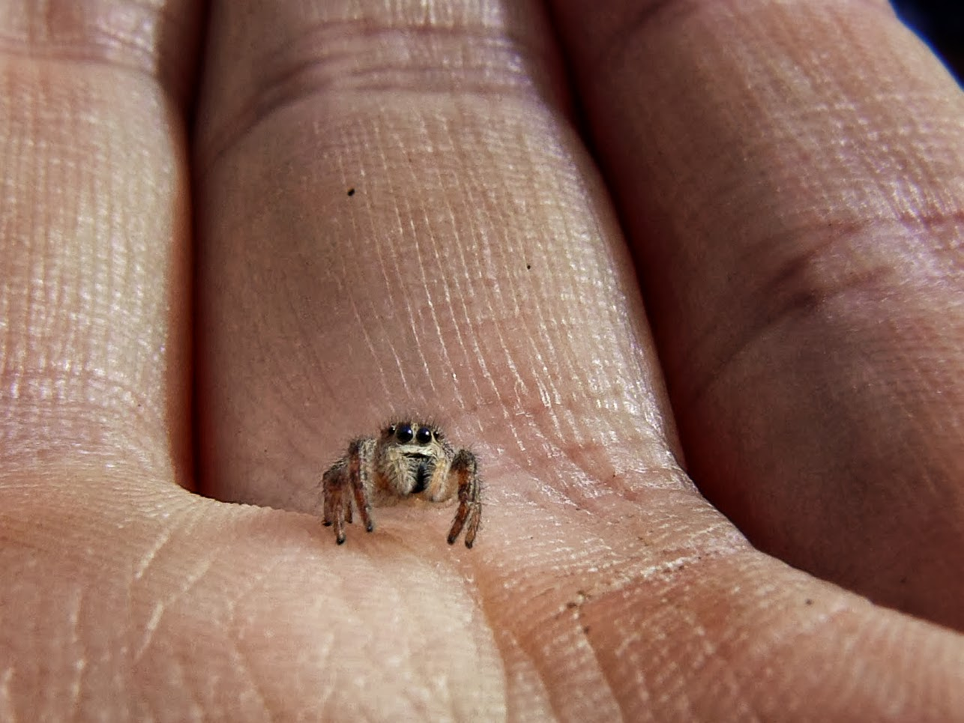
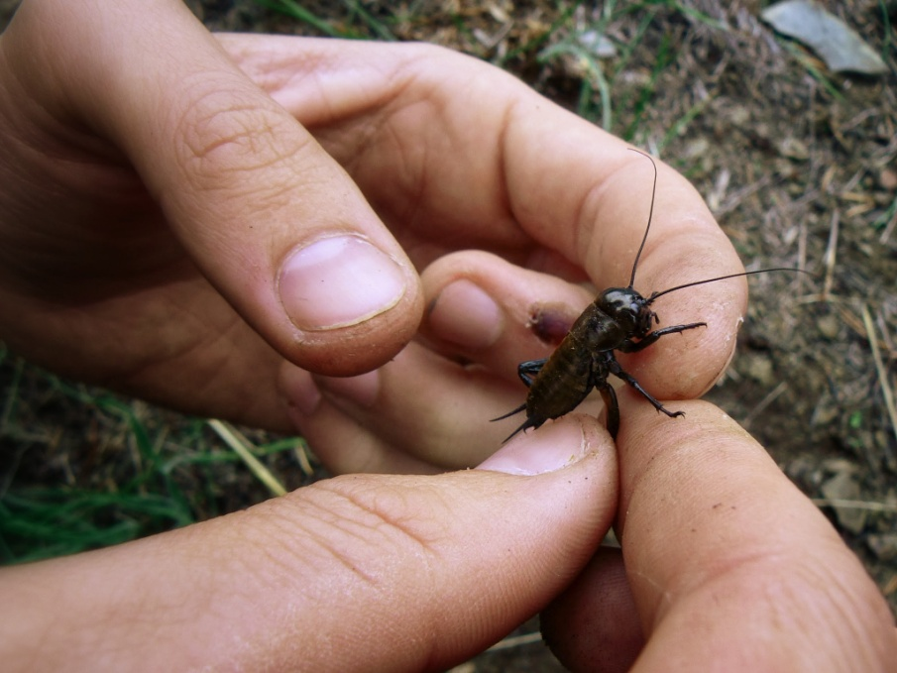
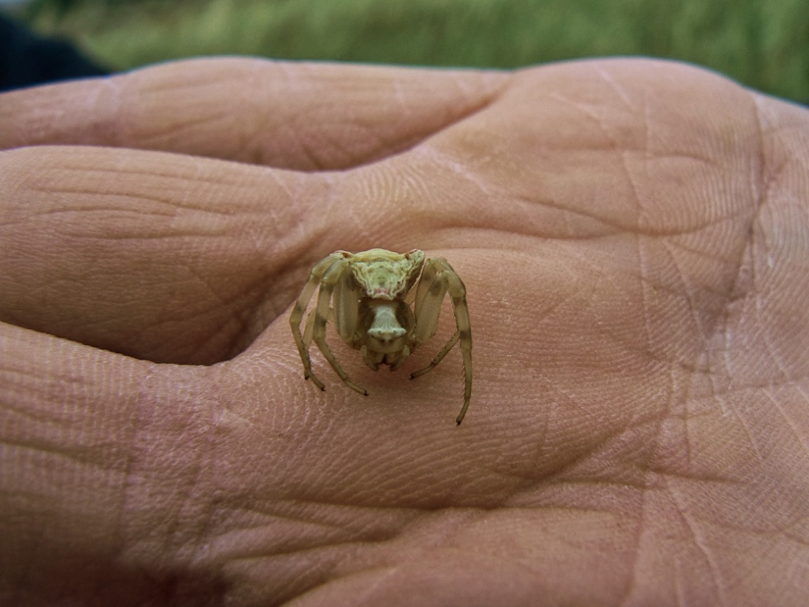
Thank you for your attention!

