Slide 1
Mohelno 2013
Comparing the abundances of birds on the river and the forest edge
Martin Hůlka, Eva Švamberková,
Veronika Schaabová, Ludmila Vlková,
Veronika Otisková, Alexandra Průchová

Slide 2
Methods
8 nets
4 on the river edge
4 on the forest edge
2 days (3 hours) + 1 day (6 hours)
Check every 30 minutes
Birds: trap → determine → ring → write down → release
Comparison of two years (2013 and 2011)

Slide 3
Map of nets
River edge
Forest edge

Slide 4
Results 2013
Total number of birds 28 (10 species)
17 birds on the river edge
11 birds on the forest edge

Slide 5
Number of species 2013
N

Slide 6
Number of trapped birds
Trapped – 1hour/1m²
Species
How many birds were trapped during 1 hour on 1 m² ?
Number of birds is standardized (we considered length of nets and time of catching in hours)

Slide 7
Notes:
U řeky – více druhů ptáků než v lese pokud bude stejný effort a trend je stejný v obou letech –> že víc bychom prostě chytit nemohli

Slide 8
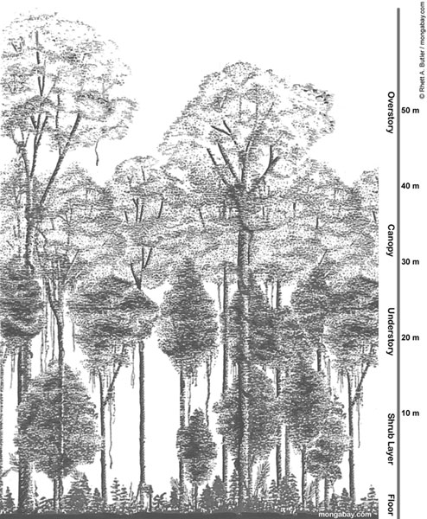
Habitat characteristics used
Canopy openness (% of foliage on photo of canopy)
Shrub density (% of shrub coverage in 5x5 m)
Grass coverage (% of grass on 1 x 1 m square on forest floor)

Slide 9
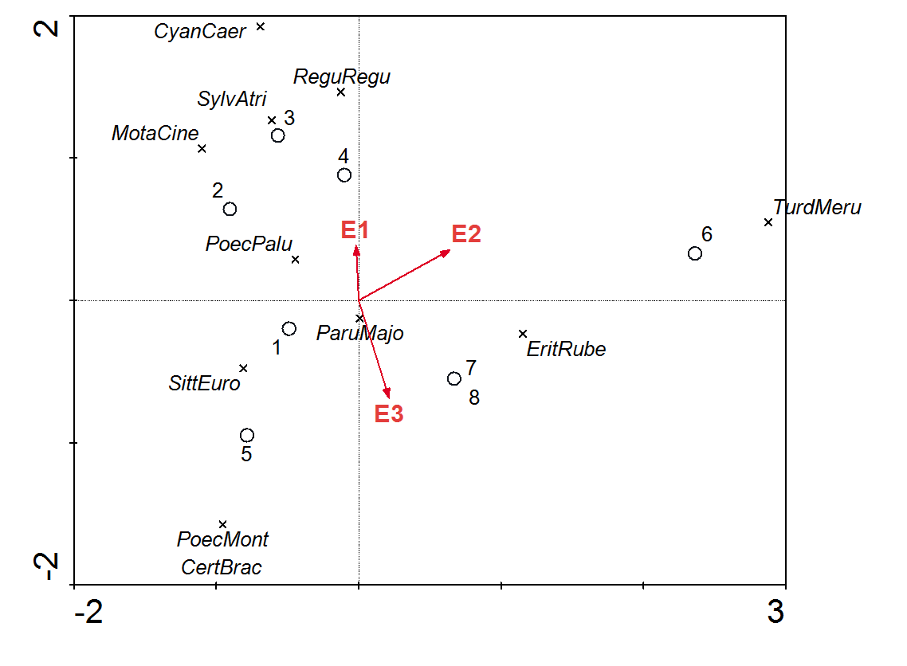
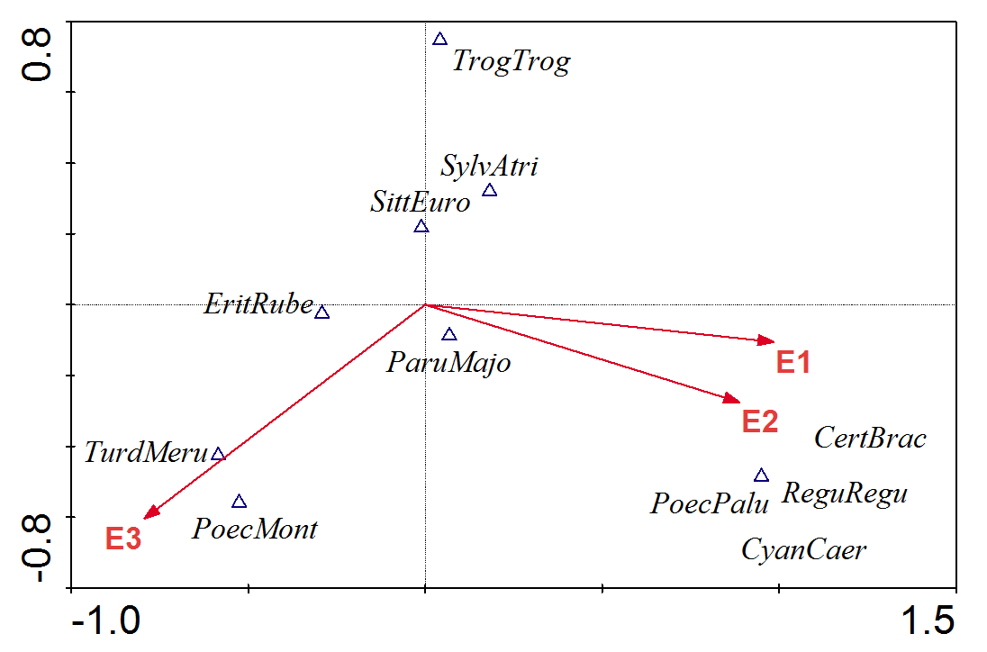
CCA
2013
River edge
Forest edge
2011
E1 – grass
E2 – shrubs
E3 - canopy
Notes:
Canonical corespondence analysis
Reg + cyan – preferují trávu i keře v obou letech
Poec mont – preferuje koruny stromů v obou letech
Parus major - nevyhraněná

Slide 10
Years 2011 and 2013 together
River edge
Forest edge

Slide 11
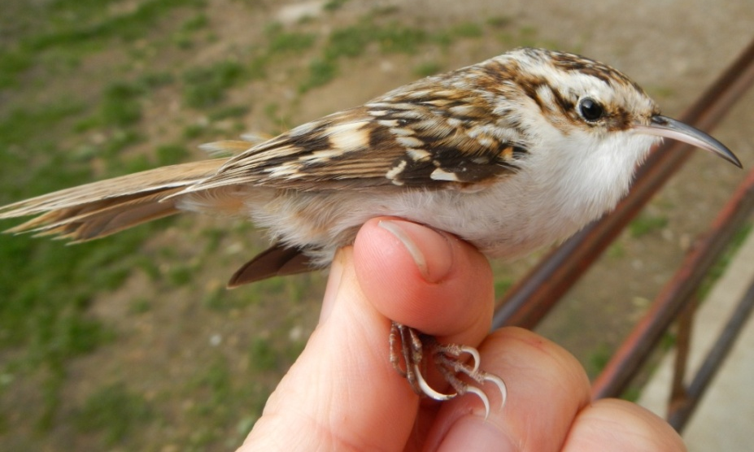
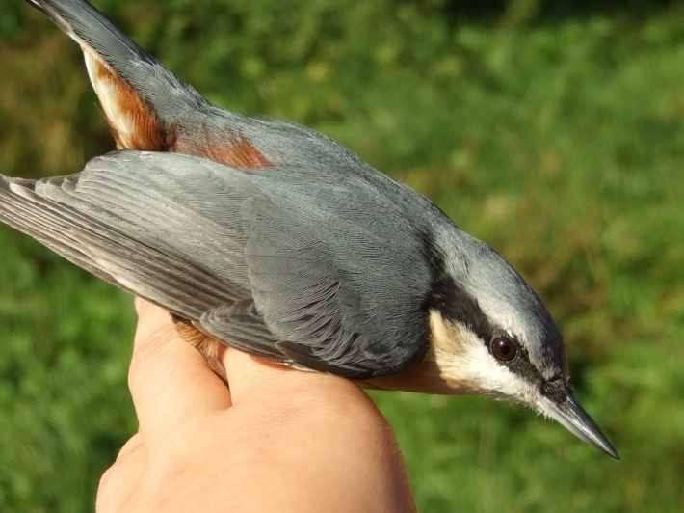
Birds
Robin
Goldcrest
European Nuthatch
Long-toed Treecreeper

Slide 12
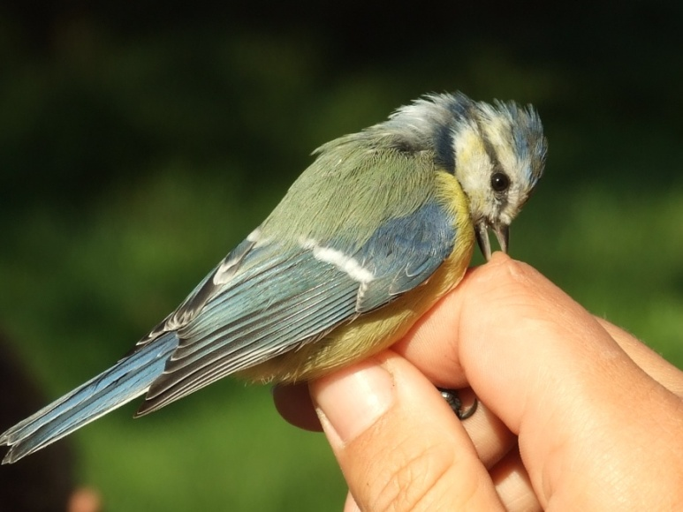
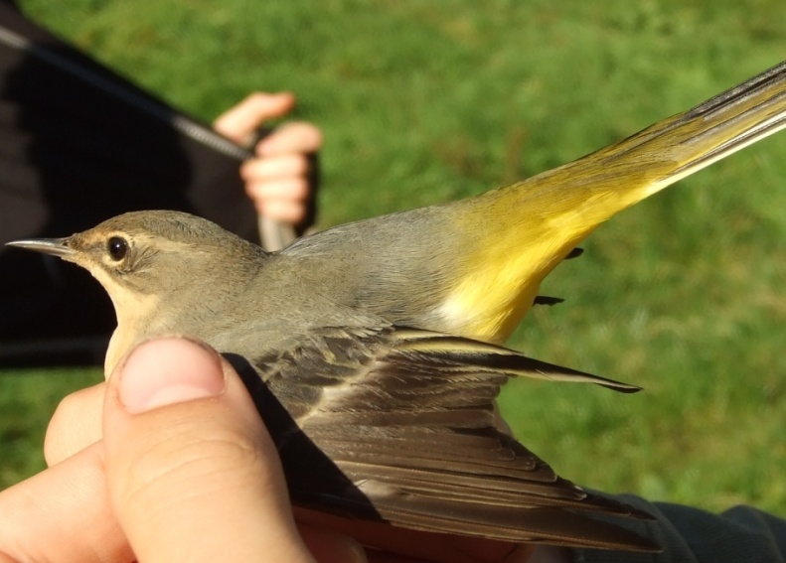
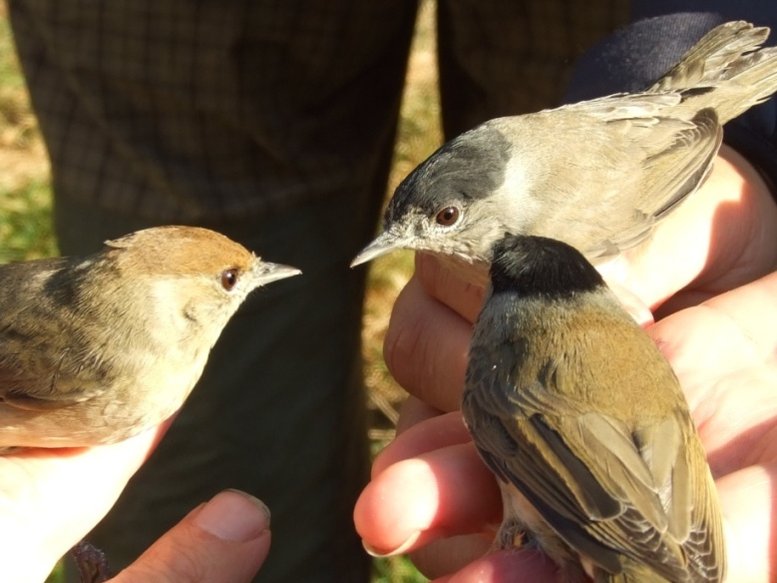
Birds
Great tit
Blue tit
Grey wagtail
Blackcap

Slide 13
Treecreeper
Short-toed
Long-toed
http://www.stephenmenzie.com/2012/04/brachydactyla.html

Slide 14
Thank you for your attention

