Slide 1
HIGH LEVEL PROCESSES IN ECOLOGICAL COMMUNITIES
Jhonny Capichoni Massante
České Budějovice- 2017

Slide 2
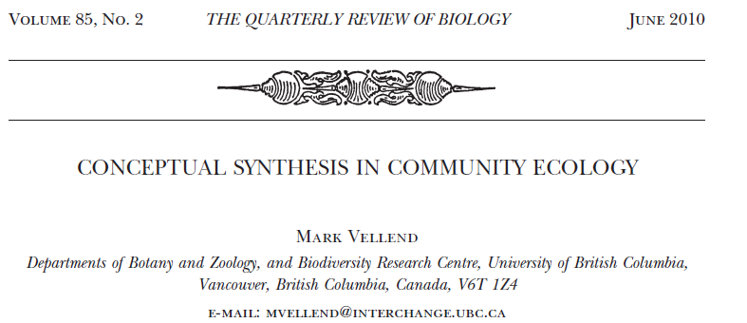
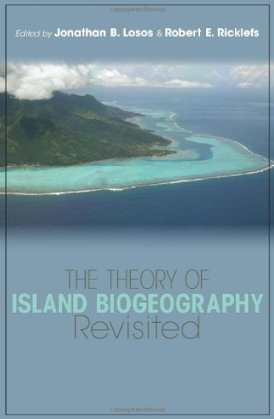
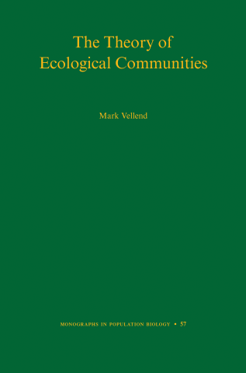
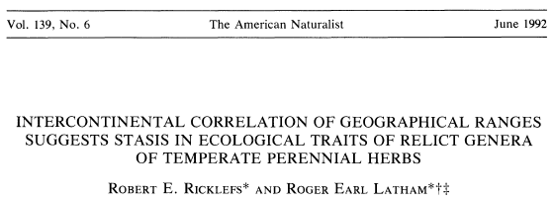
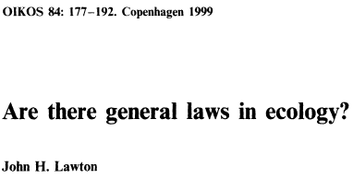
The idea...

Slide 3
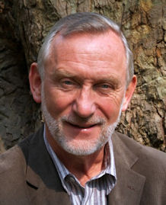
Community Ecology is a MESS
Processes
Patterns
THE
BLACK BOX
OF COMMUNITY ECOLOGY
Species-area relationship
Relative abundance
Distributions
Composition-environment relationships
Latitudinal Diversity Gradient
Distance-decay of similarity
Diversity-productivity relationships
Diversity-disturbance relationships
Selection
Drift
Speciation
Dispersal
“(…) A purely local, ecological theory of diversity also cannot account for certain empirical patterns.” (Ricklefs 2006:S4)
“(...)The rules are contingent in so many ways
as to make the search for patterns
unworkable.” (Lawton 1999: 181)
(Vellend 2010)

Slide 4
An ecological community sensu lato
Abiotic conditions
(e.g. temperature, pH)
Abiotic resources (e.g. light, CO², N)
Predator
Herbivore
Pollinator
Plant 1
Plant 2
Plant 3
Decomposer 2
Decomposer 2
Pathogen 1
Pathogen 2
An horizontal community (e.g. plants)
Abiotic conditions
Abiotic resources
Predators
Pathogens
Herbivores
Pollinators
Decomposers
Plant 1
Plant 2
Plant 3
Plant 4
(Vellend 2016)

Slide 5
The theory...
Global Community
Speciation
Drift
Selection
Regional Community
Dispersal
Speciation
Drift
Selection
Dispersal
Local Community
Dispersal
Dispersal
Speciation
Drift
Selection
(Vellend 2010)
Notes:
all processes at each scale to illustrate the full range of theoretical possibilities, even if some processes are unlikely to be important at particular scales (e.g., speciation at the local scale).

Slide 6
Fundamental ways to change the number of species
S = 3
1. Speciation
S = 4
Ways to gain species
2. Dispersal
Somewhere else
S = 5
3. Drift
S = 4
Ways to lose species
4. Selection
S = 2
S_{t+1} = S_{t} + speciation + dispersal - extinction
(Vellend 2016)
Notes:
1-> subpopulation diverge; 2-> an species arrives; 3-> same rate of survival, but there is probability of die before reproducing; 4-> fitness advantage over the others, excluding them from the community.

Slide 7
Some processes considering shift in environment
Horizontal community
(e.g. plants, insects, etc...)
Extinct
Extinct
Extinct
Speciation
Extinct
Shift in environment
Dispersal
(Ricklefs & Latham 1992; Vellend 2016)
Notes:
At evolutionary time = andean orogeny; at current time = disturbance, fragmentation,

Slide 8
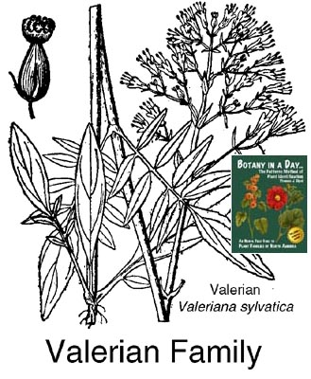
A real example…
Species take advantage of many unoccupied niches not already taken by native species
Dispersal
Dispersal
Origin
Radiation
Dispersal
Dispersal
(Bell & Donoghue 2005)
Notes:
Valerianaceae colonized South America on multiple occasions from the north. In one of these cases there appears to have been a substantial and rapid radiation, primarily in the high elevation.

Slide 9
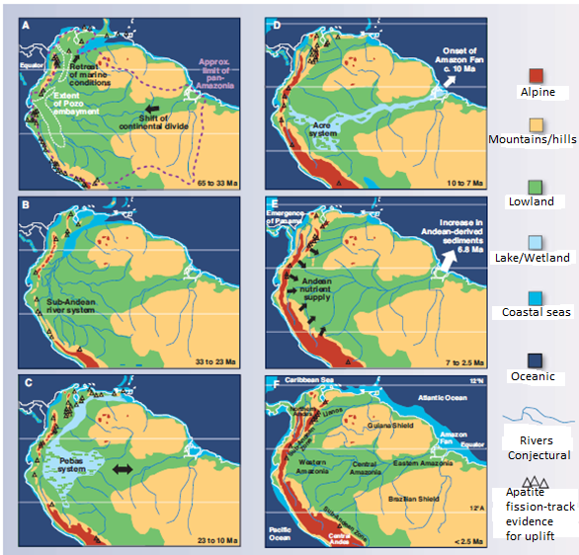
Colonization and radiation of Valerianaceae
65 to 33 Ma
10 to 7 Ma
33 to 23 Ma
7 to 2.5 Ma
23 to 10 Ma
< 2.5 Ma
Notes:
Probably arrived by long dispersal because the istmus of Panama did not emerge yet...

Slide 10
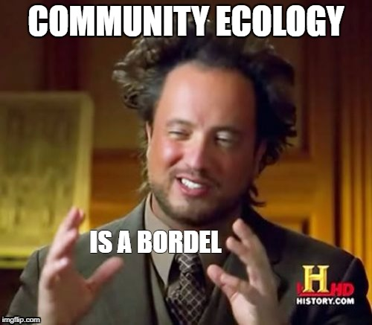
Take Home Message
All high-level processes can be important determinants of community structure and dynamics;
Local-scale variation in species diversity may very often be a result of species pools which evolved under different conditions;
Process first; Pattern after;
Does not solve all issues in community
ecology.
Notes:
Rather than short-term consequences of local selection and drift. If the process X is important determinant of community structure and dynamics, what do expect to see in natural or experimental communities?

