Slide 1
Population Ecology

Slide 2
Duties
Each of you will present (20 minutes talk incl. discussion) on an interesting population ecology topic + willtake part in a „journal club“
Oral exam
The program is tentative, but we will try to follow it as closely as possible. It will finish earlier, because we will run it as 2/2, not as 2/1.
We plan one day field trip with sampling exercise in May, with subsequent data analysis.
How many of you need to finish before state exam?

Slide 3
Population Ecology
Ecologists use to count as neolitics (one, two, three [population ecology], many [community ecology]) – distinction between population and community ecology is rather arbitrary
Few populations(<4), Focuses on single population and pairwise interactions – population ecology [nevertheless, 3 and less populations are usually not alone in nature, we just simply ignore them
With more populations, the number of pairs increases quadratically (n*(n-1)/2) - so, we concentrate on general properties of the interactions (e.g.. „assembly rules“) – community ecology

Slide 4
Focus of population ecology
Population ecology used to be domain of zoologists (possibility to define „easily“ an individual)
John Harper: „Plants sit and wait to be counted“ – book Population biology of plants (1977).
Population biology – besides population ecology includes also, population genetics
Population ecology – most often focused on organisms, where it is feasible to define functional unit (“individual”). Vertebrates, arthropods, higher plants (vascular plants and mosses). „Plants vs. Animals.“ (Advances in molecular methods – population ecology of fungi.)

Slide 5
Content of the course
Characteristics of population size and their estimates; spatial pattern and its description
Population dynamics (population growth) incl. structured populations
Metapopulations
Life history strategies
Intra- and inter- population relationships (competition, predation s.l., mutualism) [focusing on the paiwise interactions]
Community ecology will run autumn 2023

Slide 6
Selected references
McCallum, H. 2000. Population parameters. Estimation for ecological models. Blackwell, Oxford.
Ranta E., Lundberg P. & Kaitala V. 2006. Ecology of populations. Cambridge Univ. Press.
Sutherland, W.J. 1996. Ecological census techniques. Cambridge University Press, Cambridge.
Hastings A. 1997. Population Biology. Concepts and Models. Springer, New York.
Gibson, D.J. 2002. Methods in comparative plant population Ecology. Oxford University Press.
Vandermeer, J.H. & Goldber, D.E. 2003. Population Ecology. First principles. Princeton University Press.
Caswell, H. 2001. Matrix population models. 2nd edition. Sinauer.
Hanski, I. 1999. Metapopulation ecology. Oxford Univ. Press.
Mangel, M. 2006, The Theoretical biologist’s toolbox. Quantitative methods for ecology and evolutionary biology. Cambridge Univ. Press.
Rockwood, L. L. 2006. Introduction to population ecology. Blackwell, Oxford.
Grace, J.B. , Tilman, D. (Editords) Perspectives on Plant Competition. Academic Press.

Slide 7
Population – a set of individuals…
Of the same species, appearing in the same location and at the same time (and thus interacting)
Dependent on the definition of species, on spatial scale (same location)
Metapopulation
Populations in continuous space (e.g. plants in a field) and populations in discrete natural units (e.g. parasite in their hosts)
Population in statistics is the synonym of “statistical universe“

Slide 8
Population size (well desribed in McCallum 2000)
Basic characteristics – Number of individuals
(Plain number need not be sufficient, size and age structured populations)
To get total number of individuals, I need:
Closed (spatially restricted) population (easy for fish in closed pond, more complicated for fish in a river, or for butterflies etc. )
What is an individual (operational definition)
Sometimes, it is meaningful to consider just some types of individuals (to characterize the population of an orchid, it is more useful to omit the seedlings than to mix seedlings and adults together; for birds, it is sometime good to have number of nesting pairs, etc. )

Slide 9
Unitary and modular organisms
The body of unitary organisms is a determinate structure consisting usually of a strictly defined number of parts (such as legs or wings) established only during embryogenesis.
Modular – body composed of repeated modules
What is an individual in modular organisms?
- Genet vs. Ramet

Slide 10
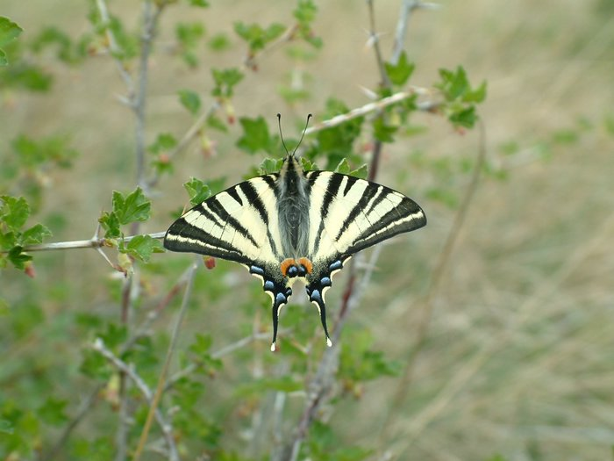
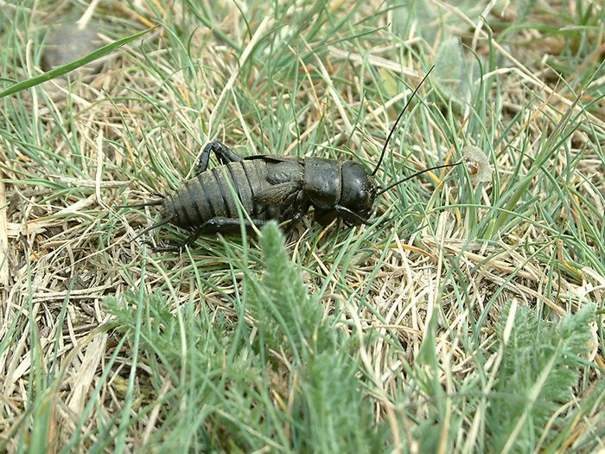
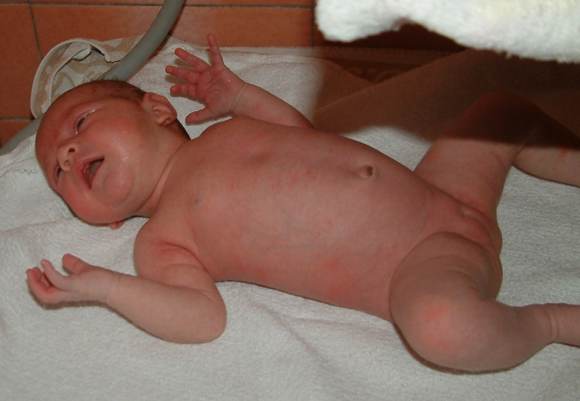
What is an individual?
Unitary – determined number of parts, lost of a part is often fatal
- no problem to say, what is an individual [usually]

Slide 11
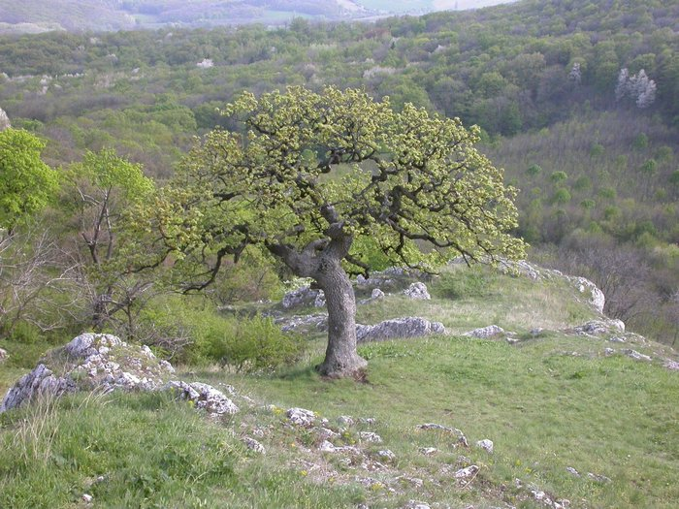
What is an individual modular organisms
Body composed of large number of modules, each of them having usually multiple functions. In some, it is quite easy to say what is an individual.
Loss of a module usually not fatal.
Individual as a population of its modules.

Slide 12
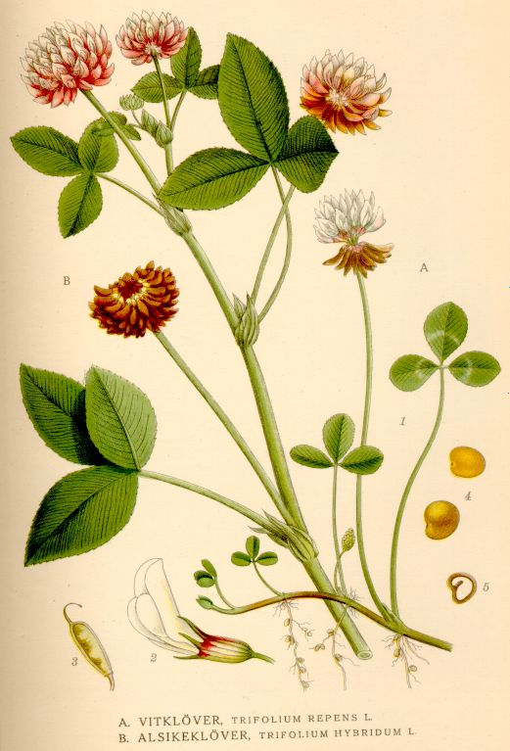
What is an individual? (clonal organisms)
Clonal organisms (often plants) – special case of modular organisms. For population ecology:
Genet – from a single zygote
Ramet – module able of independent life –vegetative propagation
Molecular methods of genet extent determination

Slide 13
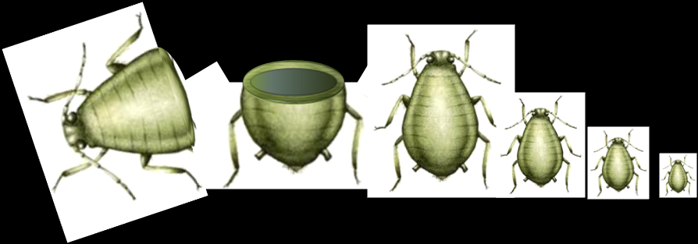
Even unitary organisms can multiply without sex
Partenogenetic generations in arthropods, crustaceans, etc. - fast multiplication
Telescoping generations in aphids (what is an individual there)
https://www.cleanpng.com/png-telescoping-generations-aphid-parthenogenesis-paed-6989855/download-png.html

Slide 14
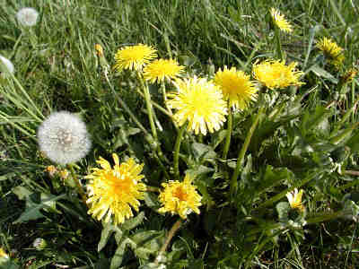
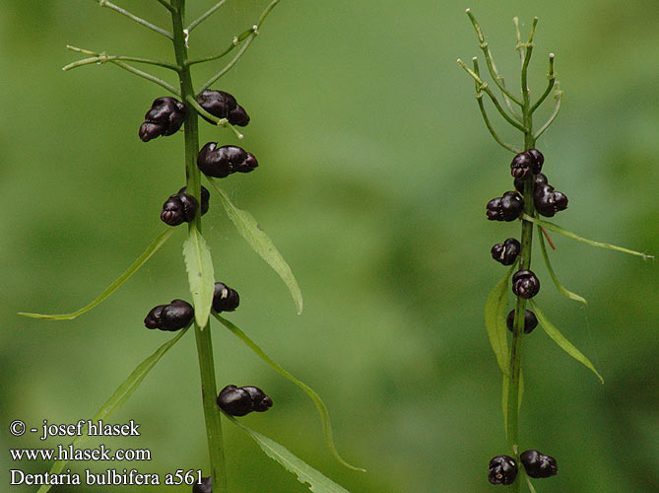
Examples of progeny in plants without a sexual process – all the progeny is genetically identical to the mother plant
Apomictic “seeds”
Bulbs –Dentaria bulbifera
No recombination, but morphologically seeds
Taraxacum officinale (sect. ruderalia)

Slide 15
And what is an individual in social insects?
Ants – the workers do not reproduce, the genetic unit is basically the queen
Ecological “individual” is just one ant
Nature is not simple and do not follow our categories

Slide 16
Other characteristics of population size / often standardized per area
Density – (average) number of individuals per area
Simple relationship
Density = Total population size/Total area
Nevertheless, the density can be estimated and is a useful characteristics even in the cases, where the populations are not closed

Slide 17
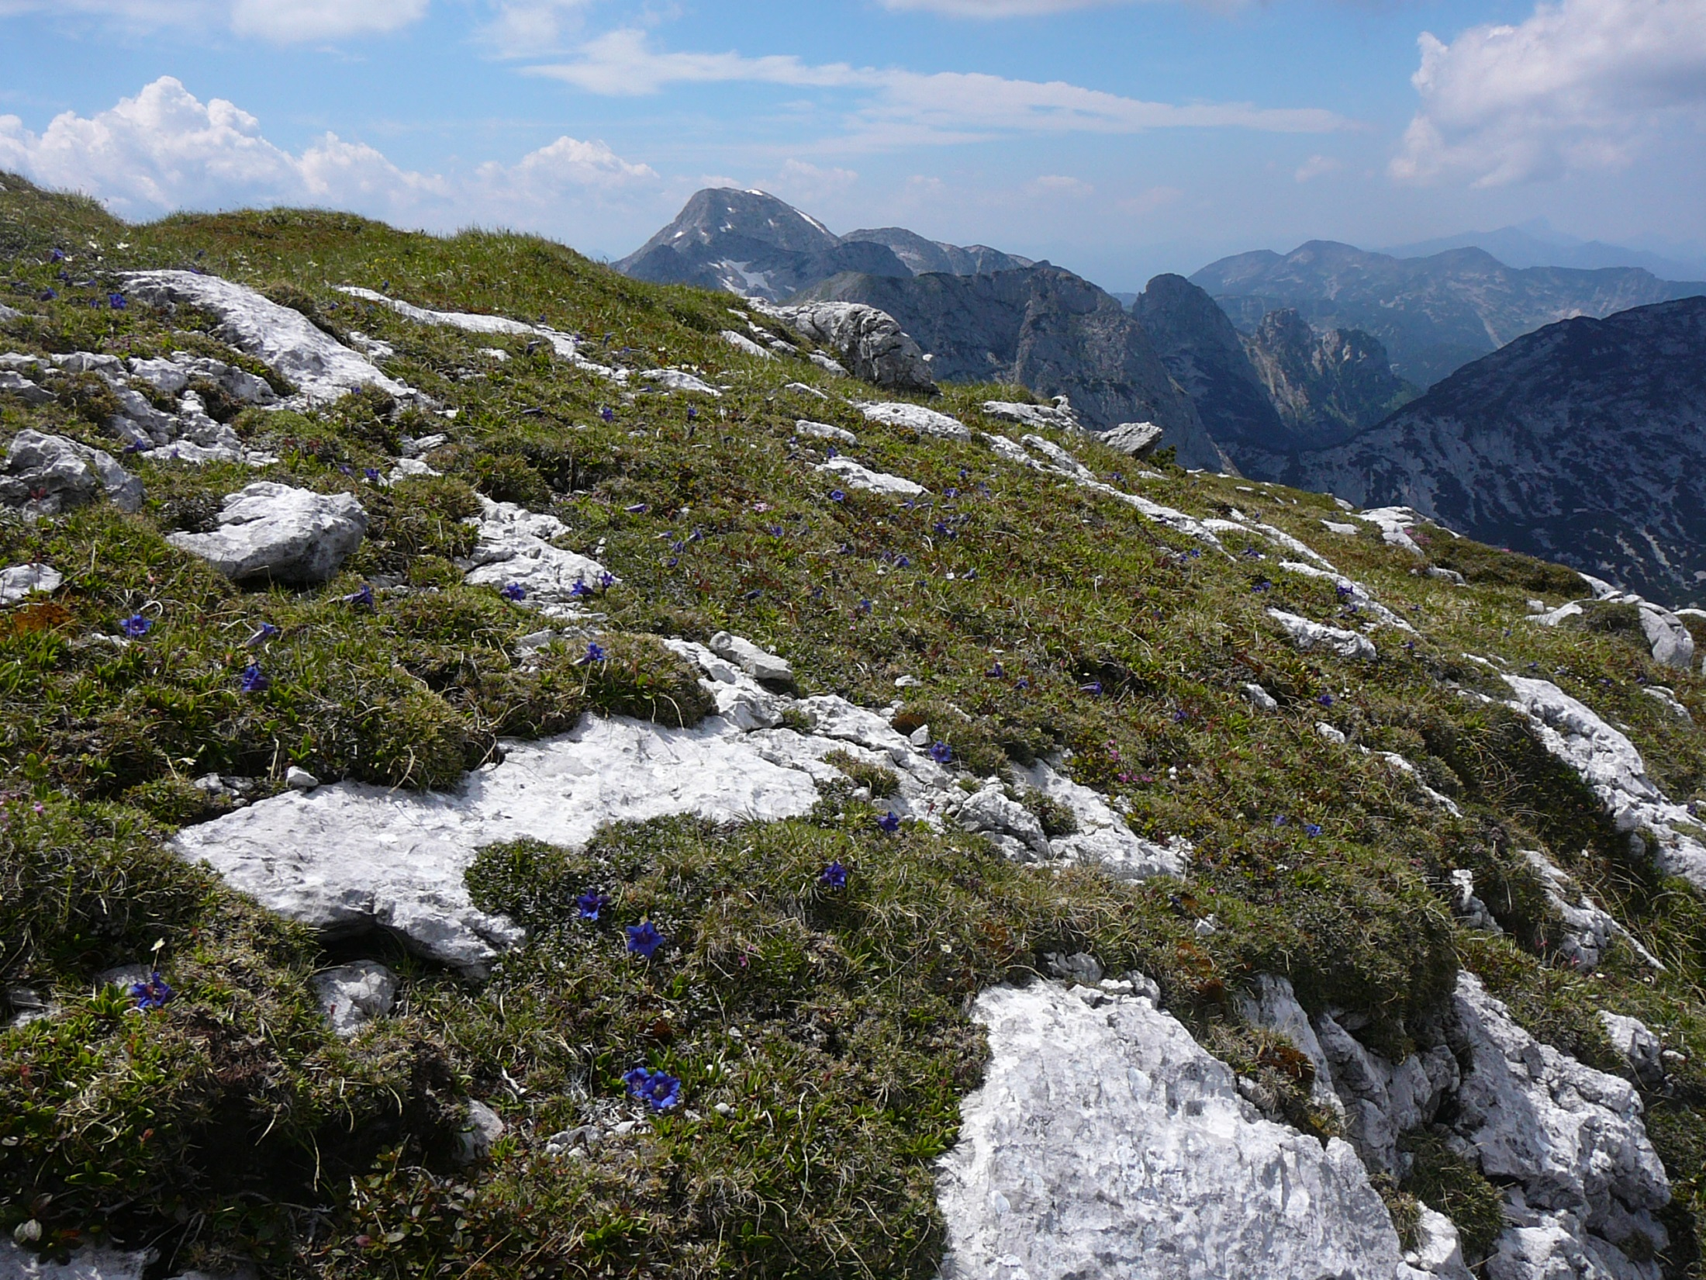
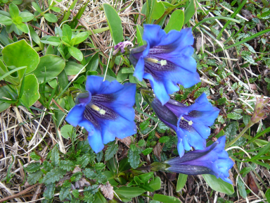

Slide 18
Other characteristics of population size
Frequency = proportion (either a number between 0 and 1, or directly percentage) of occupied units
Units can be natural (percentage of islands inhabited by a species), or artificial sampling units (percentage of [randomly located] quadrats with Gentiana)
Dependence on the unit size (unit definition)
Applicable also in cases where the individuals can be hardly distinguished, but might be less informative than density
Plants: root vs shoot frequency (important for small quadrats)

Slide 19
Other characteristics of population size
Biomass (usually biomass per plot)
Typically for plants
Again, does not need definition of an individual, in plants, can be more useful than density (biomass=density * average biomass of an individual)
Cover (mostly for plants, or at least sedentary organisms)
Percentage of the area occupied by a perpendicular projection of all the aboveground parts

Slide 20
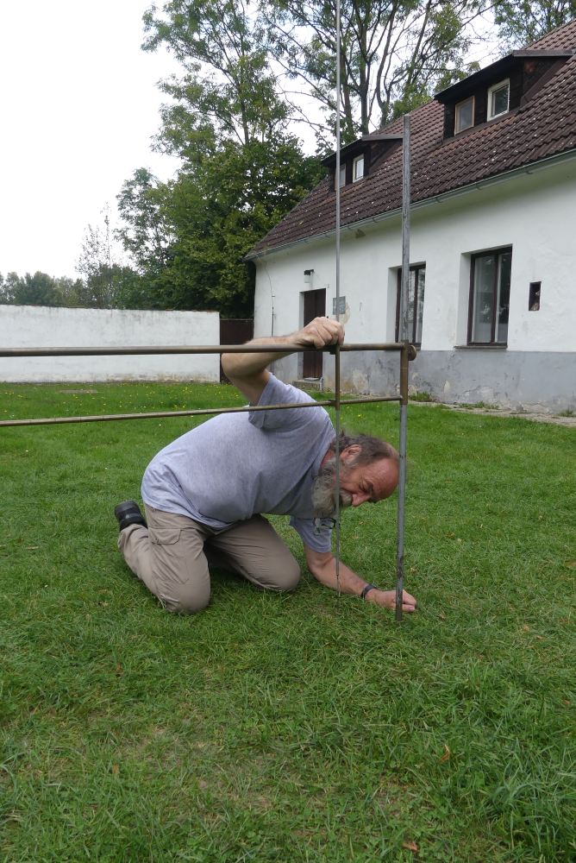
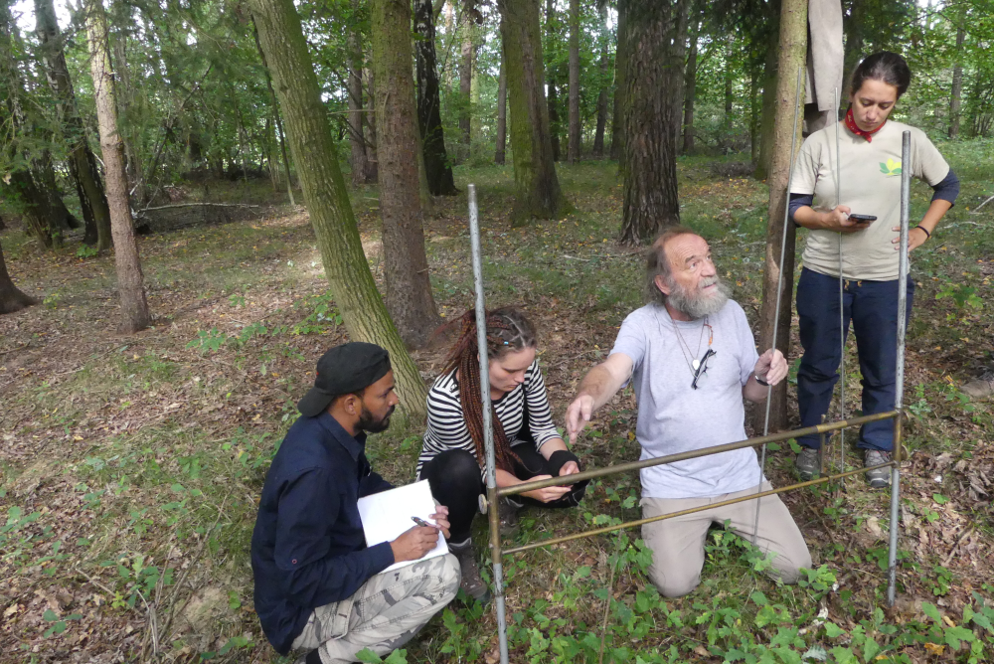
Cover as frequency in points (quadrats of zero size)

Slide 22
Population of Gentiana clusiana
Continuously growing in the mountain ridge of the Totes Gebirge
Spatial extent of the population is large, scattered in a continuous area, total population size of little interest
Local characteristics (local density) are more informative. If I am interested in the dynamics, permanent plots will be useful, and, under certain assumptions, dynamics in permanent plots will probably correspond to the dynamics of total population size.

Slide 23
Population of Gentiana clusiana
Clonal plant – so, density of ramets will be of interest (necessity of good operational definition)
Density of ramets will provide reasonable proxy for competitive effect of species on the rest of vegetation (note that the size of ramets is in this species relatively stable)

Slide 24
Population Gentiana clusiana
In this species, each ramet produces max. one flower (or, this might be part of the ramet definition). Interesting characteristics might be e.g., the density of flowers – will characterize the density of reward for pollinators, or potential for reproduction / for seed production etc.
Useful characteristics might be estimate of cover (non-destructive, suitable for permanent plots) or biomass (destructive, but various nondestructive proxy methods).

Slide 25
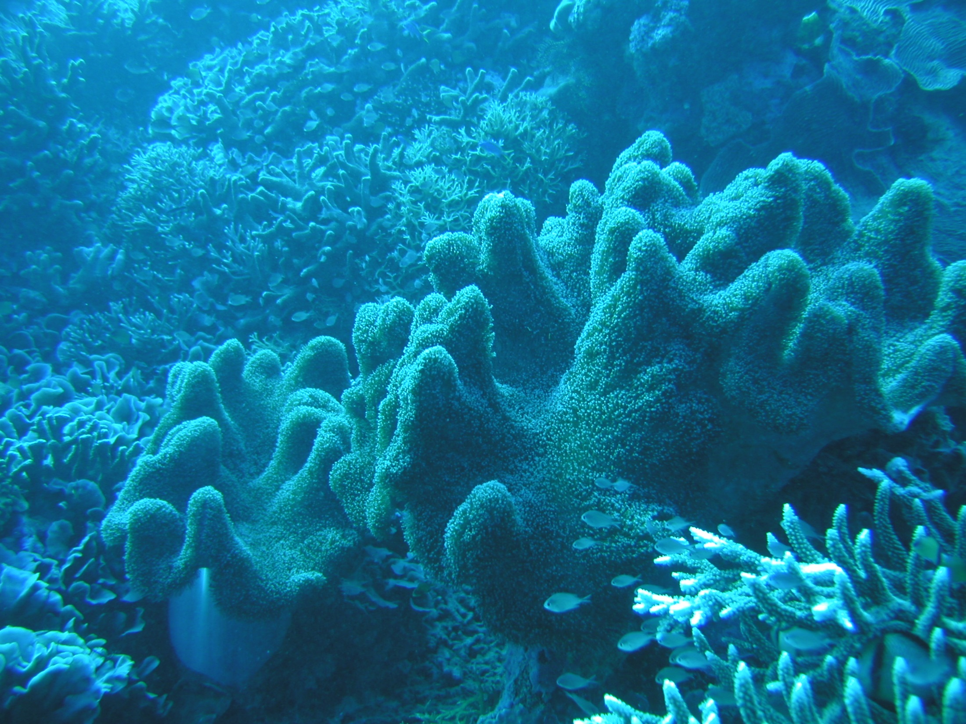
Corals – what to use to characterize the population – definitely not a single polyp

Slide 26
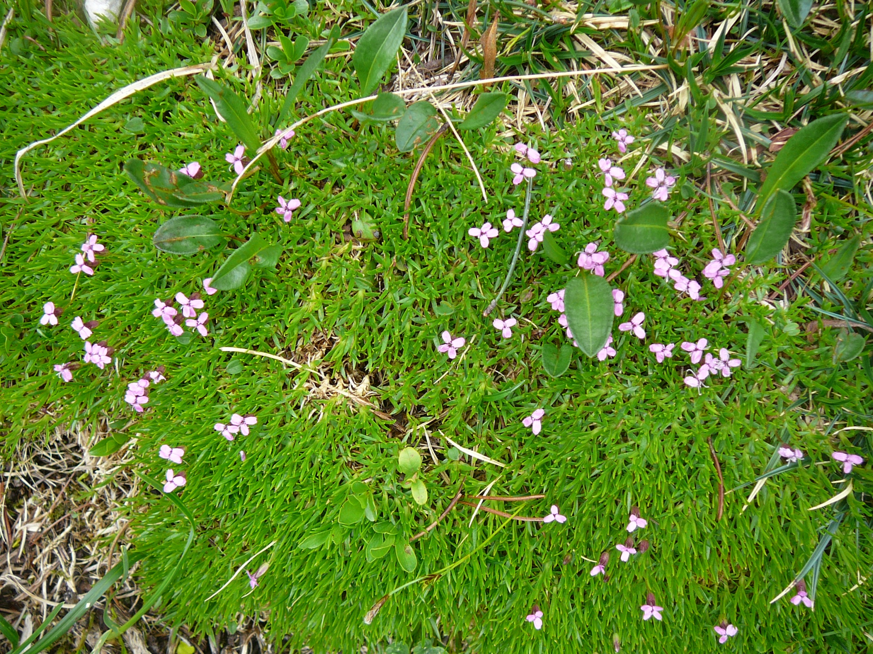
What to use as a unit in cushion plants? (Silene acaulis)

Slide 27
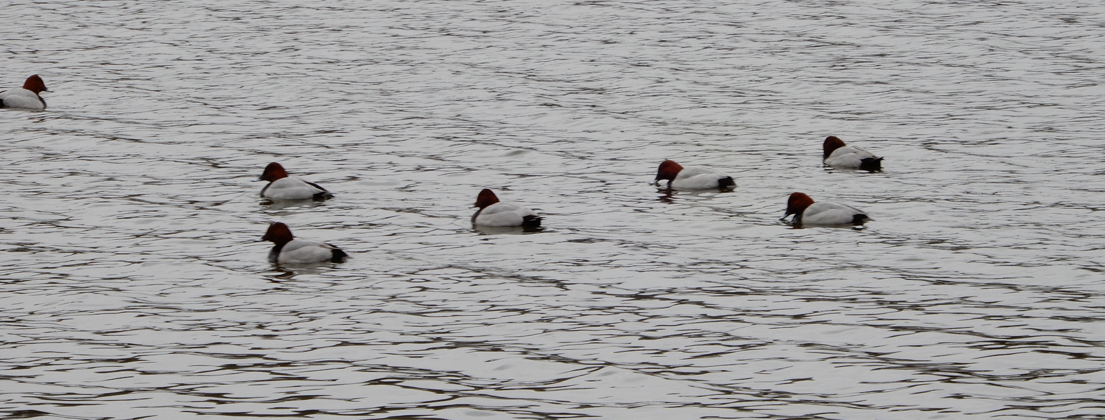
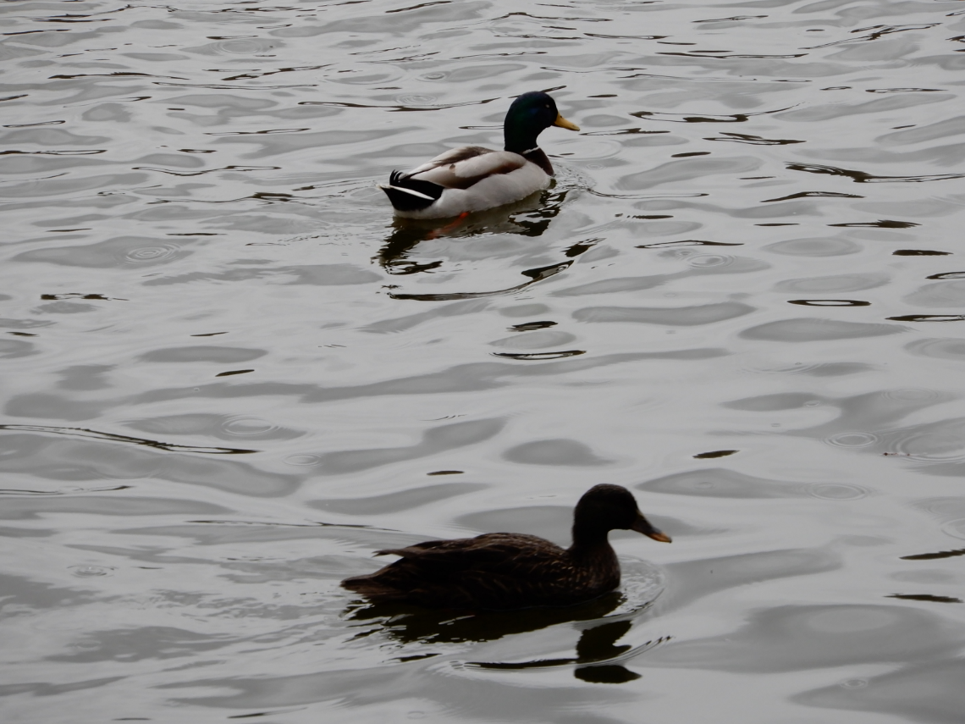
Birds – sometimes, number of breeding pairs is more informative than total number of individuals

Slide 28
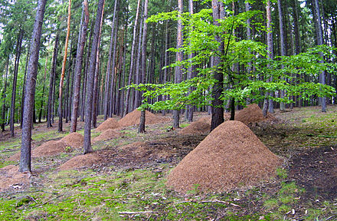
What will be a unit in eu-social insects? (Picture from Wikipedia)

Slide 29
Population size as the number of individuals (in the whole population, sometimes in permanent plots)
The absolute population size
I need clearly delineated area of interest – this delineates the area, and thus I can calculate density=total size / area
or
total size =density * area
Discriminate: census (all the individual are counted) and estimate (based on some random sample [e.g. of plots], usually because it is impossible or impractical to enumerate all the individuals)
Index of population size
To be used in comparative studies

Slide 30
Total population size / Density
(Methods for sedentary organisms)
Classical method – randomly located quadrat (to do this, randomly generated coordinates are needed), easy to calculate the average and confidence interval
total = density * area, the same applies for the limits of confidence interval (similarly, I can multiply also the standard error of the mean)
From density estimated by 0.5 m x 0.5m quadrats, I can calculate density [m⁻²] (incl. CI a SEM) by multiplying by 4. This is possible for indicators of precision, but not for indicators of variability, as s.d. (see spatial pattern)

Slide 31
Recalculation of spatial scale
In a quadrat 0.25 m² - average 5.2 SEM + 1, CI + 2 => density is 20,8 + 4 (mean + SEM) individuals per 1 m² , CI + 8.
Tolerance interval (or S.D. standard deviation, i.e. any characteristics of variability) should not be recalculated in this way – variability is always meaningful only for the size of the unit used.

Slide 32
Location of quadrats
Regular grid – better coverage of the area – the SEM is usually in reality smaller than calculated
Small danger only when there is some (very) regular pattern in the population:

Slide 33
Regular design - biased results, when there is some regular structure in the plot (e.g. regular furrows), with the same period as is the distance in the grid.

Slide 34
Heterogeneous area (stratified sampling)
You need a total size of population, inhabiting a locality, which is heterogeneous (e.g., small core high density, and relatively large rest with low density). Delineate individual parts and sample them separately. You will be able to add the two numbers (to get the estimate of the total population size) and also to get the precision of this estimate.

Slide 35
Adaptive sampling
Large area, the population is sparse, and very clustered. This means that most of the (randomly or regularly located) quadrats will be empty.
Solution: if is the quadrat located in a cluster (density exceeds a threshold), sample also closely located quadrats to cover the whole cluster.
Very complicated math, but formulae exist and can result in higher precision with given sampling effort (McCallum 2000)

Slide 36
Clustered sampling
Large area (travel takes lot of time). When I stop in a place, it is waste of time to do just one quadrat. So, do more, but the independent observations are not individual quadrats, but individual clusters (hierarchical design).

Slide 37
Corrected estimates
I need the estimate of algal biomass [sedentary algae at bottom] in 1 km² of the see bottom. It is possible to either estimate the quantity - simple eyeball estimate from a boat [fast, unprecise, generally an index], or scuba diver will collect all the algal biomass from a quadrat and it will be then weighted [precise, laborious, time consuming]. For precision, I need many quadrats, but also biomass and not an index.

Slide 38
Corrected estimates
A combination helps: Index (eyeball estimate) is obtained for, say 300 plots from the boat. Of them, ~ 30 randomly selected plots will be also harvested by a scuba diver and biomass determined exactly.
Then, I will use calibration, based on the 30 plots where I have both, index and exact biomass. (Calculate regression with the (unprecise) estimate being the predictor, and the precise biomass the response, and the regression provides “calibration”. I need reasonably high R² and the unprecise method needs to be much faster.

Slide 39
Used by Leps et al. 1999 to estimate the biomass os food for individual insect species
Select 100 quadrats and estimate individual species cover (covering the area around a light trap that might provide the food source for insects)
In 10 of them, cut the biomass, sort it out, dry, and weight
Calculate regression of biomass on the cover
Use it as calibration

Slide 40
Cover is fast and non-destructive
The equation for calibration
Note, that the cover (estimated, much more error prone) is the independent variable

Slide 41
Size and shape of „quadrat“
Quadrat (from Latin) should be a square, but some people use it for any rectangle
„Edge effect“ – worse for small and narrow
„Accessibility“ (nothing overlooked) – best for small and narrow
For the same area – long and narrow rectangle is better for catching the environmental heterogeneity, but increases the edge

Slide 42
Transect methods
Narrow long belt
Line for estimation of cover (both modification of quadrat method)
Most often – I walk and record everything what I notice (used for both, sedentary and mobile organisms)
We can get also absolute estimate
Most often as an index (typically, number of butterflies seen when walking 1 km for 20 minutes}
Probability of recording
Distance from a transect

Slide 43
Capture – re-capture [Mark - recapture]
Basic:
1 Capture a set of individuals from a closed population
2 Mark them and release
3 After some time: capture another set of individuals
4 Count them and count how many of them have a mark.

Slide 44
n₁ – Captured, marked and released in step 1.
n₂ – Captured in the second sample.
m₂ – number of marked individuals in the second sample.
N = estimate of the total population size
Intuitively N/n₁ = n₂/ m₂
=>
N= n₁ . n₂/ m₂
More precise (for large numbers, does not make any difference)
Standard error of the estimate S_{N}

Slide 45
For small error of estimate, I need high m₂
High number of marked individuals in the second capture
This mean to mark many individuals, and to get many individuals in the second capture (which mean to capture many individuals)

Slide 46
Assumptions
No mortality and no natality
No emigration and no immigration (for both, we need short interval between the first and second capture)
All individuals have the same probability to be captured (so, I need some time after release so that the individuals will spread evenly) (and the probablity of capture in the second is not affected by marking)
For the error of estimate - all the individuals are independent observations

Slide 47
Violation of assumptions
Population size is constant, but part of the population dies (including the marked ones) and similar number is newly born (none of them marked). Proportion of marked in population decreased, and the population size is overestimated.
Similar bias for migration (some emigrants are marked, immigrants are not)
Largest bias when the mortality is affected by marking (usually positively – size is then overestimated).

Slide 48
Violation of assumptions
Equal probability of individuals to be captured – part of the population is “trap resistant ” (too clever, not mobile enough, etc.) – size might be underestimated
Marking affected the probability of capture in the second run (more frequent for inteligent animals)
Pozitively (“trap happinies”) – size underestimated
Negatively (painful marking, the animal learn to recognize and avoid the trap ) – size is overestimated

Slide 49
Remedies
Many capture - recapture methods and modification (Lincoln, Petersen).
Improvements:
Individual marks for each animal, I always know this is shrew Jimmy [and I can weight him, measure, estimate his age etc. - capture recapture has further benefits in addition to the estimation of the size], and also
More subsequent captures or
Simultaneous captures in various locations

Slide 50
Information obtained
Jimmy is regularly found in trap no. 3 – probably not simply by chance, but he learned that there is some food there, and after his lunch, he is released
Jimmy is found in various traps – I can estimate his „homerange“
Combination of repeated captures, spatial arrangement of traps and individual marking provides info not only on population size and its dynamics, but also some behavioral data.

Slide 51
Nice example of use for butterflies
Vlasanek, P., Sam, L., & Novotny, V. (2013). Dispersal of butterflies in a New Guinea rainforest: using mark–recapture methods in a large, homogeneous habitat. Ecological Entomology, 38(6), 560-569.
How to estimate the mobility of a butterfly?

Slide 52
Capture – re-capture
Each method has some assumption and is connected with rather complicated statistics
Program MARK
Gary C. White
Professor, Department of Fish, Wildlife and Conservation Biology
To be foun (incl. link to the discussion forum):
https://sites.warnercnr.colostate.edu/gwhite/program-mark/

Slide 53
Index
Indirect characteristics (number/density of molehills in a meadow, number of cowpats, intensity of browsing) – often reflect population size × activity
„Catch per unit effort“ – number of individuals in light (and other) traps, „laying eight“, pitfall traps etc.
For comparative purposes only. Assumes that index: real population size is constant.

Slide 54
Typical problems
Distance from which are individuals attracted to the light trap depends opn the forest density (and thus visibility)
Effectivity of light traps affected by moon, by city lights etc.
Pitfall traps – measures „closetoproduct“ of density and activity (if I do not run, I will not fall into a trap)

Slide 55
Precision of frequency/cover
Point quadrat estimate of cover as a frequency of a species in individual points
Formula for estimate of p parameter of binomial distribution

Slide 56
Out of n=100 pins X = 15 hits , estimate of cover is estimate if binnomial p = 0.15 (15%)

Slide 57
For normal approximation (1-α) confidence interval
15 hits out of 100
95% CI is thus 15 + 7,5
Very low precision, but supposedly unbiased
Z_{(1 - α/2)} is (1-α/2)*100% quantile of N(0,1)

Slide 58
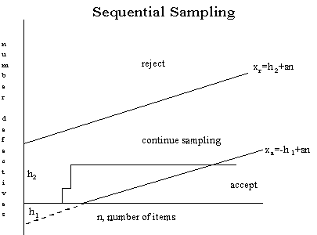
Sequential sampling – the goal is not population size estimation, but decision, whether a population reached a threshold – e.g. whether to spray by pesticide
Wikipedia

Slide 59
Mathematical theory is nice, but it usually does not reflect the practical sampling and biases
We always estimate the population size for some reason – the importance of errors differ
It is good to know about behaviour of the population
Always consider possible errors and biases
Use commonsense

Slide 60
The goals of population size estimates
For temporal dynamics – permanent plots (to partial out the spatial variability)
For comparison in space (but not only in space) – the efficiency of the method should not be affected by the explanatory variables (light trap / higher population index far from cities)
Spatial scale and goal of the study – e.g. plants of food source

