Slide 1
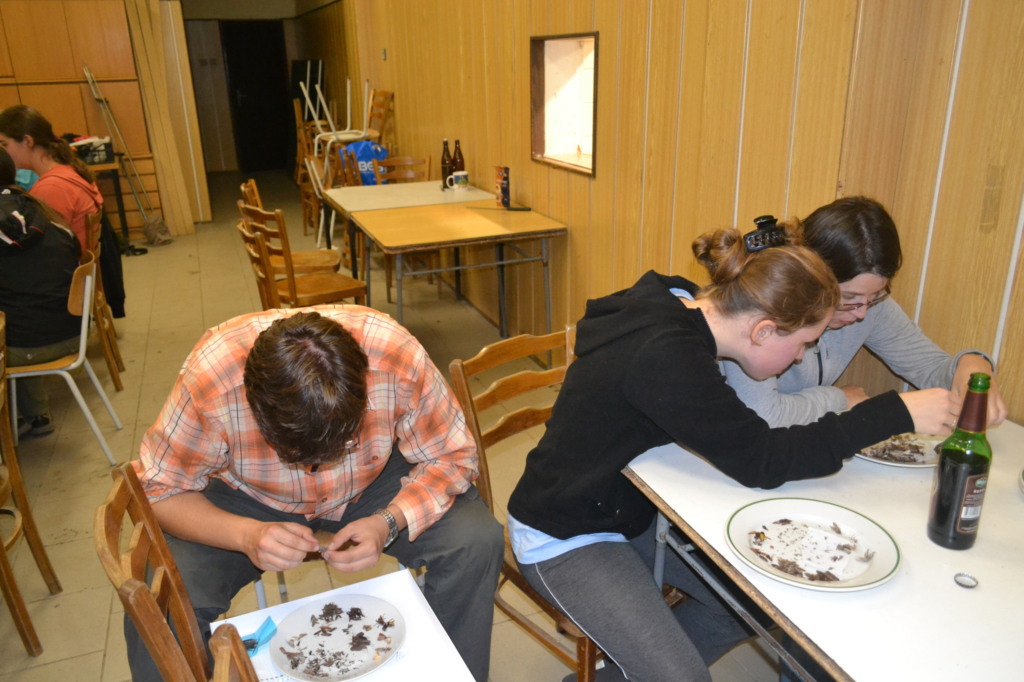
Species diversity of Lepidoptera and Trichoptera in Oslava river valley
Ekologická terénní praxe III – 2: Mohelno 2013
Authors:
Tereza H., Michal „Koumák“, Eva Š., Tomáš E., Denisa M.

Slide 2
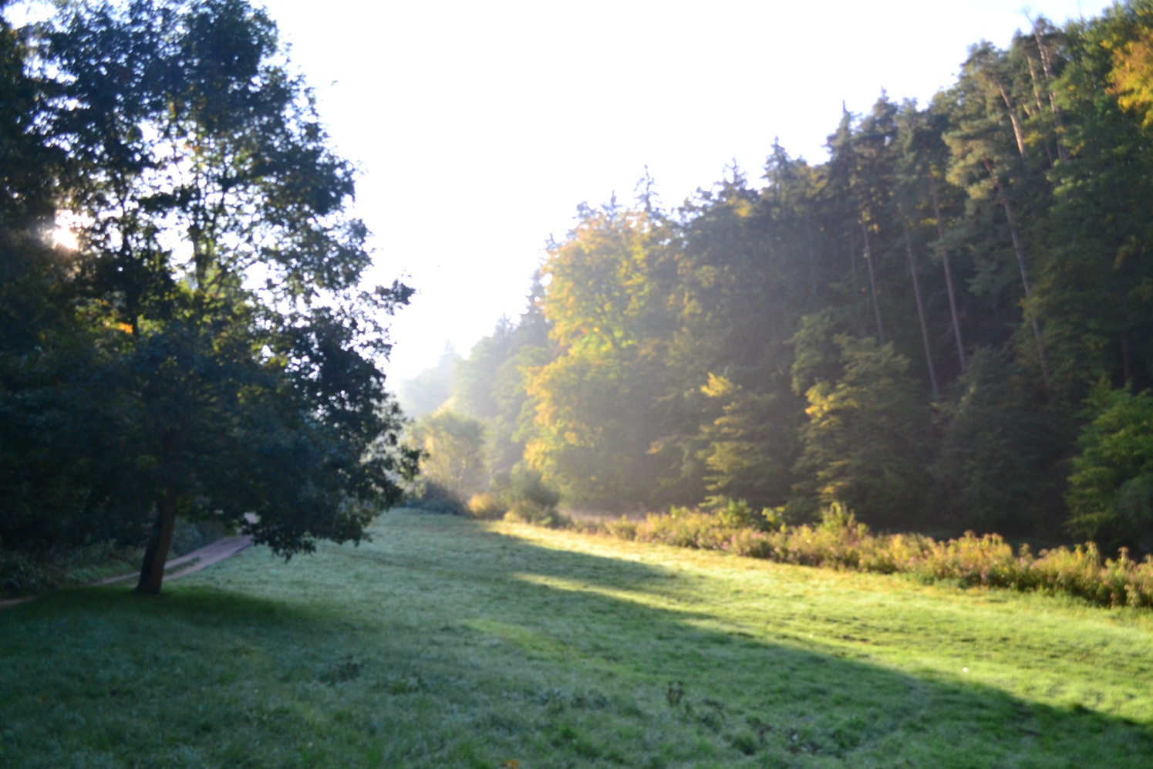
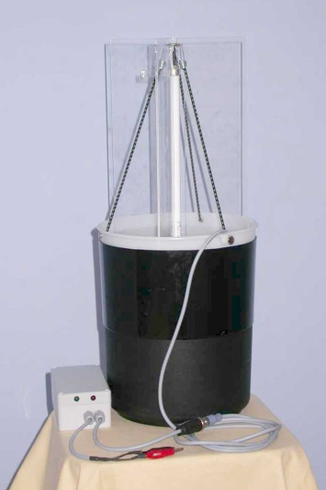
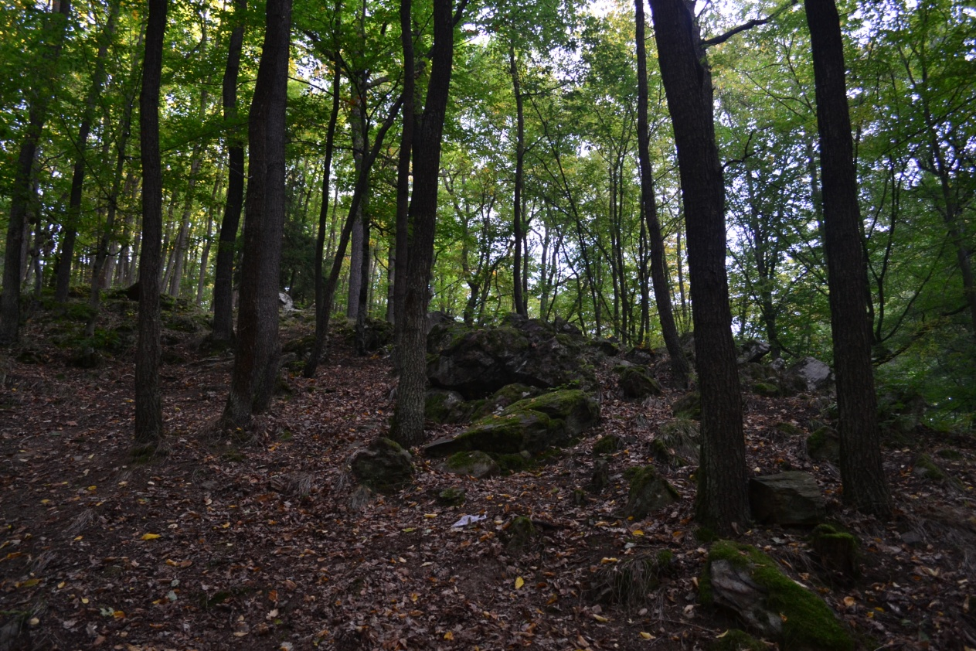
METHODS
Location:
meadow 1, 2
forest 1, 2
Night capture of insect during 3 nights
Using light traps

Slide 3
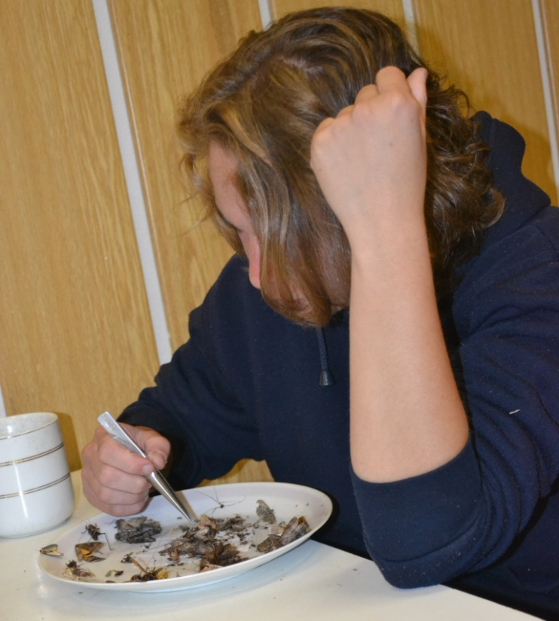
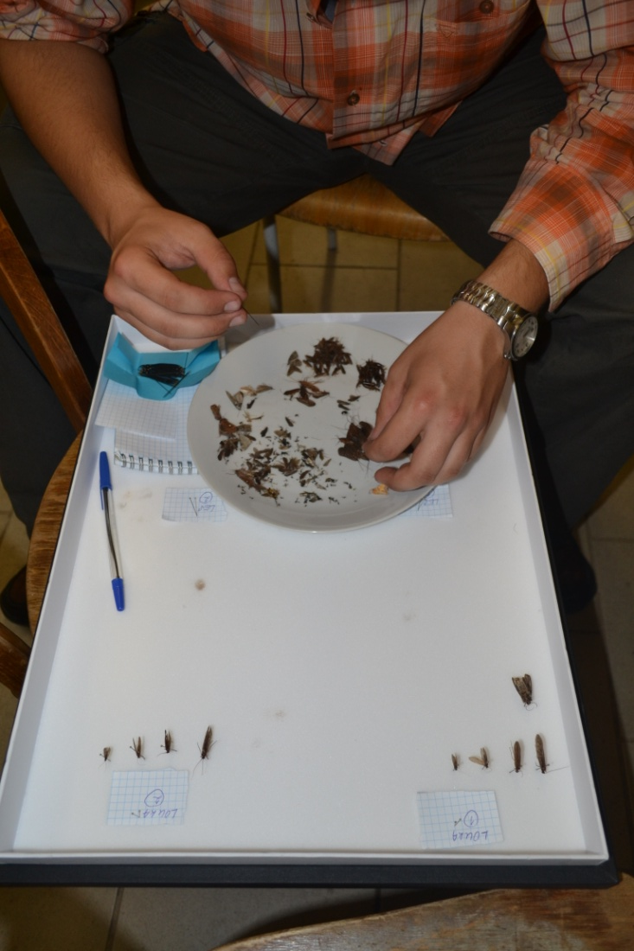
Sorting and counting:
Tab.1: Number of species (NS) and individuals (NI) captured during nights in chossen locations.
Location | Capture | NS | NI
meadow 1 | 1. night | 17 | 140
 | 2. night | 2 | 2
 | 3. night | 6 | 25
meadow 2 | 1. night | 10 | 92
 | 2. night | 2 | 22
 | 3. night | 10 | 35
forest 1 | 1. night | 29 | 124
 | 2. night | 8 | 17
 | 3 . night | 16 | 49
forest 2 | 1. night | 18 | 81
 | 2. night | 9 | 39
 | 3. night | 15 | 43

Slide 4
RESULTS Used test: Hierarchical ANOVA
Img.1: Graph of dependance of species number on location
(1-meadow, 2-forest).
Img.2: Graph of dependance of species number on location (1-meadow 1, 2-meadow 2, 3-forest 1, 4-forest 2).
The test is not significant
(p = 0,052).

Slide 5
RESULTS
Used programe: CANOCO

Slide 6
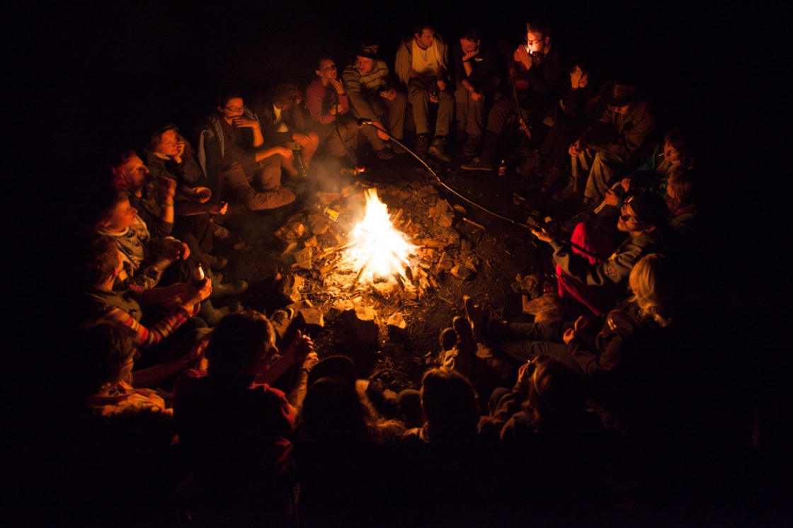
Thank you for your attention

