Slide 1
Diversity determinants
- are also determinants of community species composition
(or better:
Determinants of species composition determine also the diversity)

Slide 2
To be present in a community, a species has
1. To be able to reach the site (overcome the dispersal limitation)
2. To be able to survive there (including reproduction) – overcome the habitat limitation
Both the processes have probabilistic character – on average, (many) thousands seeds are needed to give rise to a single fertile adult – consequently, a single seed arriving to a site has a negligible chance to form a population

Slide 3
Grime (1998) – three species types in a community
Dominants
Subordinates
Transitional: species, population of which is able to survive only because of continuous supply of diaspores from outside – in fact, sink populations in metapopulation (Hanski)

Slide 4
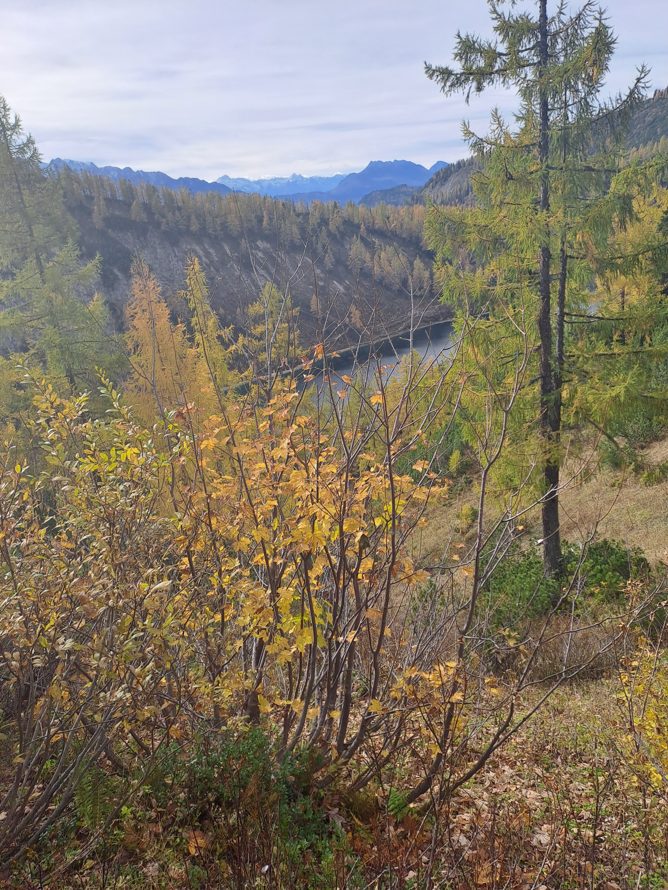
Acer pseudoplatanus in Alps close to treeline - typical transient species (sink population according to Hanski) – great majority of the individuals does not form seeds – seeds probably arriving by wind from lower elevations

Slide 5
Species pool
Even more complicated.
Distinction between local and regional species pool.
Also, presence of some species is beneficial to other, sometimes even necesssary (more often for species of different trophic levels).
Environmental filter
Community filter
Biotic relationships
Community composition

Slide 6
Species pool – determined mainly historically (evolutionary history): Central Europe – also ability to migrate in post-glacial period (but includes also biotic factors, as competition on migration pathways) – note, this is very wide definition – for some: Species pool excludes species not able to withstand given abiotic environment, and sometimes it is defined in even more restrictive way
Community filter – current ecological interactions, i.e. ability to withstand the abiotic environment [often extremes] and to cope successfuly with biotic interactions (competition, predation, etc.)

Slide 7
Continuing debate – which differences in community richness are caused by historical factors (species pool hypothesis), and which by current ecological interactions
Is the low species richness of fertile grasslands caused by increased rate of competitive exclusion (current interactions), of by the fact that there were no fertile grasslands in postglacial period and so there is very limited species pool (historical factors)? Note, that here, the species pool is in the narrow sense.

Slide 8
Correlation of species pool size (e.g. from Ellenberg) and average richness (vegetation database) does not help
Both causalities are possible
Average species richness of limestone grasslands is higher because the species pool of calciphilous grassland species is bigger
OR
The species pool of calciphilous grassland species is bigger because species richness of limestone grasslands is higher (e.g. because slower competitive exclusion)

Slide 9
My concerns
Lepš, J. (2001). Species-pool hypothesis: limits to its testing. Folia Geobotanica, 36(1), 45-52.
http://botanika.prf.jcu.cz/suspa/pdf/fg_36.pdf

Slide 10
Probably, the most promising approach
Comparison of gradients of species richness in contrasting biogeographical areas (e.g. mangroves are species poor (in comparison with tropical forest) everywhere, very likely due to harshness of environment. In similar conditions, however, SE Asian are richer than African – very probably consequence of evolutionary history. Examples from Schluter and Ricklefs in Ricklefs and Schluter (1993): Species diversity in ecological communities

Slide 11
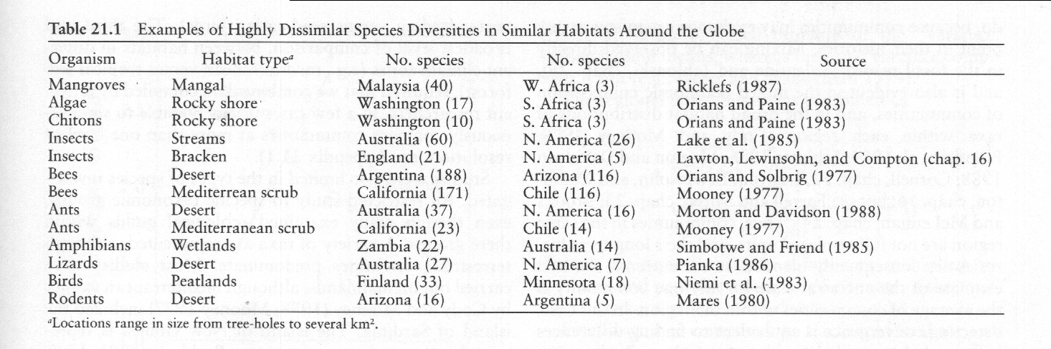
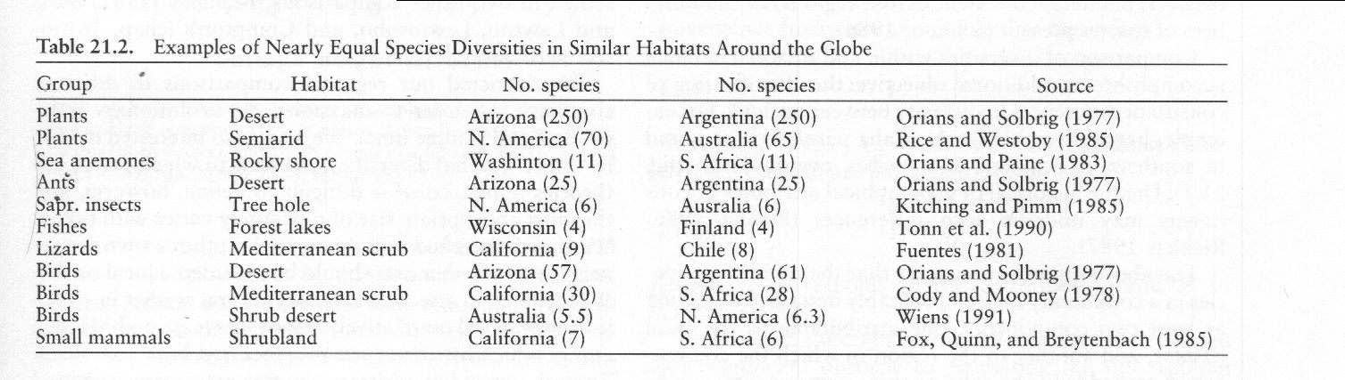
Schluter and Ricklefs in Ricklefs and Schluter (1993): Species diversity in ecological communities – Examples of both, similar and dissimilar richness in similar habitats.

Slide 12
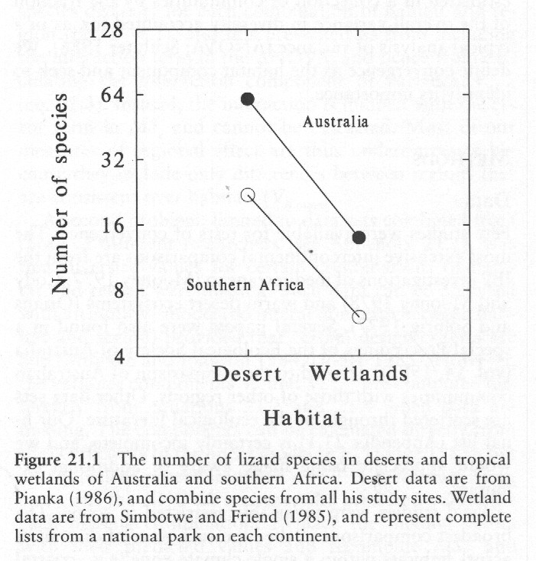
Concordant patterns in various geographical regions
In 2-way ANOVA, no interaction effect between habitat and region (would be better with log transformed richness data)
Schluter and Ricklefs in Ricklefs and Schluter (1993): Species diversity in ecological communities

Slide 13
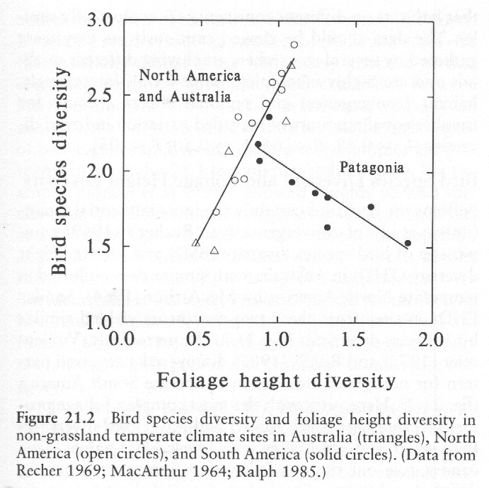
Discordant patterns in two geographical regions
probably legacy of history and distribution of various habitat types
(Highly significant interaction Foliage height*Region)

Slide 14
How to define, and how to identify species pool

Slide 15
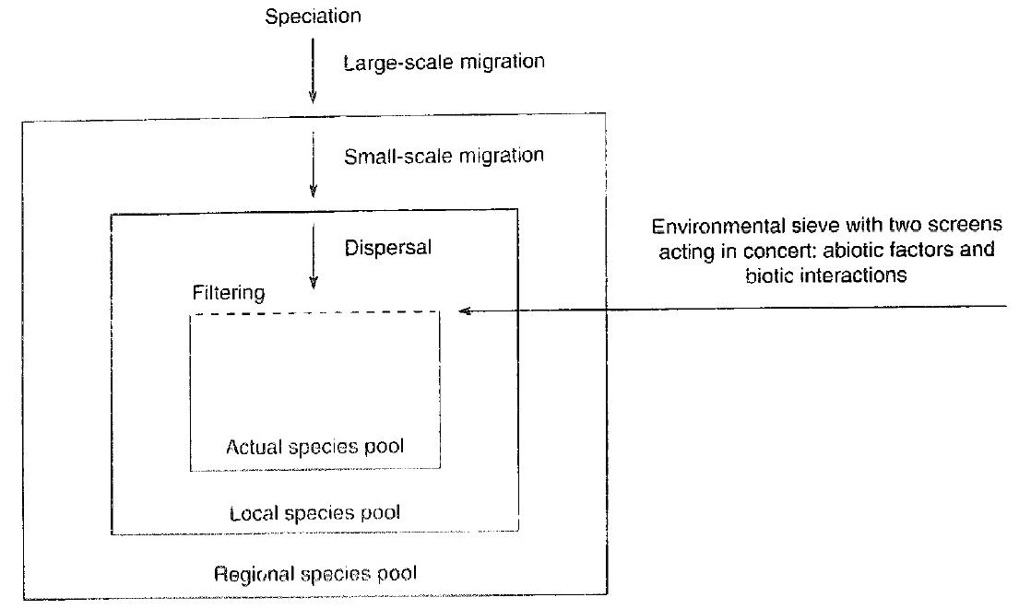
Zobel 1997

Slide 16
Dark diversity concept
Species that are in the community actual species pool, but not present in the community
Show the potential of habitat to host species
Pärtel, M., Szava-Kovats, R., & Zobel, M. (2011). Dark diversity: shedding light on absent species. Trends in Ecology & Evolution, 26(3), 124-128.

Slide 17
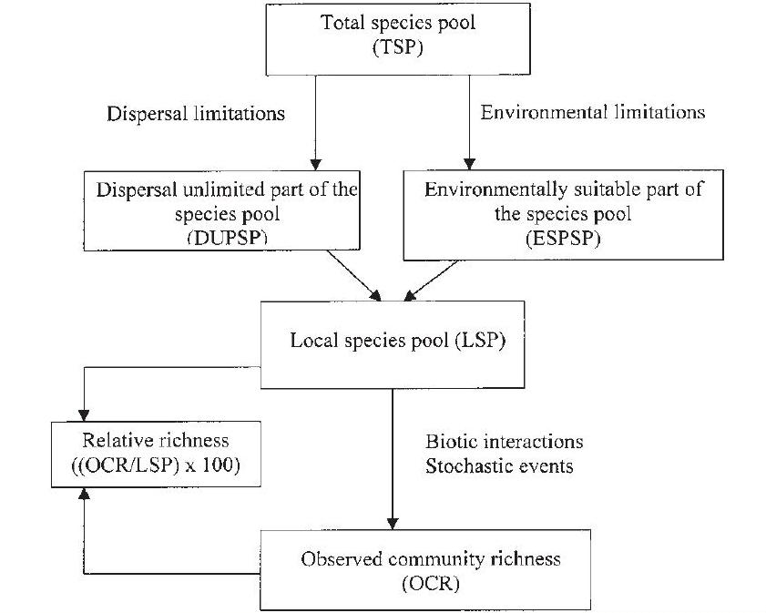
Butay et al 2001

Slide 18
In my view – a species must go through both!
Difference between local species pool and actual species composition reflects the biotic interactions

Slide 19
Practical identification of species pool composition
Using Ellenberg values
Using Beals index
Using traits of species
Using expert knowledge (Sádlo) – empirically, the species would be able to live there
All these take into account actual species co-occurence – and so the results of biotic interactions (and so correspond to concept of Zobel 1997)

Slide 20
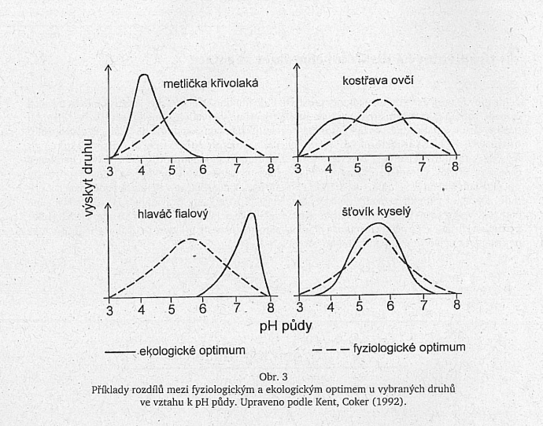
Reminder: Physiological - - - - and Ecological optimum
Deschampsia flexuosa
Festuca ovina
Prach: Úvod do vegetační ekologie.
Scabiosa columbaria
Rumex acetosa
Physiological optimum reflects response to abiotic environment, ecological to both, abiotic environment and biotic interactions – in plants mostly competition
Soil pH

Slide 21
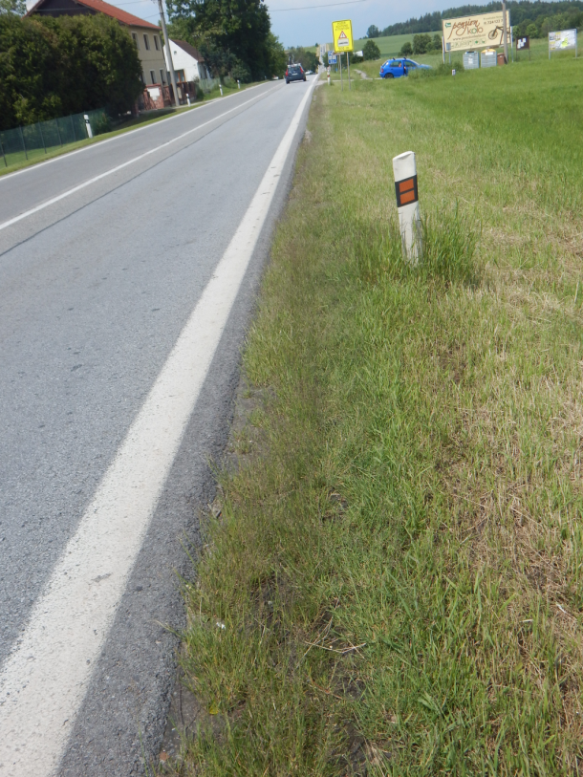
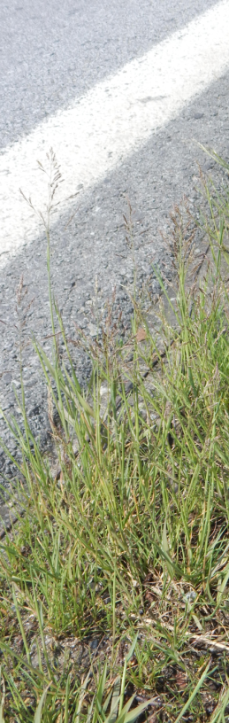
History of Puccinellia distans in Czech Republic
Treating roads with salt – it does not improve the conditions for Puccinelia, but excluded all the better competitors

Slide 22
Using Ellenberg
For a habitat, complete a relevé, and calculate CWM (community weighted or unweighted mean) for (say) moisture, temperature and light (perhaps reflect also pH, salinity) and take the species with Ellenberg indicator values close to these.
Both, CWM and species values reflect species ecological optima

Slide 23
Using traits
Again, take a relevé and include species with traits corresponding to traits of the constituent species
Again, both traits of the vegetation, but also preferences of individual species reflect species ecological optima – species with low SLA are physiologically able to grow in wet habitats, but are missing there because of competition
Problem – high functional alpha diversity

Slide 24
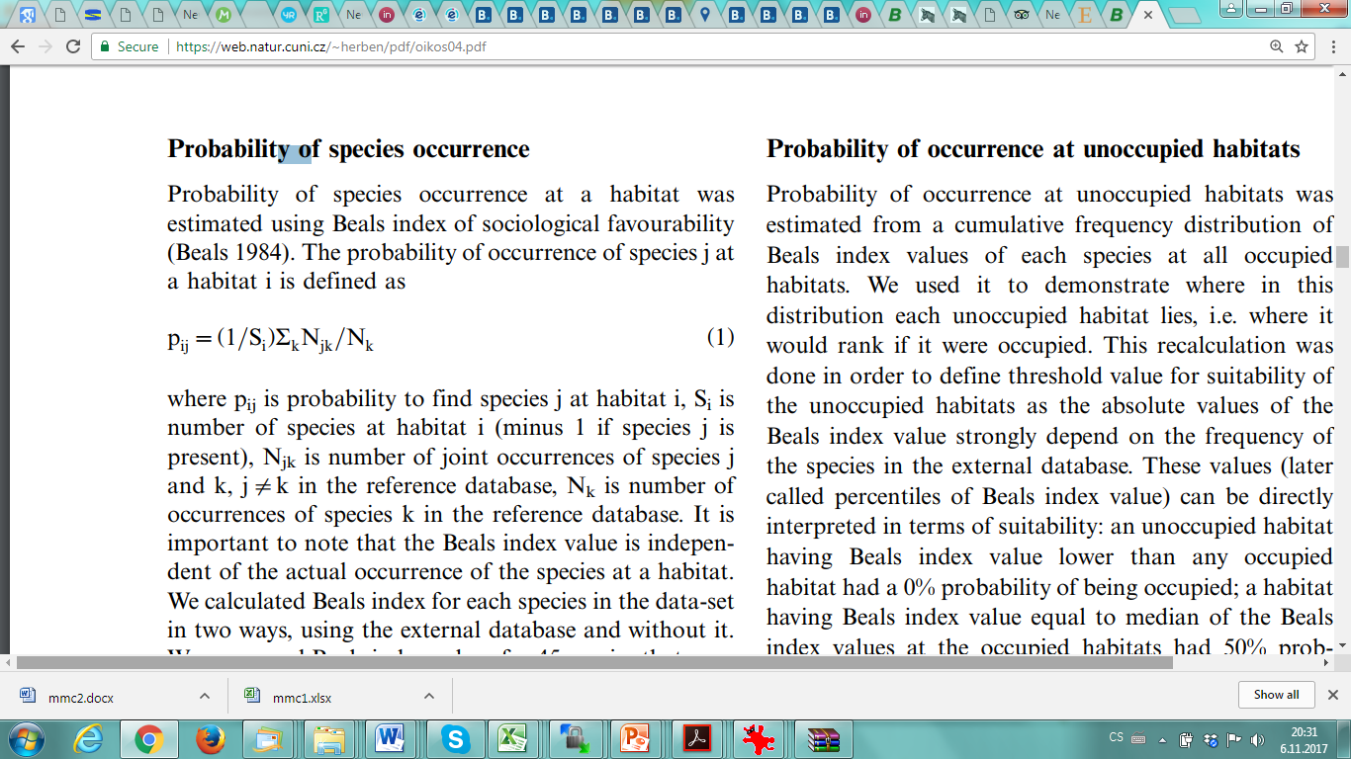
Beals index
How likely is the species presence in a site?
Compare the releve from the site with the (reference) phytosociological database
(Beals 1984): The probability of occurrence of species j at a habitat i is defined as
where p_{ij} is probability to find species j at habitat i, S_{i} is number of species at habitat i (minus 1 if species j is present), N_{jk} is number of joint occurrences of species j and k, in the reference database, N_{k} is number of occurrences of species k in the reference database

Slide 25
Again
Beals index also reflects species ecological optima
In all above cases, the methods select species that should be able to tollerate both, the environmental (abiotic) conditions AND the biotic pressure (competition)

Slide 26
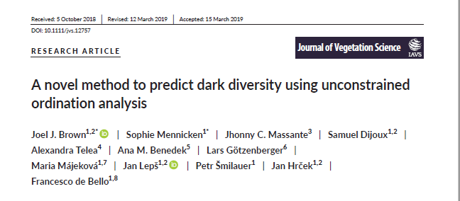
And again, this method reflects the ecological optima of the species (again, based on the large databases)

Slide 27
Consider also biogeography
And thus the dispersal limitation on medium spatial scales
If you take as a basis the Czech National Phytosociological database for calculation of Beals index, some results would be biased

Slide 28
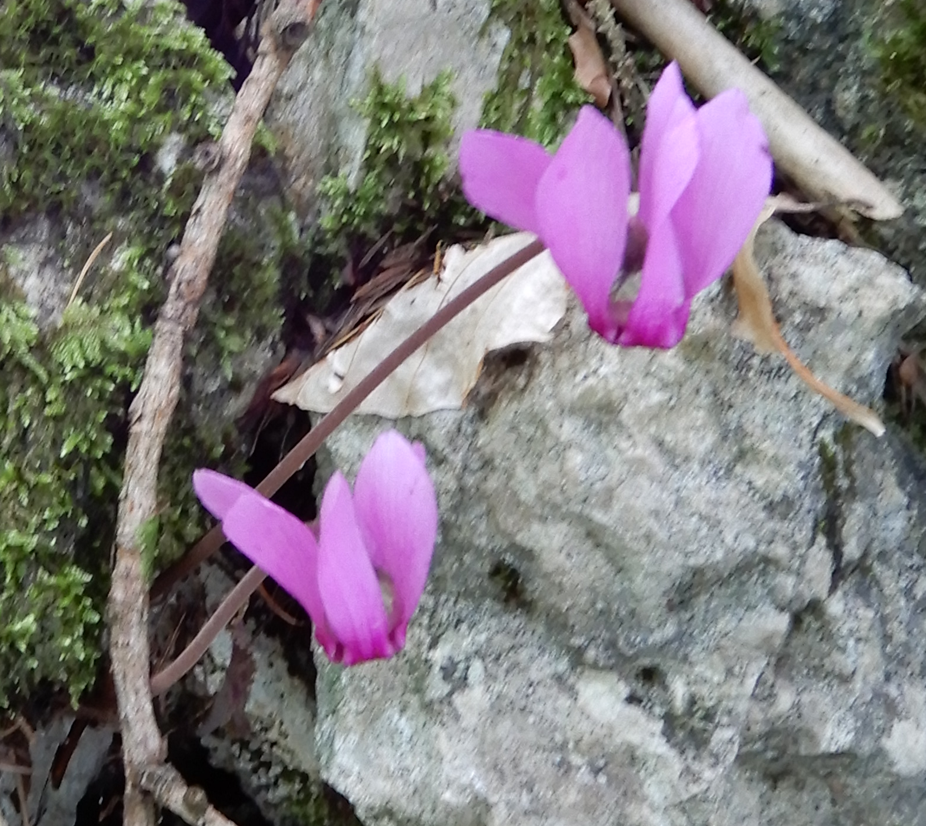
Dispersal limitation on regional scale
Cyclamen purpurascens
Common in the area of Mohelno field course, completely missing from similar sites in surrounding of Ceske Budejovice unless artificially introduced)

Slide 29
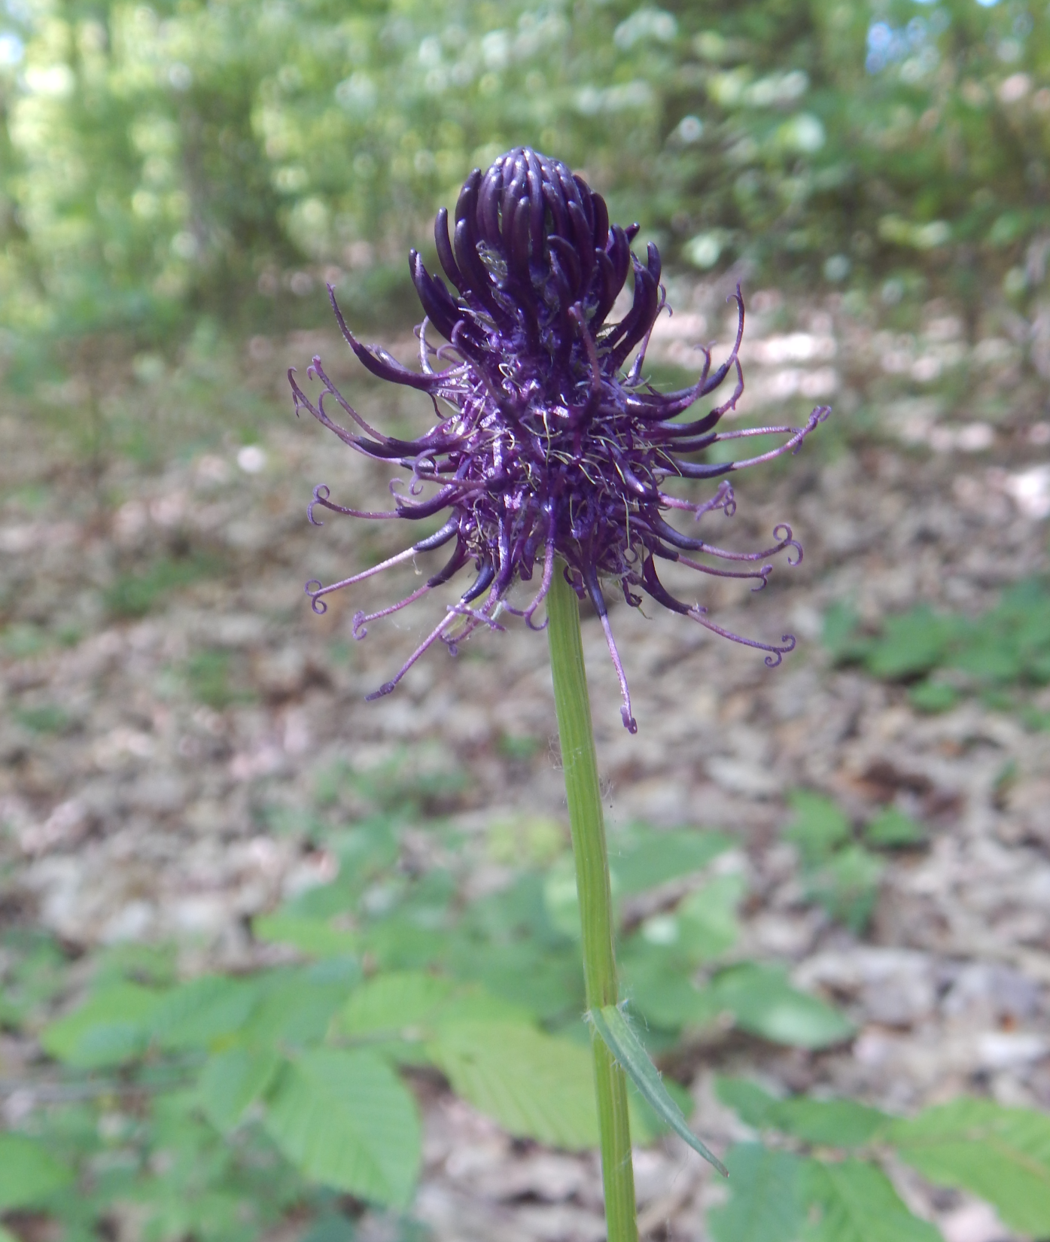
Zvonečník černý –Phyteuma nigrum
In the Czech republic, it has rather strange distribution, (photo close to Purkarec, north of ceske Budejovice)

Slide 30
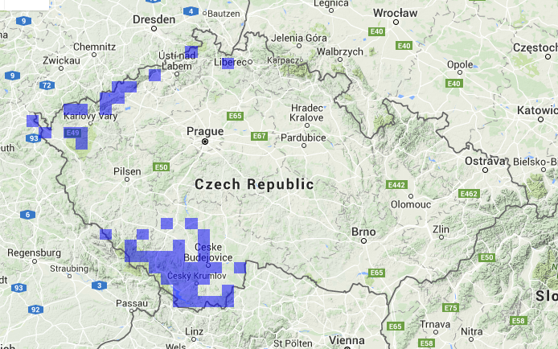
Distribution of Phyteuma nigrum in the Czech republic–
http://quick.florabase.cz/map/show/taxon/Phyteuma%20nigrum/callback/???

Slide 31
Taking the whole database, the Beals for localities in Sumava Mts will give unrealistically low, and for localities in White Carpathians positive value (and the species is missing there)

Slide 32
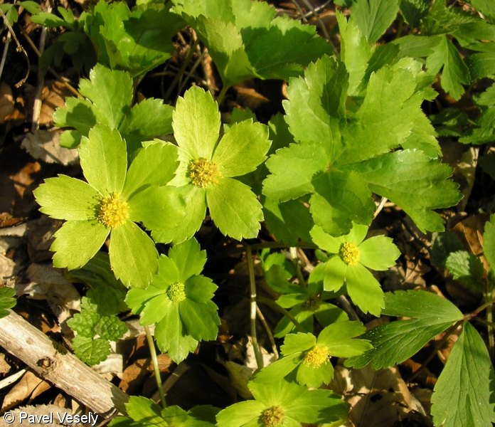
Hvězdnatec čemeřicový – Hacquetia epipactis
http://www.botanickafotogalerie.cz/fotogalerie.php?lng=cz

Slide 33
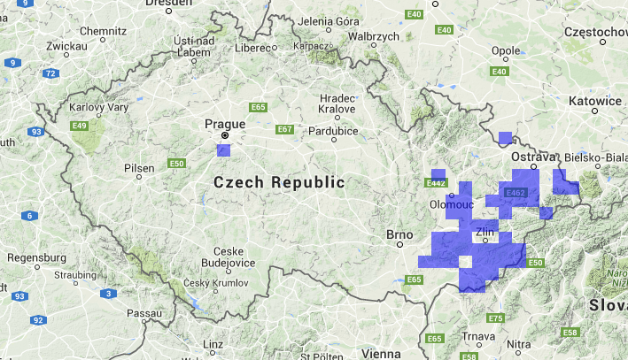
Distribution of Hacquetia epipactis in the Czech republic (locality close to Praha is clearly result of arteficial introduction)
http://quick.florabase.cz/map/show/taxon/Hacquetia%20epipactis/callback/??? - Beals would again not work when based on database for the whole Czech republic

Slide 34
Empirical studies
testing the determinants of community structure
(i.e. the dispersal limitation vs. habitat limitation)

Slide 35
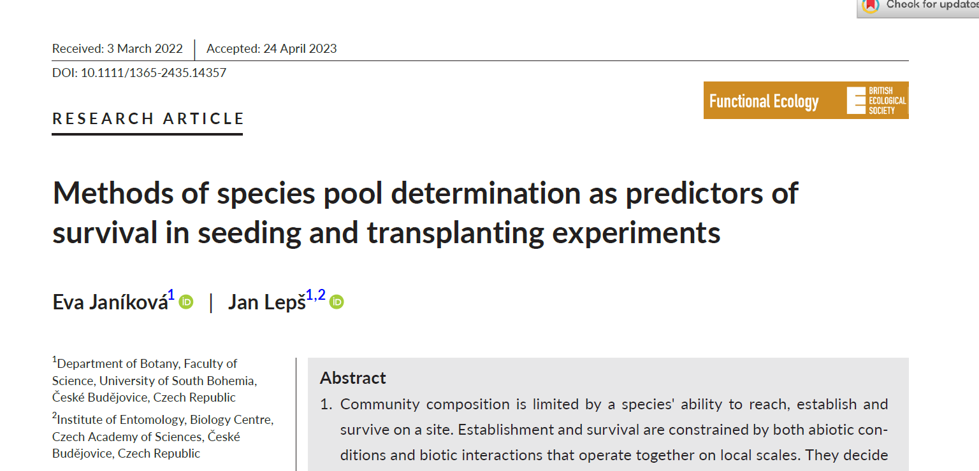
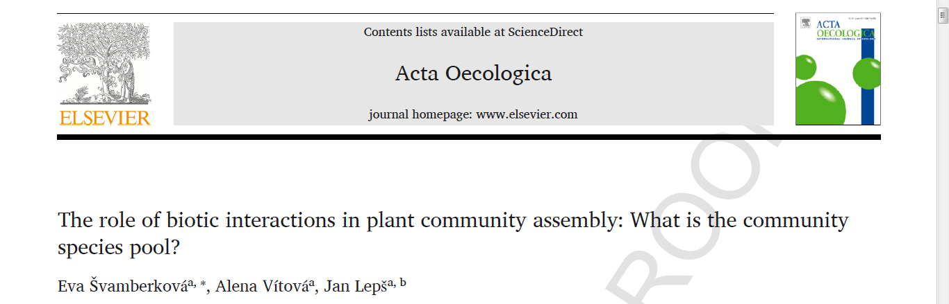
Identification of species pool acoording to Butay and disentangling abiotic abd biotic limitation
Experimental sowing (removes the dispersal limitation)
(all the species able to reach a site should be used (☺)

Slide 36
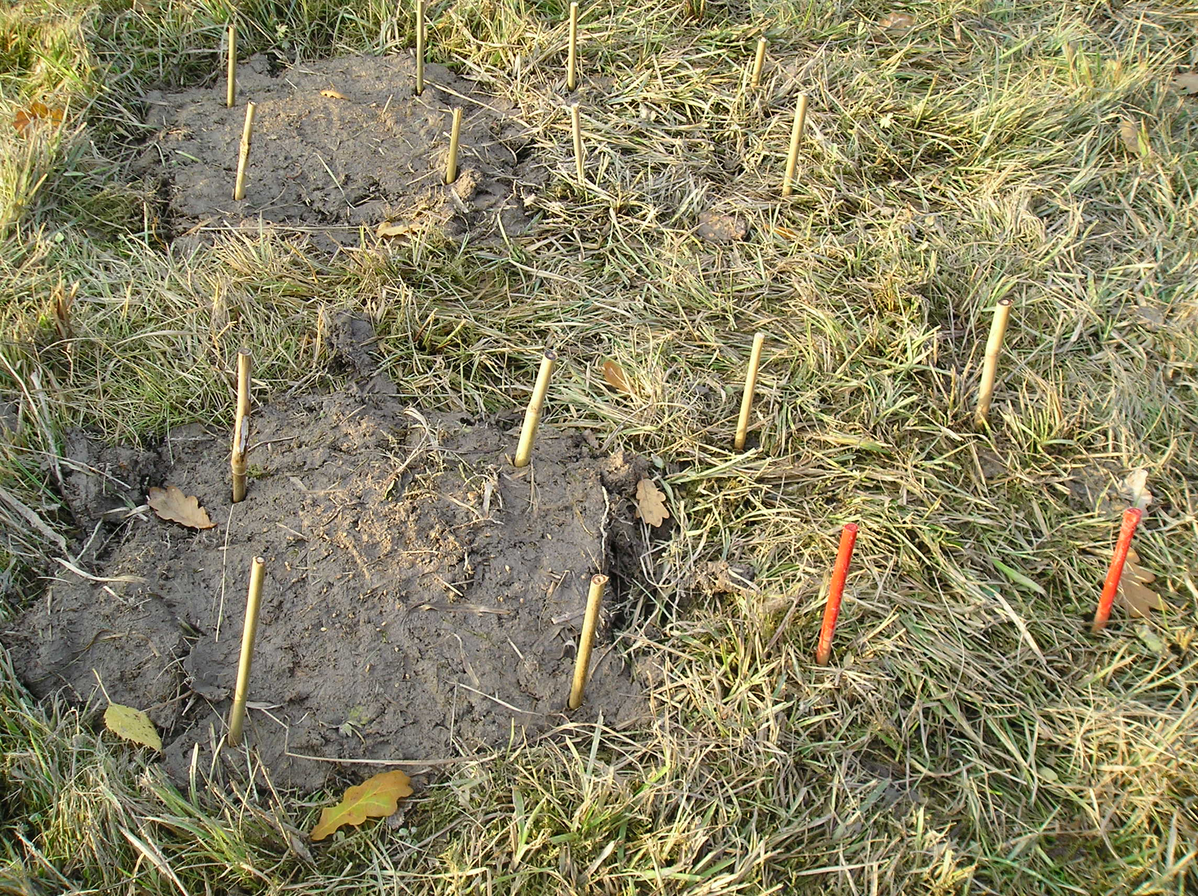
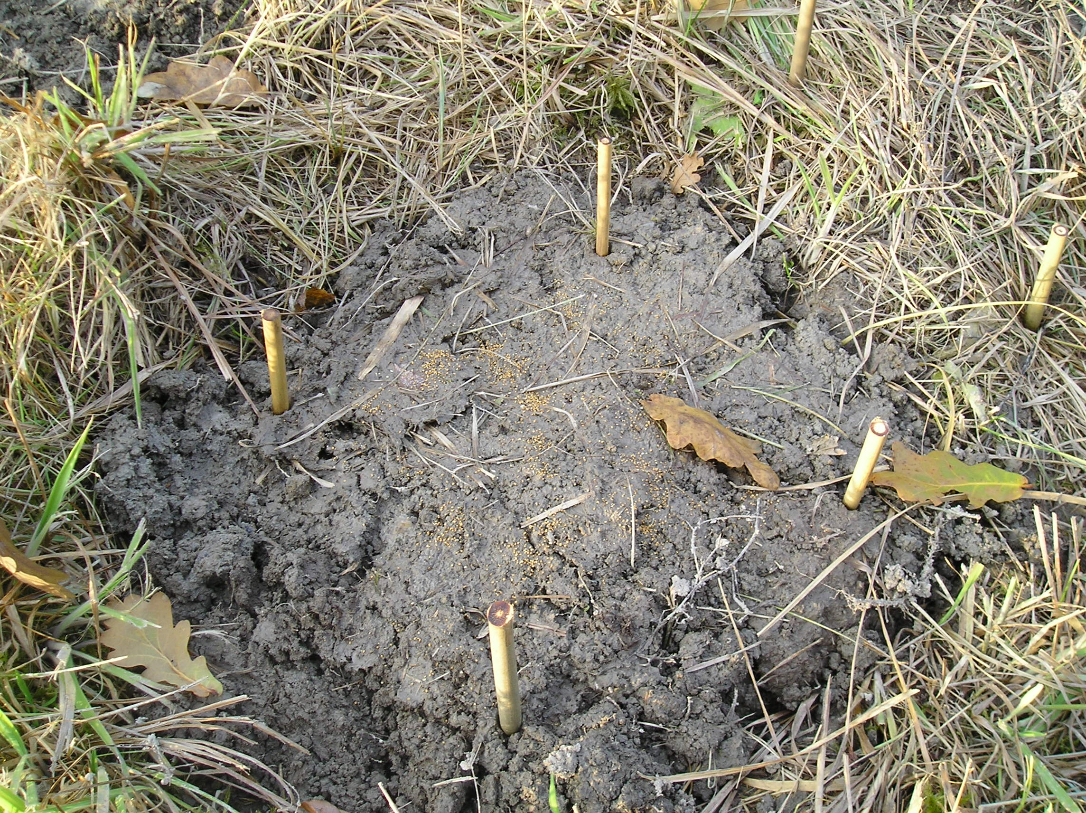
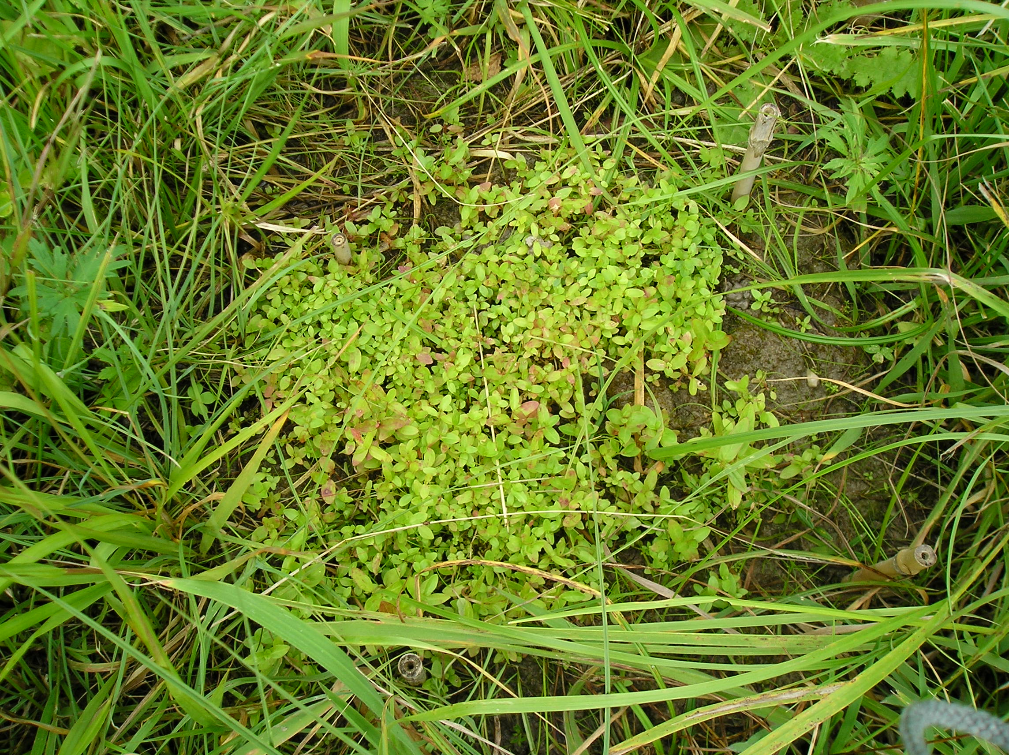
Gap and control.
Hypericum hirsutum seeds in gap
Eva Švamberkova experiments in a wet meadow
Obr. 4: Seedlings of Hypericum hirsutim in gap.
Švamberková, E., Vitova, A., & Lepš, J. (2017). The role of biotic interactions in plant community assembly: What is the community species pool?. Acta Oecologica, 85, 150-156.

Slide 37
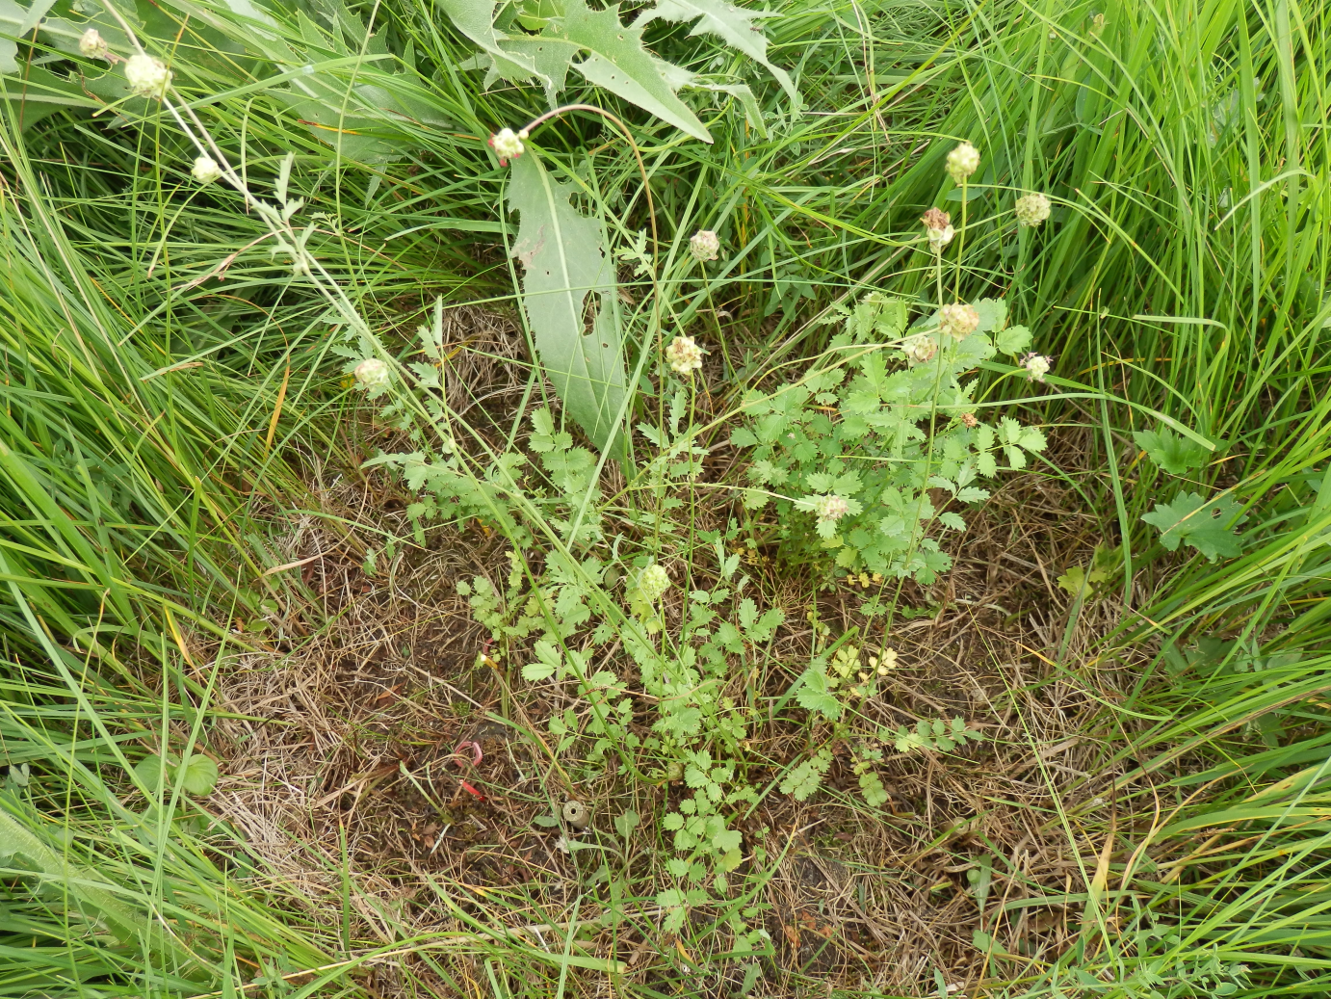

Slide 38
In gaps, i.e. without competition, species with extremely low Beals, and Ellenberg values far from the CWM of the community were able to establish – e.g. Sanguisorba minor in this wet meadow - its absence in a community is clear consequence of competitive exclusion.
Beals and Ellenberg are good to predict species success in intact vegetation, but mostly fail in gaps
If the biotic interactions are estimated on the basis of species pool according to Zobel (delimited on the basis of co-occurence), the importance of biotic interactions is underestimated

Slide 39
Dispersal limitation
as demonstrated by sowing experiments

Slide 40
Basic idea
Should a species be solely dispersal limited (i.e. its absence is because the species was not able to reach the site, although it would be able to grow in the habitat), then after adding the propagules, the species should be able to established a viable population there. Nice in theory, practical application has some problems.

Slide 41
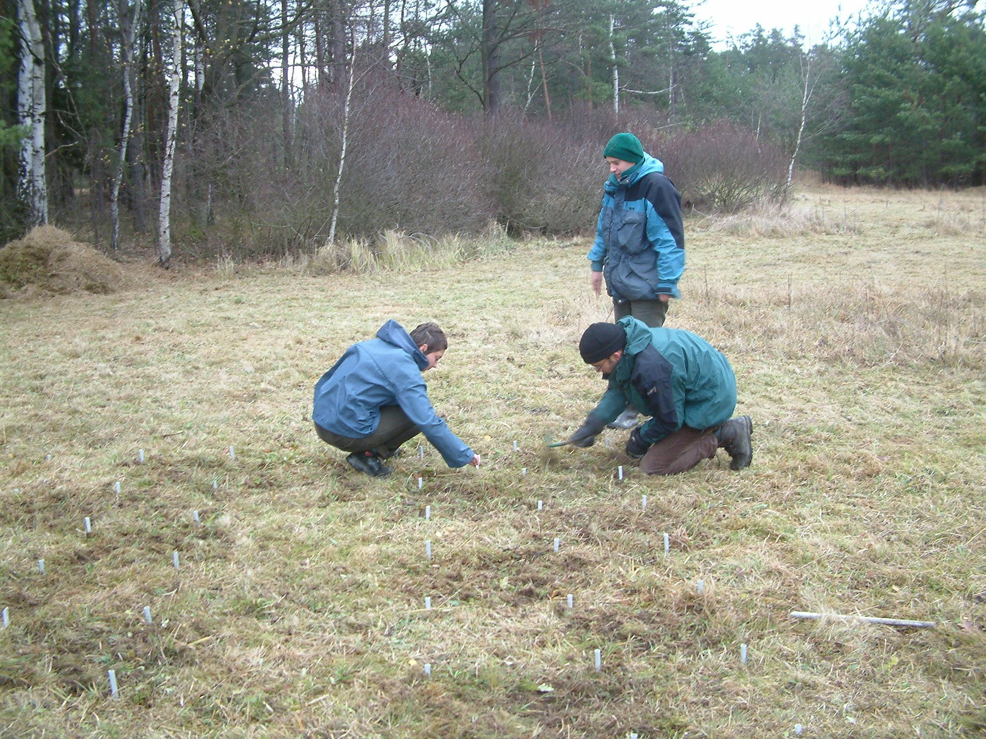
Vítová, A., & Lepš, J. (2011). Experimental assessment of dispersal and habitat limitation in an oligotrophic wet meadow. Plant Ecology, 212(8), 1231-1242.

Slide 42
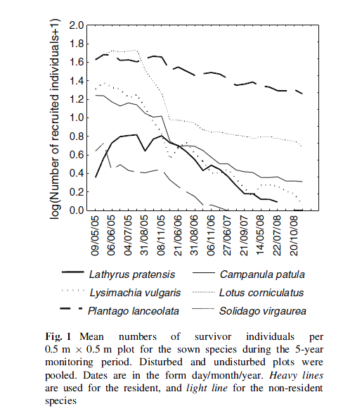
Vítová & Lepš 2011: Plant Ecology.

Slide 43
Dangers
False positive – a species do establish a population, which can even last several years, but is in fact not persistent.
False negative – for many species, the prevailing means of multiplication is vegetative propagation and seedling establishment might be limited to some (often extreme) years. The failure to establish from a sowing need not be a consequence of real habitat limitation

Slide 44
Predicting the presence of species in a site by environmental variables
The performance of models predicting species occurence from the measured habitat characteristics is better for species with good dispersal ability. This is probably because species with bad dispersal ability have many unoccupied but suitable sites, which increases the prediction error.

Slide 45
Ozinga, W. A., Schaminée, J. H., Bekker, R. M., Bonn, S., Poschlod, P., Tackenberg, O., ... & Groenendael, J. M. V. (2005). Predictability of plant species composition from environmental conditions is constrained by dispersal limitation. Oikos, 108(3), 555-561.
Predictability of species occurrence patterns was increased by a greater capacity for long‐distance dispersal, greater adult longevity and the capacity to build a persistent seed bank.

Slide 46
Clear distinction between dispersal and habitat limitation is difficult (perhaps impossible)
Fibich, P., Vítová, A., & Lepš, J. (2018). Interaction between habitat limitation and dispersal limitation is modulated by species life history and external conditions: a stochastic matrix model approach. Community Ecology, 19(1), 9-20.– high propagule pressure might compensate for less favourable habitat conditions – this is probably why species have broader niches in the center of their area of distribution

Slide 47
Dispersal limitation of individual species (or of species composition) vs. limitation of total species richness
Species composition can be limited by dispersal limitation, whereas species richness not. Species richness is dispersal limited, if establishment of a newcomming species does not cause competitive exclusion of a resident species – as a matter of fact, dispersal limitation has in some cases positive effect on species richness (as shown by invasions to islands).

Slide 48
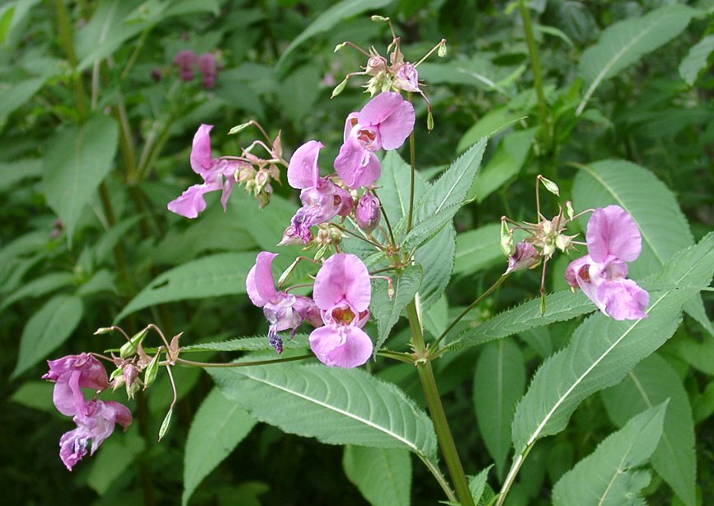
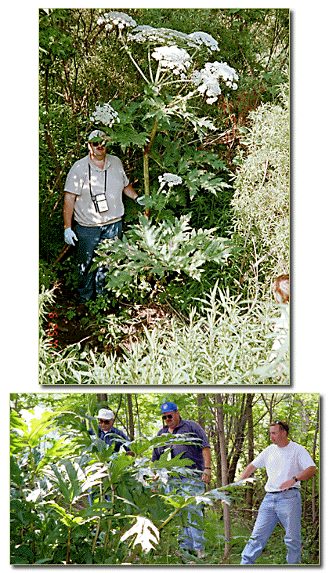
Two examples (Impatiens glanduliferra, Heracleum mandegatzianum), where adding a new species to species pool results in a decrease of actual community species richness.

Slide 49
Invasion ecology
Perfect opportunity to study the effect of increasing species pool on the composition and functioning of ecological communities
And some species survive in places (like islands) just because dispersal limitation of other plants that would outcompete them

Slide 50
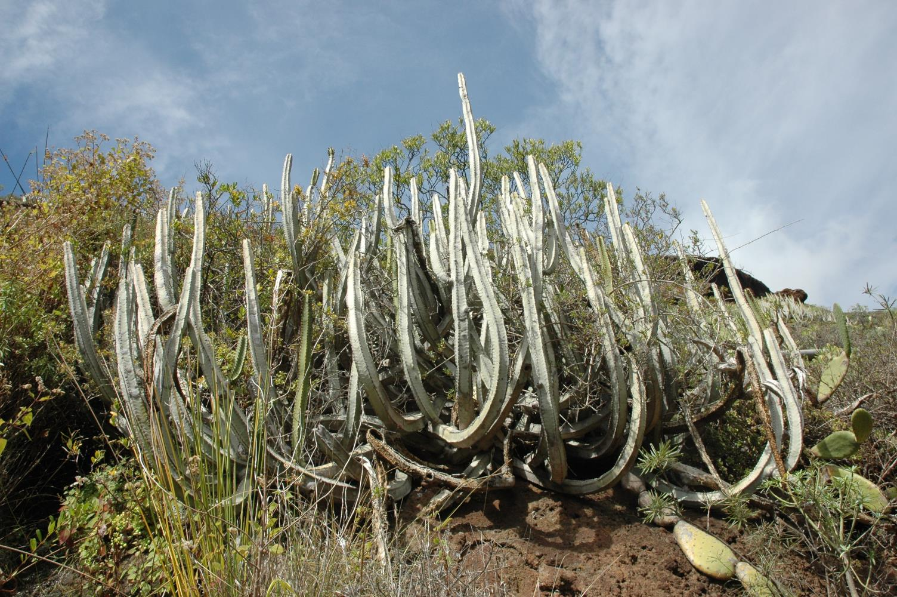
Euphorbia canariensis – closest relative are in South Africa

Slide 51
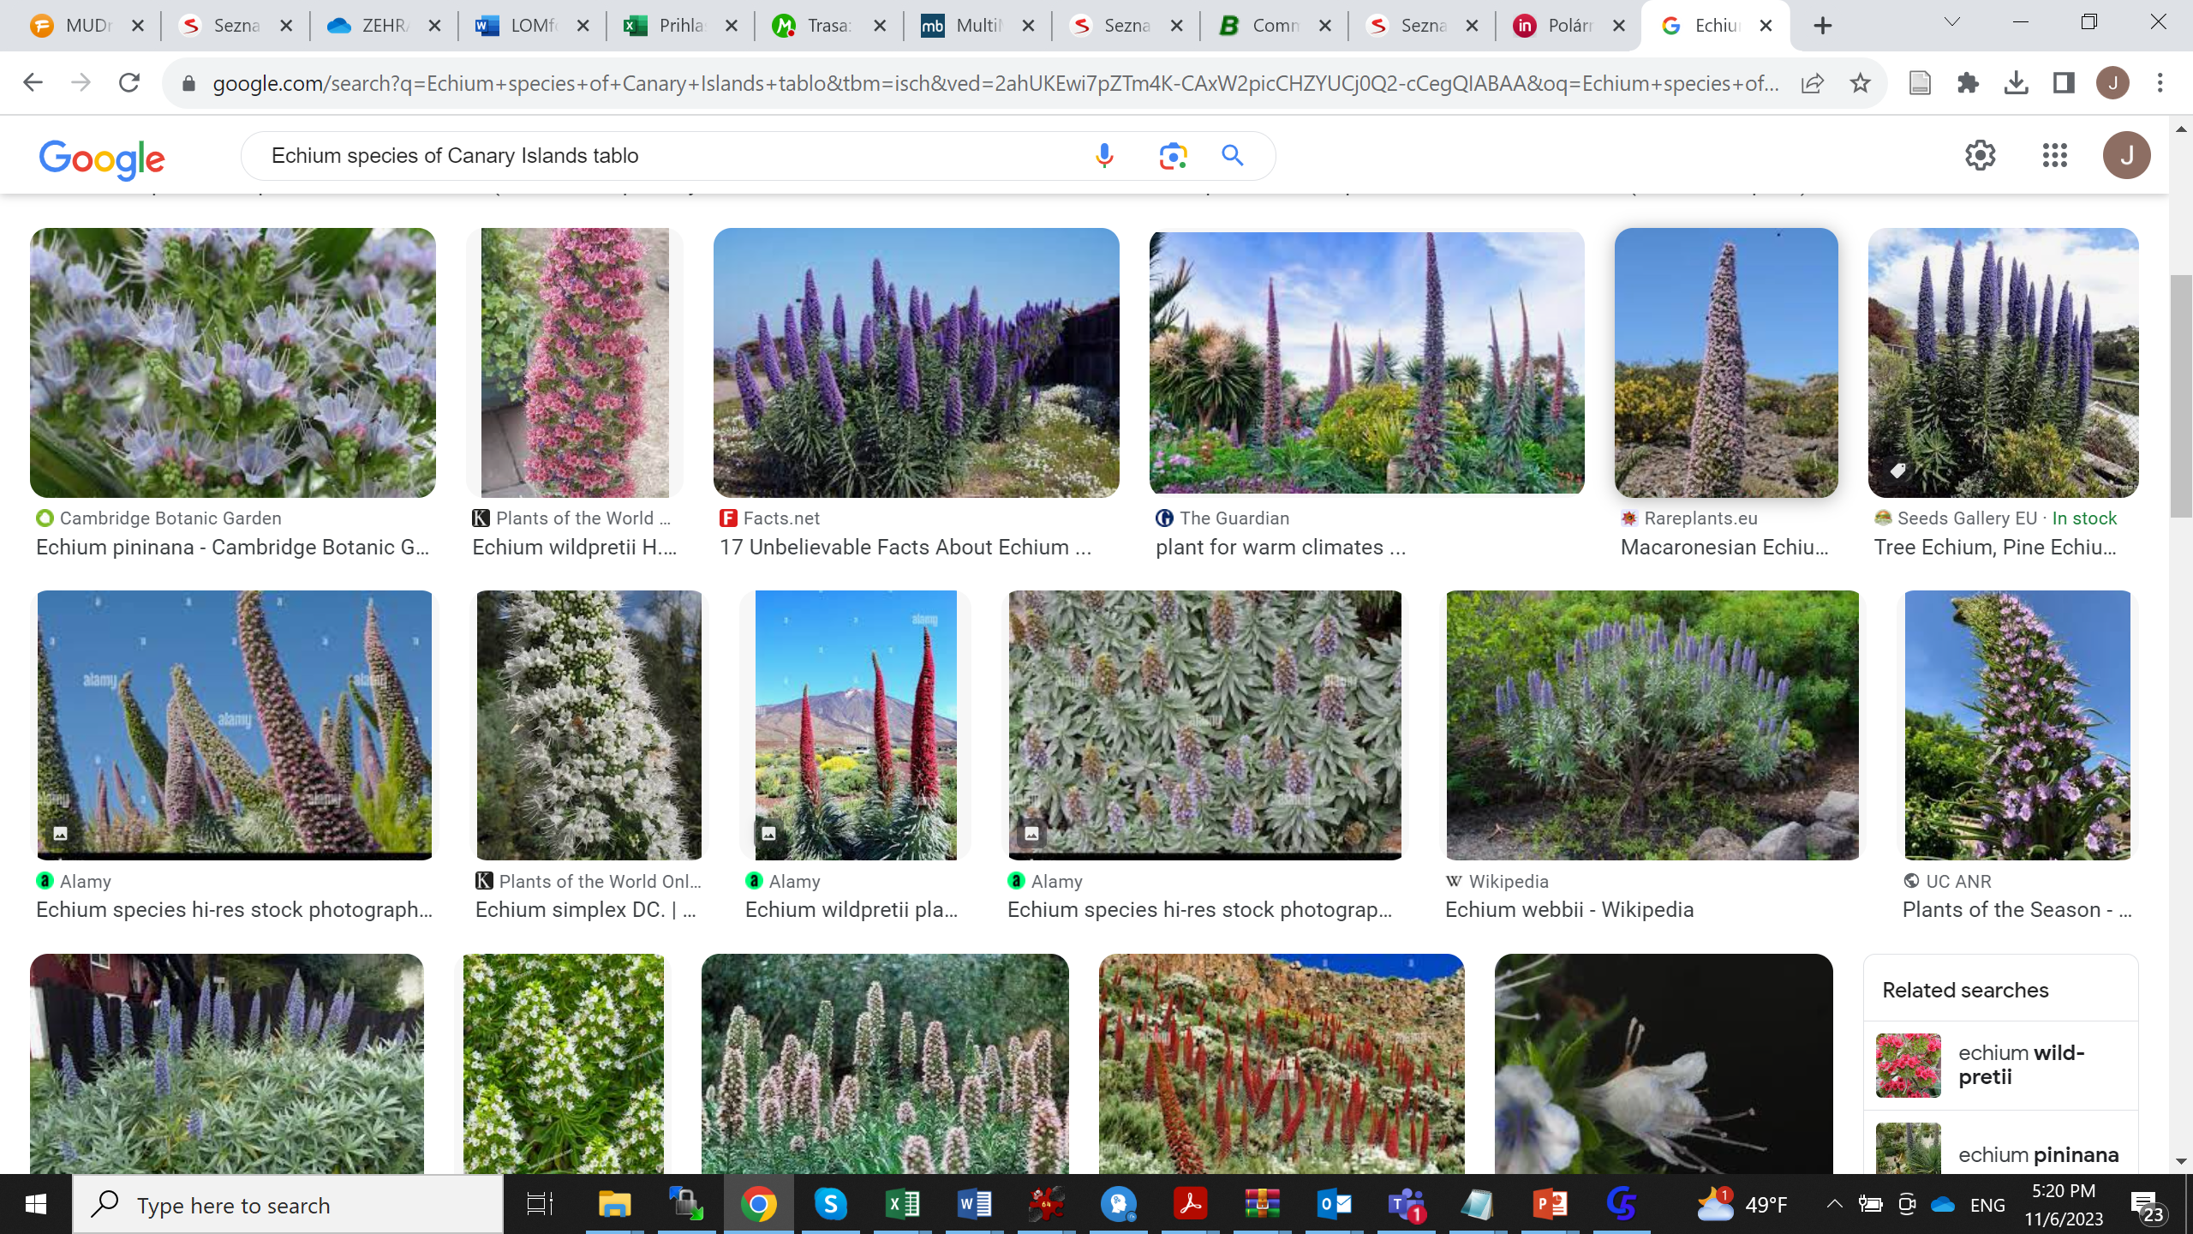
Explosive radiation on islands – Canary Islands – Example of Echium species

Slide 52
Theory of island biogeography
(Mac Arthur, Wilson 1963)

Slide 53
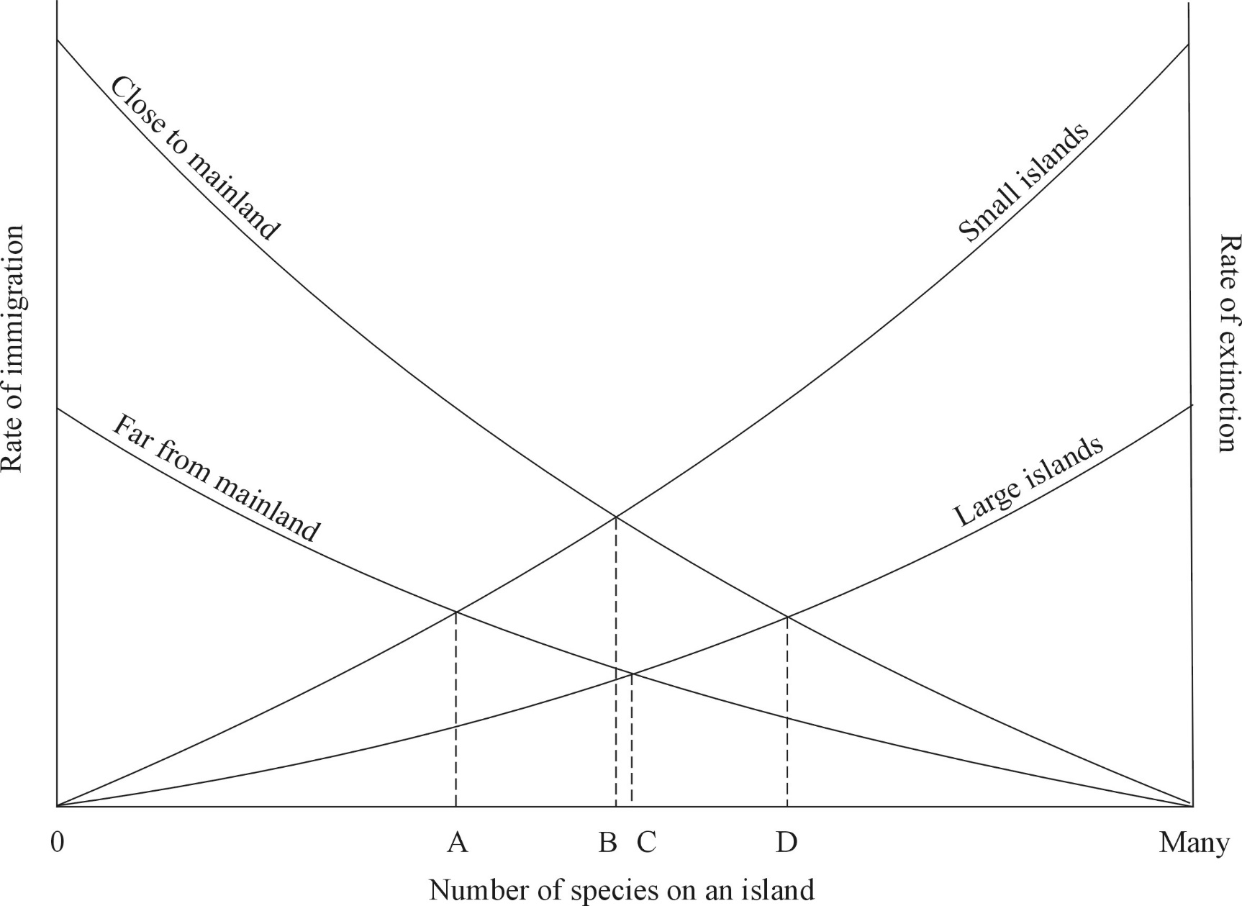
Generalization [to be seen in each textbook]

Slide 54
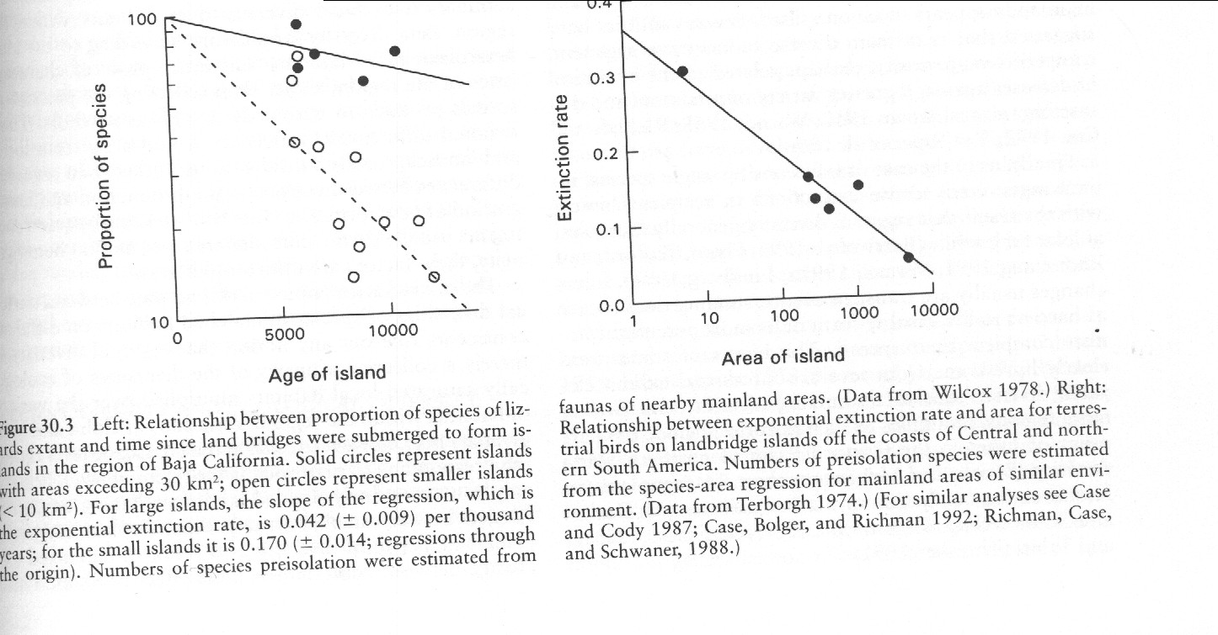
Theory of island biogeography
(Mac Arthur, Wilson 1963)
Effect of age, distance and area of an island on species richness

Slide 55
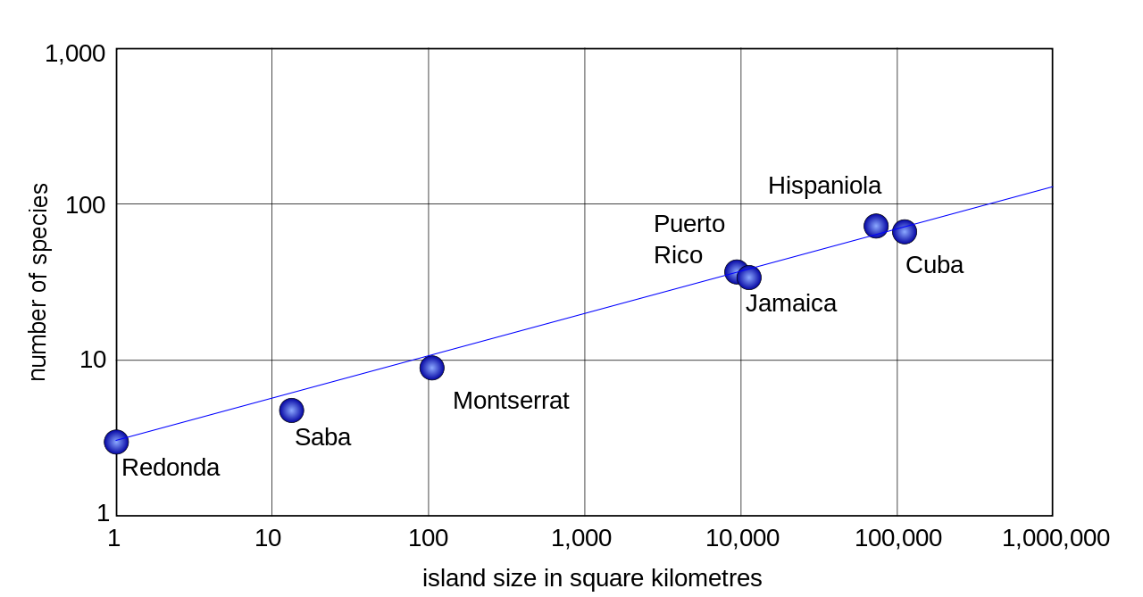
Results in classical species area relationship for islands (usually steeper then within a mainland)
Reptiles and amphibians – from Wikipedia

Slide 56
Assembly rules
The idea: the interspecific interaction (mainly competition) shape the composition of communities, so that we can detect some “regularities” in species composition (how are species assembled from the species pool)

Slide 57
To be left out
(for the mechanisms of species coexistence)

Slide 58
Limiting similarity concept
MacArthur, R and R Levins. 1967. The Limiting Similarity, Convergence, and Divergence of Coexisting Species. The American Naturalist 101(921): 377-385.
Species must differ to be able to coexist (comp. with the competitive exclusion principle) – so we expect overdispersion, i.e.trait divergence

Slide 59
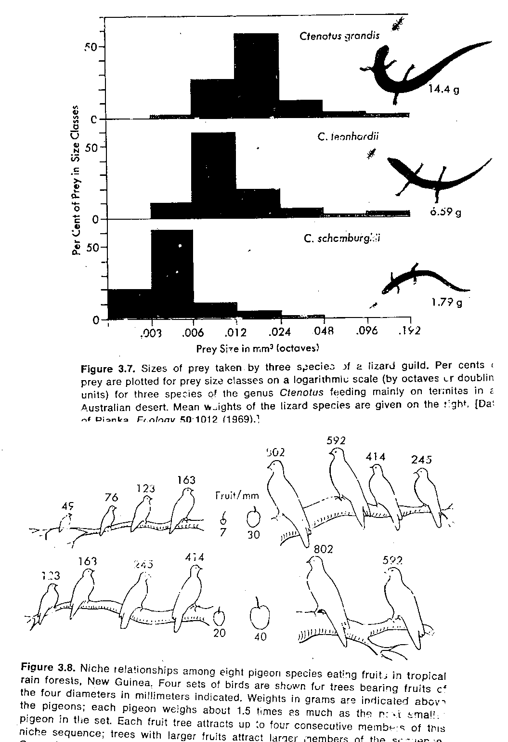
Classical niche differentiation

Slide 60
Environmental filtering
Environment selects species with similar traits
E.g. Dry environment species with low SLA
Consequently, we expect underdispersion, i.e. trait convergence

Slide 61
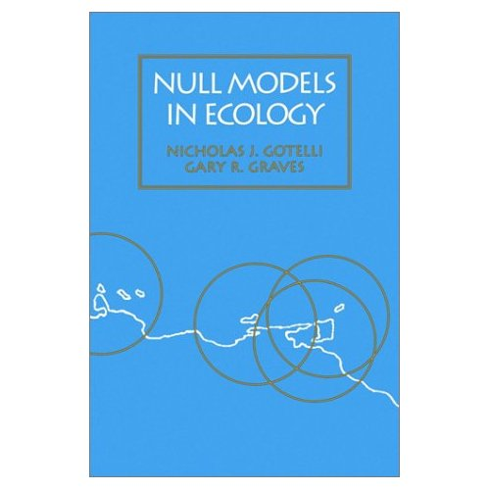
Tests using the null models
The idea: lets simulate the composition of null communities (i.e. communities where the tested factor is absent), construct the envelope and check, whether the real communities fall into this envelope
Smithsonian

Slide 62
“Niche limitation” by variance deficit
E.g. Wilson, J. B., Gitay, H. & Agnew, A.D.Q. (1987). Does niche limitation exist? Functional Ecology 1, 391–397.
The number of species in sampling units is more constant than if the species are distributed among the units randomly.

Slide 63
Testing for variance deficit: real data
 | Site1 | Site2 | Site3 | Site4 | Site5
Species1 |  |  |  | 1
Species2 | 1 |  | 1 |  | 1
Species3 |  | 1
Species4 |  |  | 1
Species5 |  |  |  | 1
Species6 | 1 | 1 |  |  | 1
Species7 |  |  |  | 1
Species8 |  |  | 1 |  | 1
Number of species | 2 | 2 | 3 | 3 | 3
Variance of no of species: |  |  | 0.3

Slide 64
Randomly reshuffle the positions of individual species [e.g. 1000 times]
 | Site1 | Site2 | Site3 | Site4 | Site5
Species1 |  |  |  | 1
Species2 | 1 |  | 1 |  | 1
Species3 |  | 1
Species4 |  |  | 1
Species5 |  |  |  | 1
Species6 | 1 | 1 |  |  | 1
Species7 |  |  |  | 1
Species8 |  |  | 1 |  | 1
Number of species | 2 | 2 | 3 | 3 | 3
You will get 1000 variance values and so also the envelope

Slide 65
Problems
No. of species is limited by number of individuals (so, in very small plots, the number of species has an upper limit given by number of individuals in a unit)
Variance excess – is there is a variability in a plot, then the variance will be higher than expected

Slide 66
Trait convergence vs. trait divergence
Environmental filter will probably select species with similar traits – > trait convergence
Competition (limiting similarity concept) will select species with differing traits -> trait divergence

Slide 67
Data needed
Species by site matrix (quantitative or presence absence)
Species by trait matrix
Various possibilities of null models: what to randomize?
And what is species pool?

Slide 68
Removal experiments
How will be the structure of the community changed by a removal of an (important) species. Will the species be replaced by a similare species? Will the dominance structure of the community change?

