Slide 1
Carex data

Slide 2
Seven Carex species coexisting in the Ohrazeni locality
Carex demissa Hornem
Carex hartmanii Cajander
Carex pallescens L.
Carex panicea L.
Carex pilulifera L.
Carex pulicaris L.
Carex umbrosa Host
Basic idea – what is the differentiation of the species enabling them to coexist at the locality

Slide 3
Two glasshouse pot experiments
Response to nutrients: Ramet of each species grown at three levels of nutrients
Reaction to competition – ramets of each species grown without competition and under two levels of competition (two densities of Holcus lanatus in the same pot)

Slide 4
We can use the data on the behaviour of the species in a manipulative experiment.

Slide 5
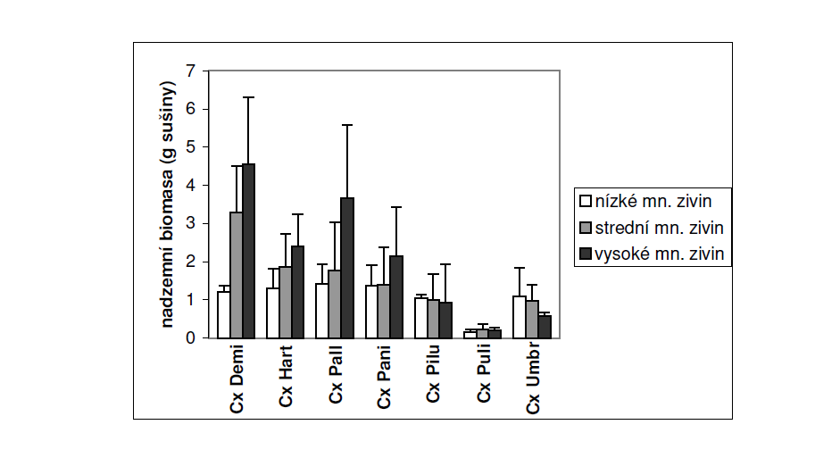
Response to nutrient levels (aboveground biomass)

Slide 6
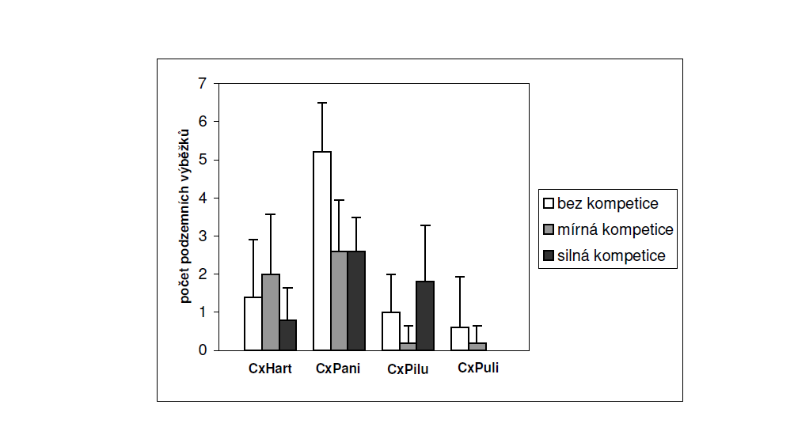
Response to competition – number of belowground stollons

Slide 7
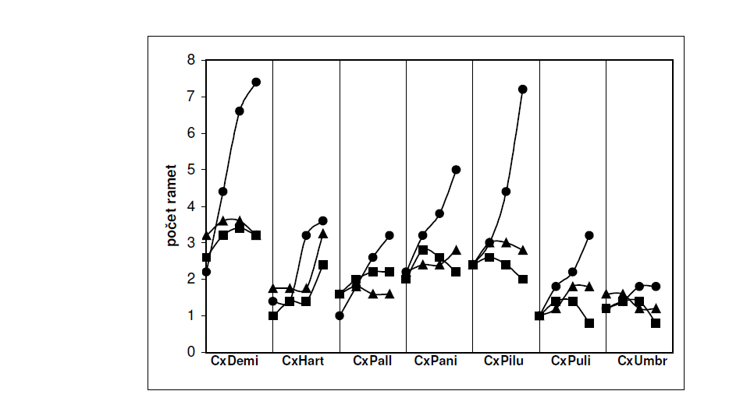
Response to competition – number of ramets in time

