Slide 1
Mutualism

Slide 2
Mutualism
relationship beneficial for both species (+,+)
in the presence of the mutualist species
  individuals live longer, grow faster, reproduce more... – increased fitness
each species is in fact selfish
  often unclear distinction of mutualists and predators/herbivores/parasites (mutual parasitism)
Types
  facultative vs. obligatory (for one or for both)
  based on tightness of the relationship

Slide 3
Mutualism
Terminology
Mutualism – mutually beneficial relationship (+,+)
  no matter how tight or obligatory is the relationship
Symbiosis – shift of meaning in time
  originally very tight realtionship,
  no matter if positive or negative
  later only positive relationship
  BTH try to bring back the original meaning

Slide 4
Models of mutualism
Not easy to make realistic model
  simple models do not work well
Lotka-Volterra model of competition
  negative effects are replaced by positive ones
presence of each species increases carrying capacity of the other species
  the effect of growth deceleration due to K is reduced
  K can be exceeded unlimitedly

Slide 5
Models of mutualism
Can lead to unrealistic outcomes
α < 1 – quite realistic behaviour, faster growth, stabilisation of N above K
α ≥ 1 – both populations grow unlimitedly (orgy of mutual benefaction)
α >> 0, r >> 0, α₁₂ ≠ α₂₁ – increasing fluctuation; in numeric simulations by difference equations, N switches to negative values...
Unrealistic assumption of linear increase of K with N of mutualist
Usually asymptotic – mutualist helps to overcome one limiting factor, but another factor becomes limiting (saturation in the benefits)
What is actually K? – simple constant, which includes various limitations (predators, infections, resources...)

Slide 6
Models of mutualism
Positive feedback
Math theory says it should destabilize the system
If positive feedback is controlled by negative feedbacks, positive feedback can lead to faster stabilisation
examples of other limitations
  if plants have enough nutrients thanks to mycorrhiza,
  they are still limited by competition for light
  if plants have enough pollinators,
  the seed production will not exceed certain limit
Mechanistic model would have to include multiple limitations to show which limitation is released by the mutualist and which stays (multiple components of K).

Slide 7
Problems of mutualism
To maintain a beneficial partner, I must offer him something
How to ensure that the partner which takes the reward also provides the service? And vice versa, how not to get tricked when providing the service?
  If cheating individuals (who save) will have higher fitness, there will be more cheaters in next generations
How to prevent others to take advantage?
In tight relationships:
How to reproduce together with the partner?
Dobzhansky: „Nothing in biology makes sense
except in the light of evolution “

Slide 8
Plenty of key relationships are mutualistic:
Plants + pollinators
Plants + mycorrhizal fungi
Plants + N fixing bacteria
Ruminants + celulose-decomposing bacteria
Termites + celulose/lignin-decomposing protozoa
Corals + algae
People + domesticated plants and animals
Plants + ants (various functions)
Fungi + algae (= lichens)
Fungi + Atta ants
Cells + (cyano)bacteria (=mitochondria, chloroplasts)

Slide 9
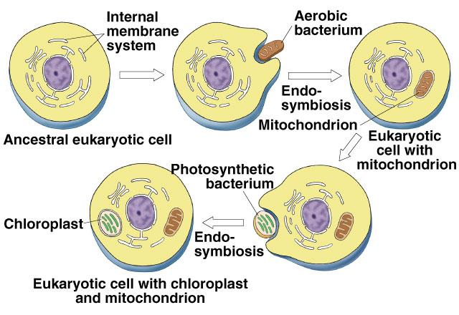
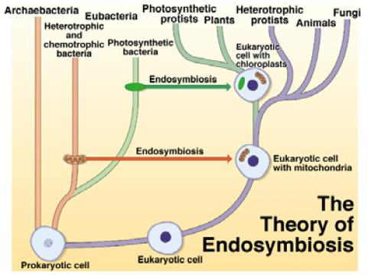
Endosymbiosis
Eucaryotic cells include mitochondria and chloroplasts with their own genetic information – obligatory mutualism with (cyano)bacteria
This relationship is so tight, that no one speaks about a cell as a mutualist community of three species…

Slide 10
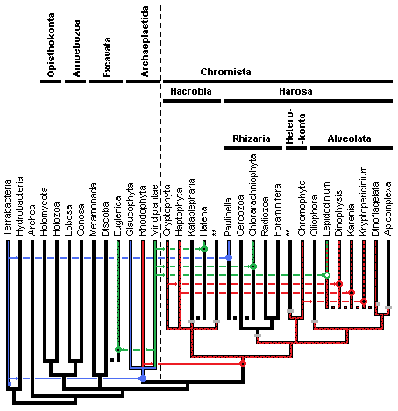
Endosymbiosis – chloroplasts
Multiple times in evolution
Primary (Cyanobacterium)
Plants and related algae
Paulinella
Secondary (Eucaryotic cell)
Chromists (multiple sources, multiple times lost)
Euglenas
Tertiary
A few Dinoflagellates
Serial (keep several types)
Lepidodinium
Cyanobacteria
Plants
2011

Slide 11
Plants
Plants are not mobile,
but they need to disperse their genetic information – seeds and pollen
Various options how to move
  abiotic – mostly wind
  biotic – often mutualism with animals
„Hire“ mobile animals to do the job
  pollinators
  seed dispersers
    but e.g. exozoochory is not beneficial for the animal

Slide 12
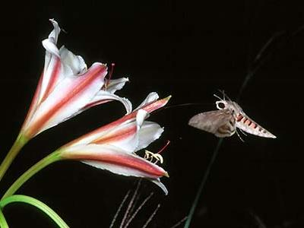
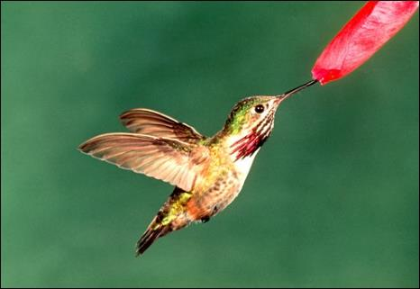
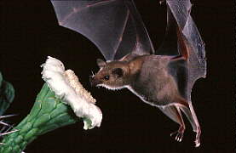
Mutualistic pollination

Slide 13
Mutualistic pollination
Not all cross pollination is assisted (e.g. abiotic)
Assisted pollination – chance to reach the conspecific flower is much higher than in unassisted pollination
Reward for pollinator – pollen on nectar
Evolutionary trade-off:
  either waste pollen in the air and hope at least some will hit the aim
  or let pollinator to eat part of pollen production
  overproduction needed in both cases
Pollinators – inscects, birds (hummingbirds), bats, small rodents or marsupials
Result – crosspolination, genetic advantage over selfpolination

Slide 14
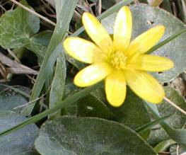
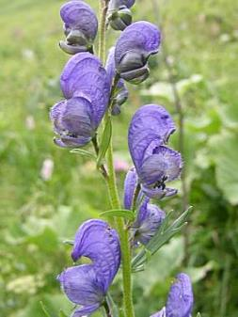
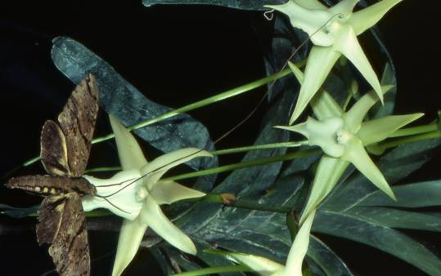
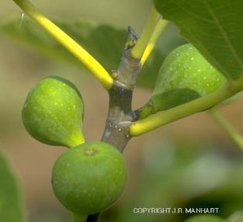
Mutualistic pollination
Various level of specialisation
  specialist pollinators increase chance of reaching
  conspecific individuals, but limit number of pollinators
Example of high specialisation: orchid Angraecum sesquipedale
  nectar in 30 cm long tubes
  moth Xanthopan morgani praedicta
Life cylcle of pollinator and phenology of plants must be synchronized (cf. hypothesised effects of global warming)
Figs + fig wasps
– větrobýl jedenapůlstopý

Slide 15
Figs and fig wasps
a favourite model of evolutionary biologists on mutualistic pollination and stability of mutualism
If Ficus had no fruits (not fertilized), all wasps would die.
Ficus must make sure that wasps would not eat all fruits

Slide 16
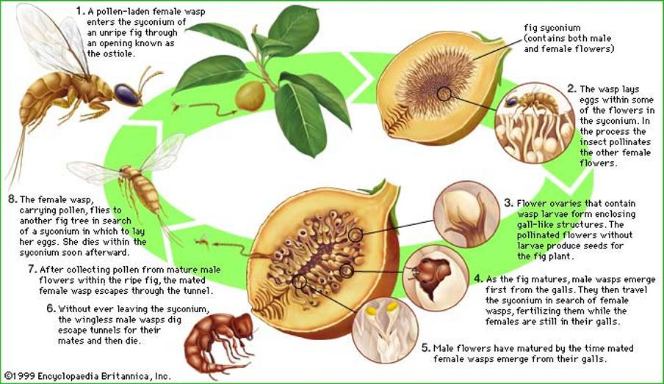
Figs and fig wasps
http://www.osel.cz/popisek_old.php?popisek=8382&img=1205405899.jpg

Slide 17
Mutualistic pollination
Susceptible to cheating
Pollen production is costly – can I offer it as reward? Pollinator should not take too much, and should really pollinate
Nectar – also costly (lot of sugar), how to do that no one else would steal it? How to protect against cheaters/robbers?
How to attract pollinators, but do not spend much nectar?

Slide 18
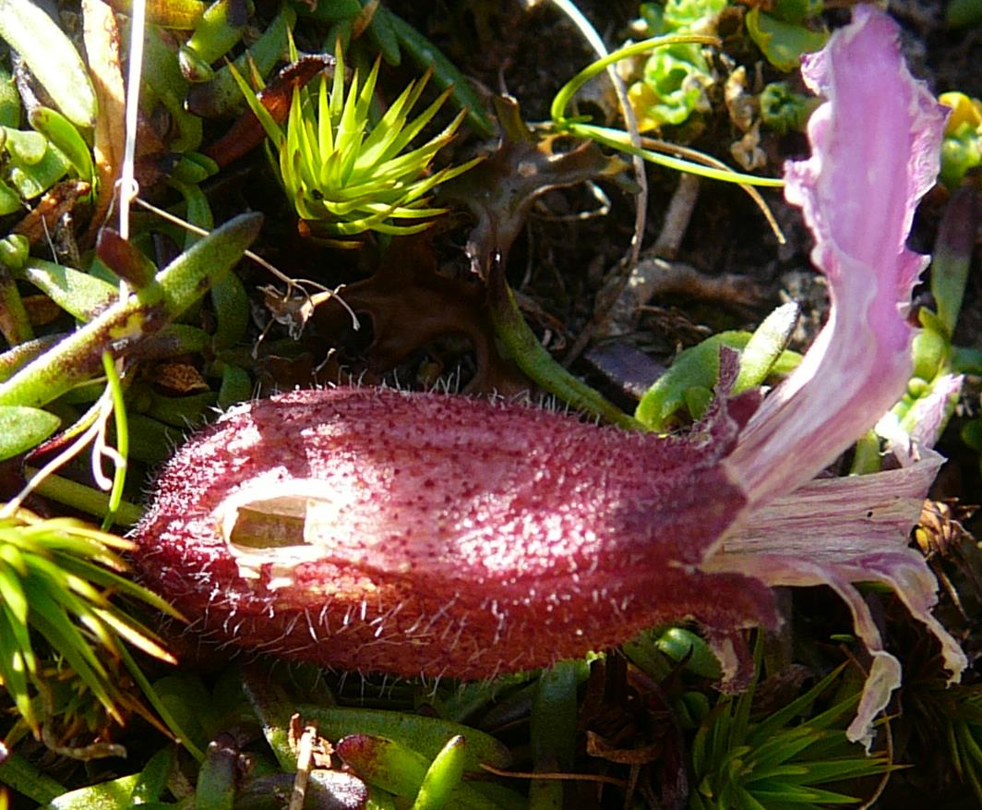
Mutualistic pollination – animal cheaters
Nectar robbers
Eat nectar but do not pollinate,
e.g. bite through calyx to overcome the long tube, but then they do not encounter stigmas and anthers
Saponaria pumila (Alps)

Slide 19
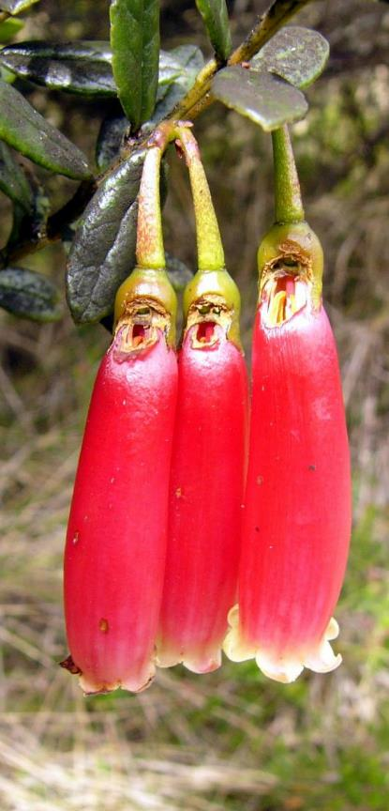
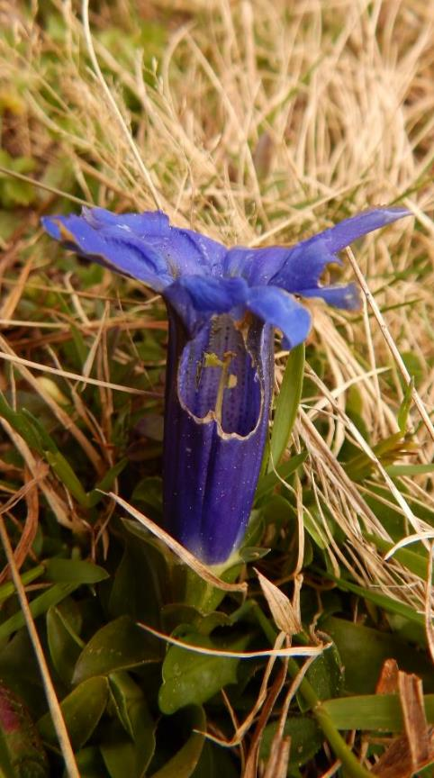
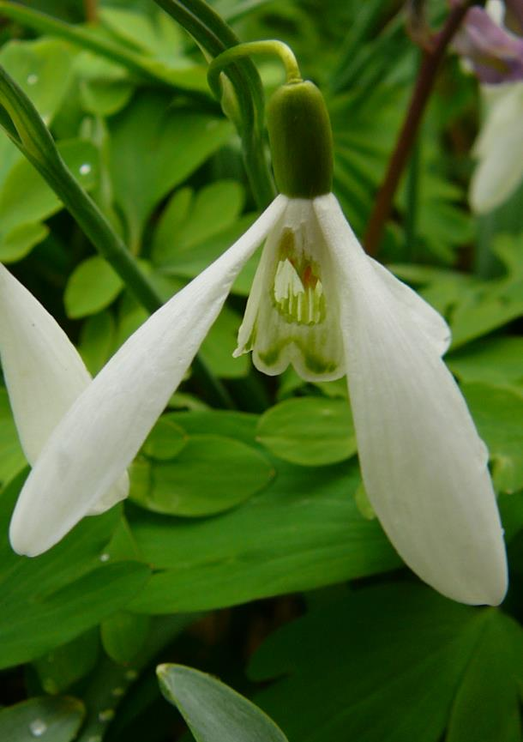
Mutualistic pollination – animal cheaters
Rhododendron
(Papua New Guinea)
Gentiana clusiana
Galanthus nivalis

Slide 20
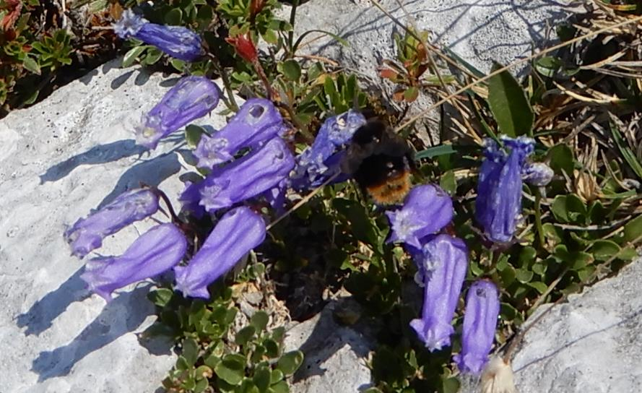
Mutualistic pollination – animal cheaters
Campanula zoysii (Alps)

Slide 21
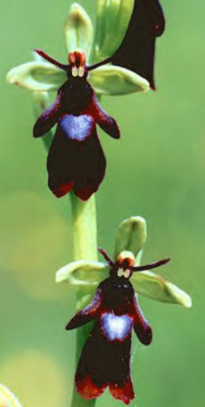
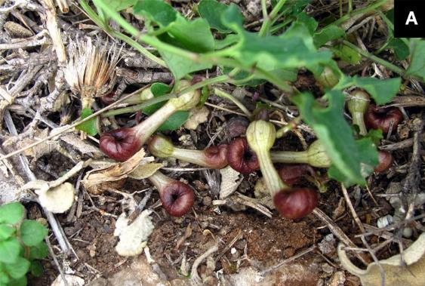
Mutualistic pollination – plant cheaters
Deceptive flowers – šálivé květy
do not offer any reward
pretend by colour, shape or scent (mimicry) that they offer nectar, other food (e.g. carrions), or mating opportunity
E.g. orchids, Aristolochia…
Aristolochia microstoma
attracting flies (Greece)
https://www.frontiersin.org/articles/10.3389/fevo.2021.658441/full
Ophrys insectifera
attracting bees

Slide 22
Seed dispersal
terms: -chory (seeds) × -phily (pollen or other)
Unassisted
  fall down (barochory)
  explosive (autochory) – e.g. Impatiens
  wind (anemochory) – either with flying mechanism, or extremely light, or tumbleweed (rolling whole plants)
  water (hydrochory) – in water streams, or just water on soil surface after downpour
Trade-off light seeds vs. nutrient storage

Slide 23
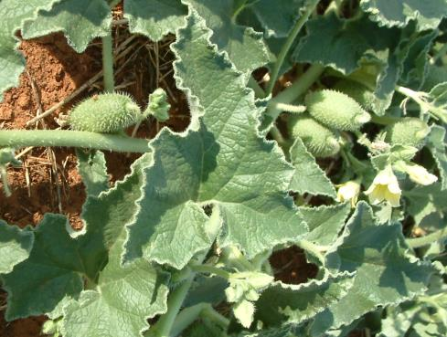
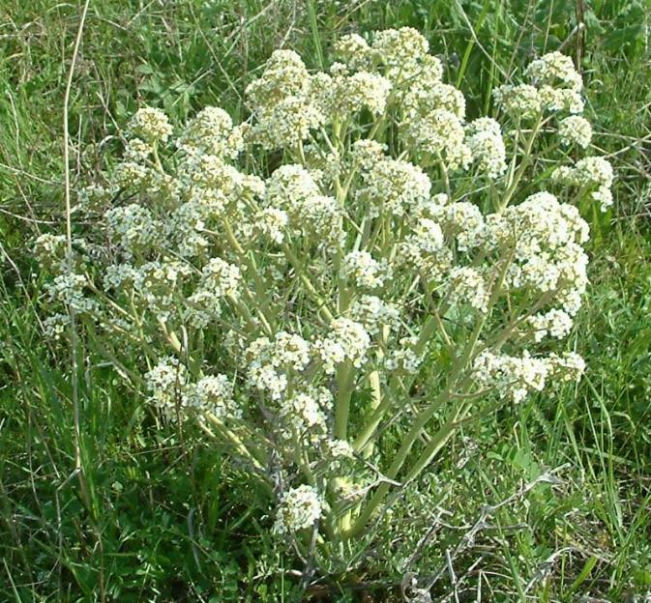
Unassisted seed dispersal
Ecbalium elaterium
– explosive fruits
tumbleweed
In several families, e.g.: Brasicaceae, Amarylidaceae, Amaranthaceae, Chenopodiaceae, Apiaceae
Crambe tataria

Slide 24
Assisted seed dispersal
Non-mutualist – exozoochory
  at least comensalism (+,0), but rather +,- (parasitism?)
Short-distance directed dispersal
Long-distance dispersal
  especially migratory water birds, also other animals
  (Krahulec F., Lepš J. (1994) Establishment success of plant immigrants in a new water reservoir. Folia Geobotanica 29: 3–14.)
Mutualistic – provide a reward,
  typically fleshy fruits with hard stone (for vertebrates)
  myrmecochory – elaiosome as a reward for ants

Slide 25
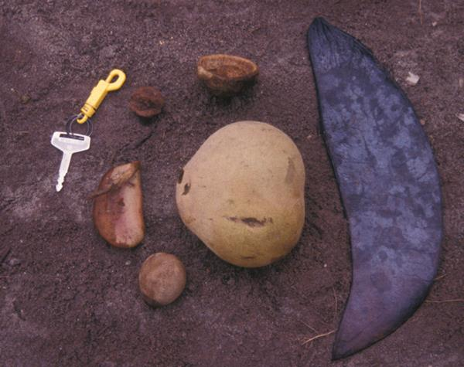
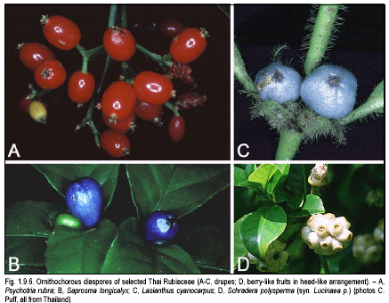
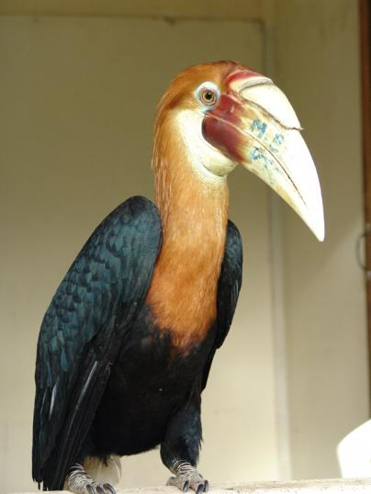
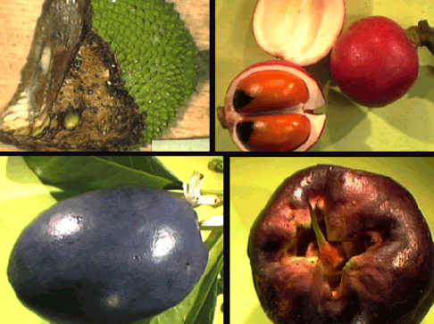
Plants live with mammals, birds, insects and other animals dispersing seeds

Slide 26
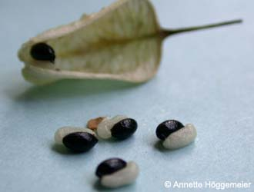
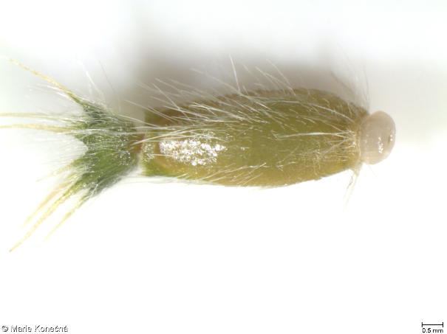
Myrmecochorous plants
Evolved independently about 100× across phylogeny
Elaiosome on seeds of Helleborus lividus http://www.botanik-bochum.de/html/pflanzenbilder/Helleborus.htm
Knautia arvensis
https://pladias.cz/taxon/pictures/Knautia%20arvensis

Slide 27
Mutualistic seed dispersal
Advantage – seeds are deposited in suitable sites
Viscum (a mistletoe) – Turdus viscivorus (bird)
  defecation on tree, seeds stick to the branch,
  no other way to ensure this.
Germination in excrement – more nutrients
Directed dispersal by ants

Slide 28
Mutualism or herbivory?
Cows – herbivores, eat also seeds (not selective)
  seeds which survive the passage through digestive tract can be dispersed far and germinate in nutrient rich microhabitat, which may compensate the loss
  some seeds require passage through digestive tract to break dormancy
If seed predators make winter storage
  some seeds are lost or forgotten
Elaiosome
  sometimes considered protection against herbivory

Slide 29
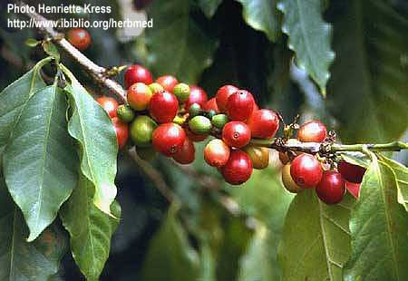
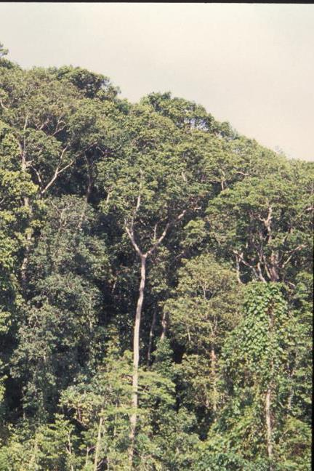
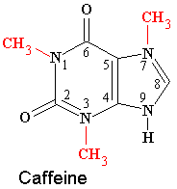
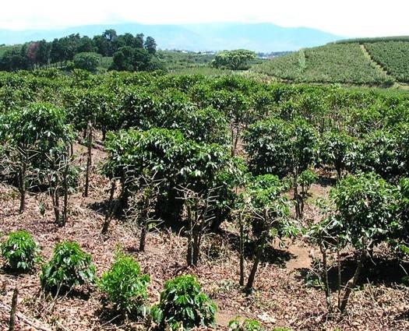

People live with domesticated plants and animals
Coffee a Homo sapiens live in mutualism where people helped coffee to win competition with other species and increas the range of distribution

Slide 30
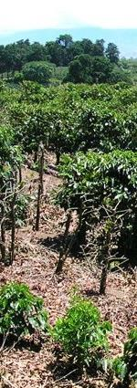
Domesticated plants and animals
Advantageous for whole population
(not for each individual)
Humans help coffee to disperse and grow
(and invest a lot of energy into this support)
but then fry (almost!) all seeds
In natural stable population (in average):
a single plant produces many seeds,
but just a single one survives until seed production
  People ensure this, and also help with dispersal

Slide 31
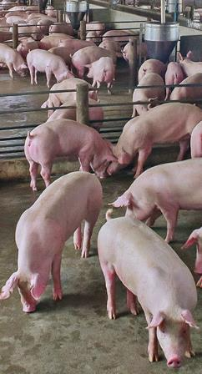
Domesticated plants and animals
Advantageous for whole population
(not for each individual)
Humans help pigs with food and reproduction,
(and invest a lot of energy into this support)
but then kill and eat (almost!) all offspring
In natural stable population (in average):
just a single piglet per mother survives
until the age of reproduction
The distribution range of both coffee and pig
is much wider than without people

Slide 32
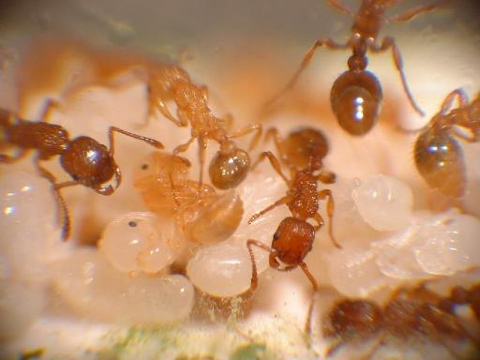
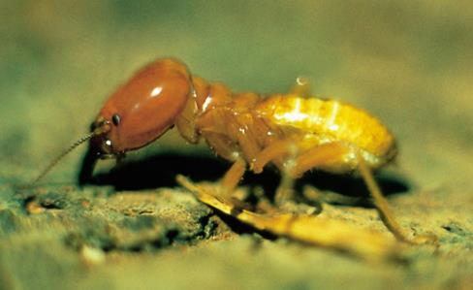
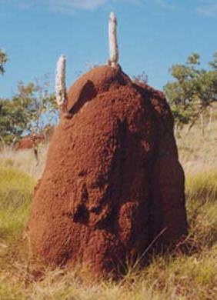
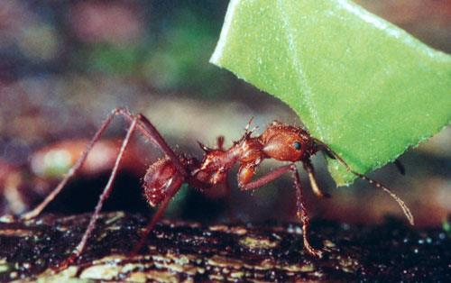
Domesticated plants and animals
Analogy in nature (often ants):
Growing „mushrooms“, aphids,
catterpilars of Phengaris alcon (rather parasitism)

Slide 33
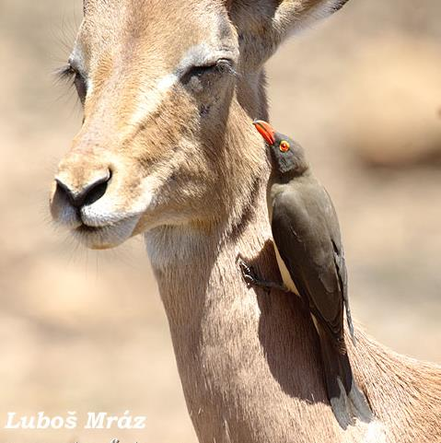
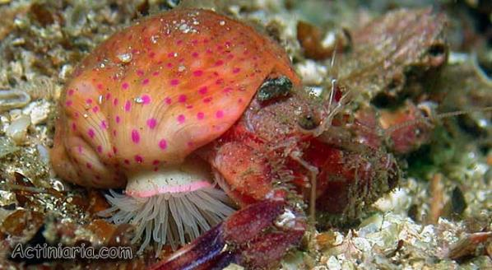
Mutualistic protection
Cleaning from ectoparasites
  oxpeckers (Buphagus erythrorhynchus)
    eat parasites, but also blood
    from open wounds,
    which they keep open...
  fish
Protection against
herbivores / predators
  often plants + ants
  hermit crab + sea anemone

Slide 34
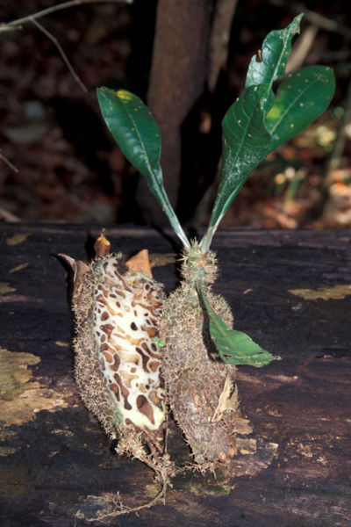
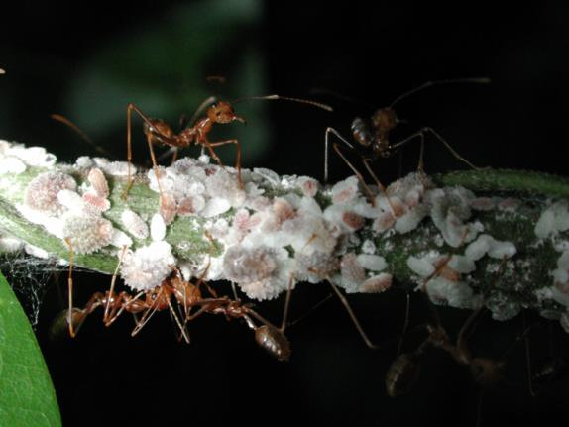
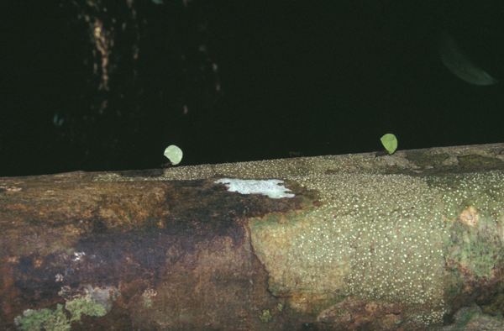
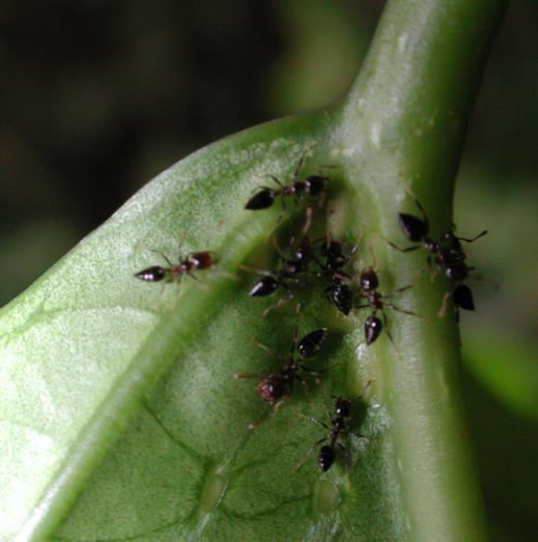
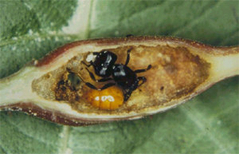
Mutualistic relationship of plants and ants (myrmecophily)
Ants and myrmecophilous plants (myrmecophytes):
- plant gets nutrients, defense against climbers and herbivores, ants get nesting place and food (extrafloral nectaria, protein bodies)
Ants and homoptera (aphids, scale insects)
- insects are protected from predators and parasitoids, ants gain food (redundant suger from phloem)
Ants (Atta) and fungi
fungi get optimal conditions for growth including food (leaves brought to ant nest), ants eat the „mushrooms“
Hydnophytum, Rubiaceae
Notes:
Myrmekofilní rostliny - hnízdící mravenci vytvářejí detritus z rozkládajícího se odpadu a hnízdního materiálu, jež přináší rostlině živiny, dále ochrana před liánami a herbivory

Slide 35
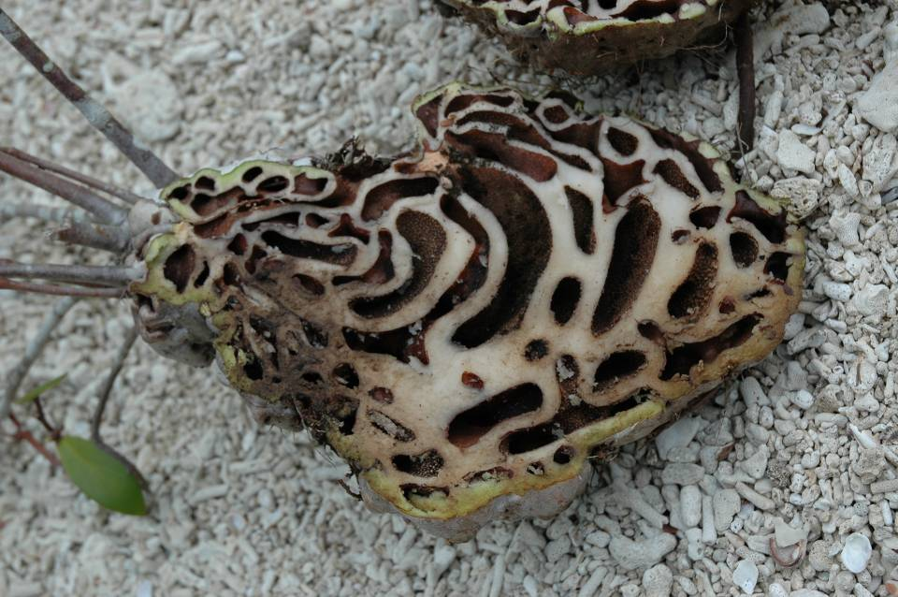
Ants can provide nutrients

Slide 36
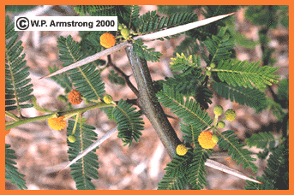
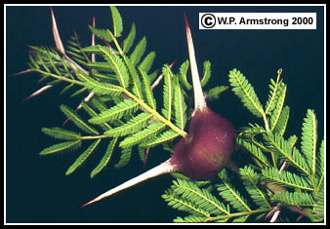
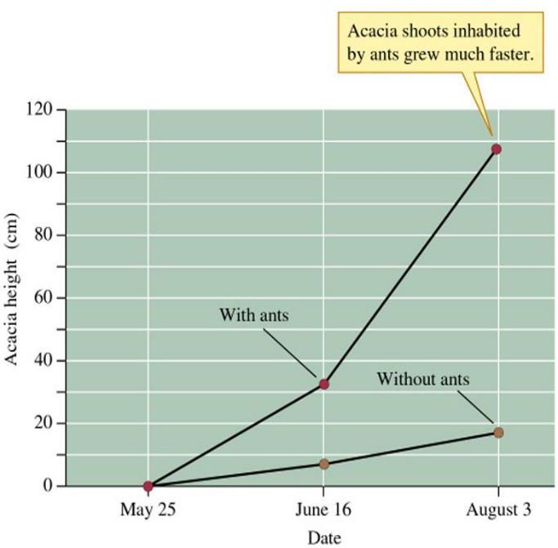
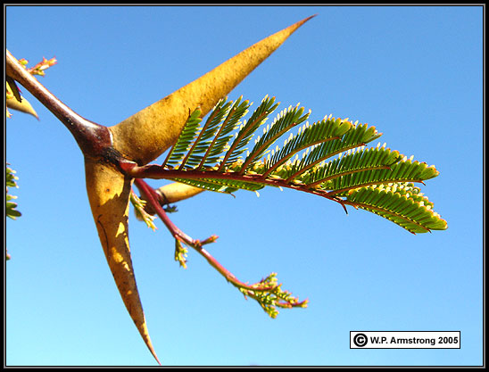
Mutualism of ants and Acacias
Acacias offer nesting places in modified thorns, ants protect them from herbivores so that Acacias occupied by ants grow better than unoccupied ones
Acacia macrantha
Acacia drepanolobium
Acacia cornigera

Slide 37

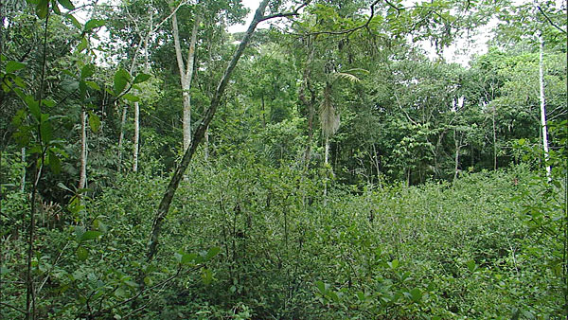
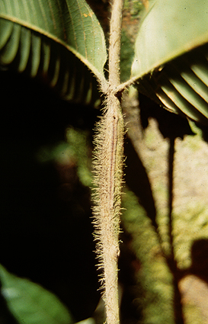



Devil's gardens
Monocultures of myrmecophilous tree Duroia hirsuta (Rubiaceae) in Amazon created by ants Myrmelachista schumanni killing other plants by formic acid (image shows necroses on leaves). D. hirsuta provides nesting cavities for ants. Each garden managed by single ant colony, some of them up to 800 years old.
Frederickson M.E., Greene J.M. & Gordon D.B. (2005):
'Devil's gardens' bedevilled by ants. Nature 437: 495-496.

Slide 38




„Cheating“ in mutualist relationships:
ant Crematogaster nigriceps and Acacia drepanolobium in Afrika
C. nigriceps lives on myrmecophilous Acacia, but can be outcompeted by other ant species if they reach the same tree
competing ant species colonize new trees by crawling on touching branches
the ant clips buds of host tree so that the branches would not touch other trees
the ant increase its chance of survival, but decrease fitness of host tree
Stanton et al. 1999
Crematogaster nigriceps

Slide 39

Mycorrhizal fungi live with vascular plants
Generally – fungus provides water and nutrients in Exchange for organic carbon
Ectomycorrhiza:
about 5000 fungi species interact with 2000 plant species
Arbuscular mycorrhiza (formerly endomycorrhiza): about 150 species of fungi and 90% of all plants (genetic analysis show that there may be in fact much more fungi species)
Ericoid mycorrhiza
Notes:
Find a fig. showing endo- and ectomycorrhizal plant taxa

Slide 40


Ectomycorrhiza
Fungi form hyphal sheath covering specially branched root tips, hyphae between cells of root cortex
infected roots are often in the humus layer
EM fungi can get P and N from nutrient-poor forest humus
fungi get sugars from plants
many common mushrooms
https://commons.wikimedia.org/w/index.php?curid=459872

Slide 41

(Vesiculo-)Arbuscular mycorrhiza
Hyphae penetrate cells where they form arbuscules (branched structures)
main benefit for plant – P
  also N, defense against pagogenes...
http://archive.bio.ed.ac.uk/jdeacon/FungalBiology/mycorhiz.htm

Slide 42
Mycorrhiza may not be beneficial for both
The relationship is mostly not physiologically obligatory, but ecologically obligatory.
The level of profitability for either of the partners depend on environmental conditions
  If nutrients are abundant, plant may consider the costs of mycorrhiza too high and tries to cut it down
Continuous gradient to mycoheterotrophy

Slide 43



ectomycorrhizal fungi: repeated loss of mutualism
original state in this clade of fungi is ectomycorrhiza (red),
but the mutualism was abandoned (black) several times

Slide 44
Nitrogen fixing
legumes (Fabaceae) + bacteria (Rhizobium)
Costly for plant, it is assumed that plants invest up to 12% of photosynthetic production; nitrogen fixing costs a lot of energy, therefore the bacteria need to be fed sufficiently
Advantage mainly in competition with plants without nitrogen fixers. But the soil enrichment eventually helps also to the competitors

Slide 45



Nitrogen fixing
legumes (Fabaceae) + bacteria (Rhizobium)
E.g. Alnus or Hippophae rhamnoides
+ actinomycetes (also bacteria) – Frankia
cs.wikipedia.org

Slide 46

Nitrogen fixing
legumes (Fabaceae) + bacteria (Rhizobium)
E.g. Alnus or Hippophae rhamnoides
+ actinomycetes (also bacteria) – Frankia
Frankia alni nodules
on roots of Alnus
http://www.bladmineerders.nl/gallen/fungi/frankia/alni/_752_2.jpg

Slide 47


Nitrogen fixing
legumes (Fabaceae) + bacteria (Rhizobium)
E.g. Alnus or Hippophae rhamnoides
+ actinomycetes (also bacteria) – Frankia
Cycas + cyanobacteria (Nostoc)
Coralloid roots - Cycas revoluta
www.flickr.com - George Shepherd

Slide 48
Digestion of plant biomass
Plants are „not ideal“ food
  difficult to digest polysacharides and other structural molecules
Microbial community („microbiome“)
in digestive tract of all animals
Especially important for herbivores and for specialists on hard plant tissues
  bacteria (mostly), archaea, protozoa and fungi
Most of mass of feces is the microbiome

Slide 49


Digestion of plant biomass
starch, (hemi)celulose, lignin (and their products)
synthesis of vitamins
ruminants
  rumen (first stomach) – especially bacteria
  host – continuous supply of fodder,
  – controls conditions of fermentation
  products of fermentation are the nutrition for the host
termites
  wide hindgut – especially protozoa
    unique genera to termites and cockroaches
  eat their own faeces – multiple digestion
  spirochaetes (bacteria) – mutualism with protozoans
    N-fixing

Slide 50






Aphid Acyrtosiphon pisum and bacterium Buchnera aphidicola from its mycetocyte
Gall midge Asteromyia carbonifera and its galls with fungus Bostryosphaeria
Termites and protozoan Trichonympha from their intestine where it digest celulose
Barkbeetles and fungus Ophiostoma clavigerum transported in mycangia
Czech link: https://vesmir.cz/cz/casopis/archiv-casopisu/2003/cislo-12/kurovci-milacci-evoluce.html
Janson et al. 2008, Evolution 62:997

Slide 51
Corals
Corals and dinoflagelates
„zooxanthella“ Symbiodinium in vacuoles
Corals are animals which can feed on plancton. Most of their organic carbon actually comes from symbiotic algae
The dinoflagellate has a safe place for life and photosynthesis.

Slide 52

photo M. Janda
Notes:
Bělení korálů, čili coral bleaching, je občasný úhyn korálů na velkých plochách, způsoben odumřením fotosyntetických symbiontů

Slide 53
Lichens
Fungi + algae or cyanobacteria
So tight relationship that there is a taxonomy of lichens, i.e. the pairs of species were considered as a single species, lichenized fungi
Enable colonisation of relatively unsuitable habitats
Problem – how to reproduce?
  sexually – just fungus
  asexually – izidia, soredia

Slide 54

Lichen Cladonia is able to compete with lingonberries (pine forest in Estonia)

Slide 55
Facilitation
usually used in plant ecology
one plant helps another one, (often:+,0).
  temporary
  not species specific
succession
  litter of one species prepares soil for another species
seedlings establishment
  shading usually means competition for light
  but it can protect seedlings against dessication

Slide 56

Cushion plants fill space (competition), but can help other plants to establish in harsh environment (facilitation)
Facilitation

Slide 57
Facilitation
More seedlings of a deciduous tree were found under a female juniper, compared to male juniper (in dry conditions in Spain). Why?
The shade of juniper protects from overheating both seedlings and frugivorous birds.
Moreover, the birds preferred to visit (and defecate) at the female junipers.

Slide 58
Evolutionary stability of mutualism once again
Dobzahnsky: „Nothing in biology makes sense except in the light of evolution “
  How to do it so that partner, which takes the reward, also provided the service?
  How to do it so that no-one else would profit?
In most types of mutualism, there are examples of one or the other partner to cheat/misuse/abandon the relationship –> predation (incl. parasitism, herbivory)

