Slide 1
Herbivory
Essentially predation, the prey is plant
Plant is predator:
parasites, mycoheterotophs, carnivorous plants
+ "Weirdly" feeding plants

Slide 2
Herbivory
grazers – typically cow on a pasture, deer in a forest, but also birds or mobile invertebrates, also mowing
not much specialized –> pairwise interactions irrelevant
Community ecology studies the effect of grazing on community of competitors,
competition of plants via shared grazer – adaptations to grazing
competition of grazers for resources (in general)
More complex relationships
frugivorous birds, pollinators: herbivory or dispersal?
predators – seed predators (kill whole individual)
Similar effect as grazers

Slide 3
Herbivory
parasites – a tree infected by caterpillars (or various other small herbivores, galls, aphids...)
Usually called just "invertebrate herbivores", distinction from grazers not clear, depends on herbivore's characteristics and research focus… (small, specialized, less mobile herbivores in plant-focused study)
It is reasonable to quantify number of infected trees (like in models of epidemy) rather than number of individual herbivores
The effective herbivore dispersal can be viewed as host-density dependent transmission of parasite

Slide 4
Herbivory
Different consequence for individual and population
Killing a seedling
Fatal for individual
Negligible for population – it would most likely die anyway
Partial defoliation of adult plant
Individual can recover
Seed production of population can be significantly reduced
The importance of losses depends on the life cycle and life history characteristics of the eaten species
remember sensitivity and elasticity analysis in matrix models
In many cases, the adverse effect is larger than proportional to the removed biomass (e.g. trunk damage, infection)

Slide 5
Herbivory and mutualism
Seed dispersal and pollination (detailed in next lecture on mutualism)
Consumed biomass is a cost for the service
Dispersal can be haphazard or targeted to suitable sites / flowers
Many seeds, but just one successful is enough to keep stable population
Clear adaptations – fleshy fruits, elaiosomes, nectar
Dubious adaptations – seeds and other parts are eaten, but some seeds are dispersed far
Quite high cost, but may still be worth for the dispersal
Seedlings germinated in cattle excrements may have an advantage
Squirrel always forgets some nuts (post-dispersal seed predation)
Pre-dispersal seed predation
efficient for herbivore (seeds are the best before ripening), very bad for plant

Slide 6
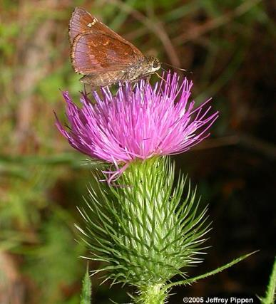
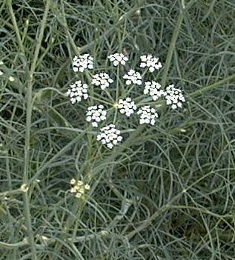
Herbivory and mutualism
Seed dispersal and pollination
Plant needs pollinators to find the flowers, but not those which would eat the seeds.
Consequences on compactness of inflorescence:
Asteraceae Apiaceae

Slide 7
Seed predation
Mostly harmful, especially invertebrate seed predators.
Escape in time – seed production just in some years
Escape in space – Janzen-Connel hypothesis

Slide 8
What and how can be eaten
Roots, rhizomes (e.g. aphids, rodents)
Leaves and/or stems
Large herbivores
Guilds of invertebrate herbivores – chewers – suckers (phloem, xylem) – skeletonizers – miners – galls
Reproduction structures (flowers, ovaries, seeds)
Seedlings

Slide 9
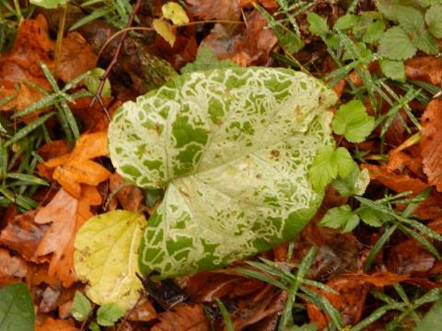
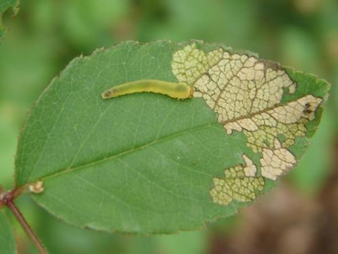
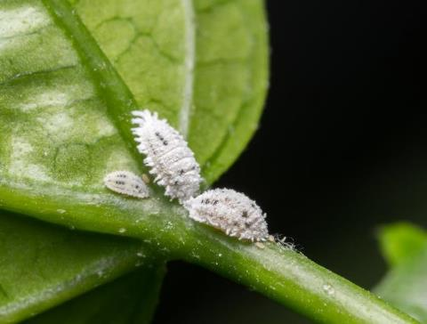
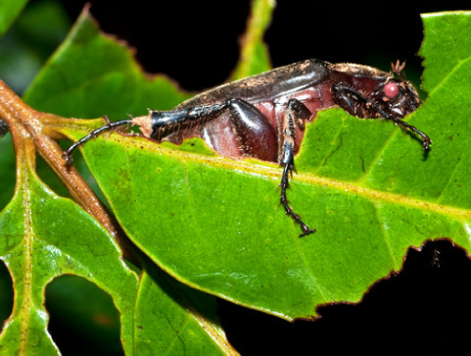
https://bugguide.net/node/view/51362
https://www.beefcentral.com/production/the-small-sap-sucking-insect-that-could-be-causing-pasture-dieback/
https://news.psu.edu/story/314397/2014/05/02/research/leaf-chewing-links-insect-diversity-modern-and-ancient-forests

Slide 10
How to study food specialization
Observations in nature:
Data of Vojtěch Novotný from Papua New Guinea
Food webs
Experiments:
Each individuum gets just one type of food and record fitness
Cafeteria experiments – offer more kinds of food
Various indices of food specialization

Slide 11
How to study food specialization
Food web: links of herbivores and plants:
chewers – generalists
miners and gallers – specialists
herbivore sp.
plant sp.
Volf et al. 2017

Slide 12
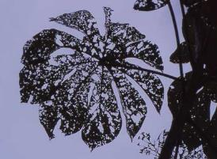
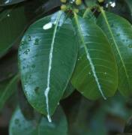
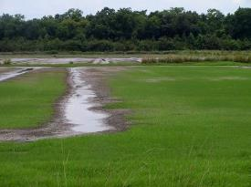
Plant response
Tolerance – compensation, regrowth
Some leaves are eaten, but other grow up fast
Avoidance
Defense
costly – trade-off
always present (depends on herbivorous pressure)
permanent vs. plastic – produce more thorns only if eaten
Escape in space or time
population level, not individual
get seeds beond (current) reach of herbivore
seed or biomass production in certain years only

Slide 13
Tolerance – compensation
In resource rich environment, high competition for light
Storage sugars are mobilized after biomass removal
Dormant buds can be activated (trees or clonal plants)
Eaten leaves reduce shading – the rest of "leaf population" photosynthetizes more (intra-individual competition for light).
Controversy: is there overcompensation?
if so, then only at the cost of storage

Slide 14
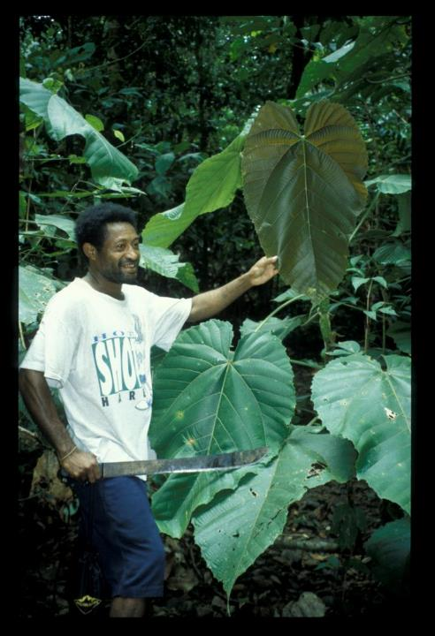
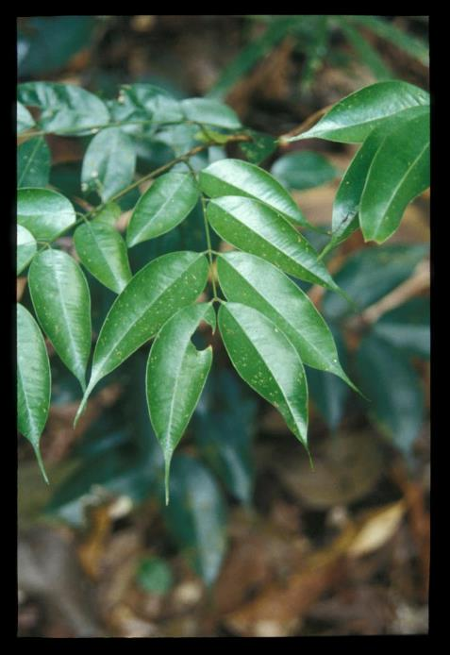
Apparent pioneers: tree species
leaves are large, thin, designed for maximum photosynthesis, short-lived and palatable to herbivores.
Macaranga sp., Euphorbiaceae, New Guinea, pioneer species
Mora gonggrijpii, Fabaceae, Guyana, primary species

Slide 15
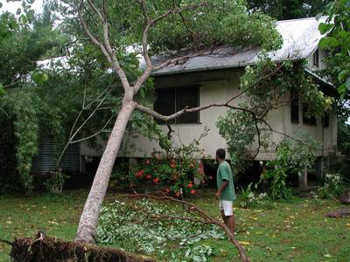
Pioneer trees: fast growth is what matters, and they grow VERY fast
Homalantus novoguineensis 4 years after planting a 1.5 m sapling (New Guinea)

Slide 16
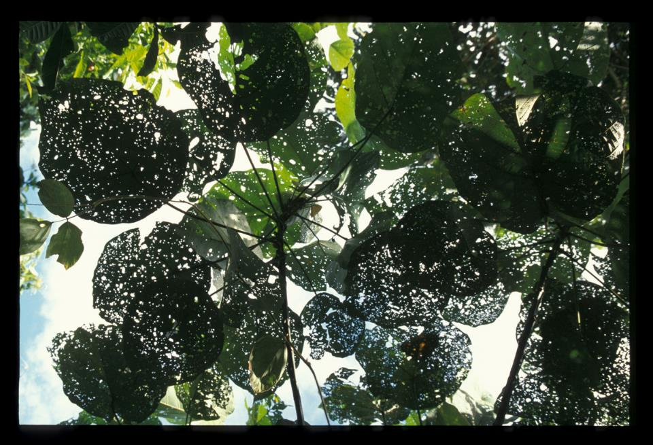
Pioneer apparent plants: the main enemy is other plants;
the herbivores are thus “ignored” (and tolerated)

Slide 17
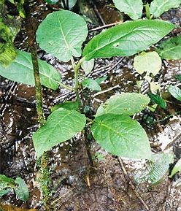
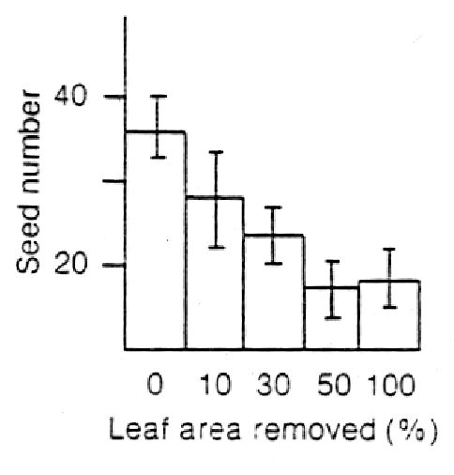
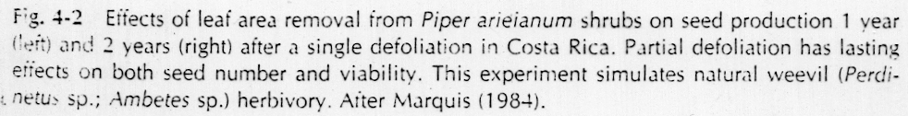
… although herbivory is still costly.

Slide 18
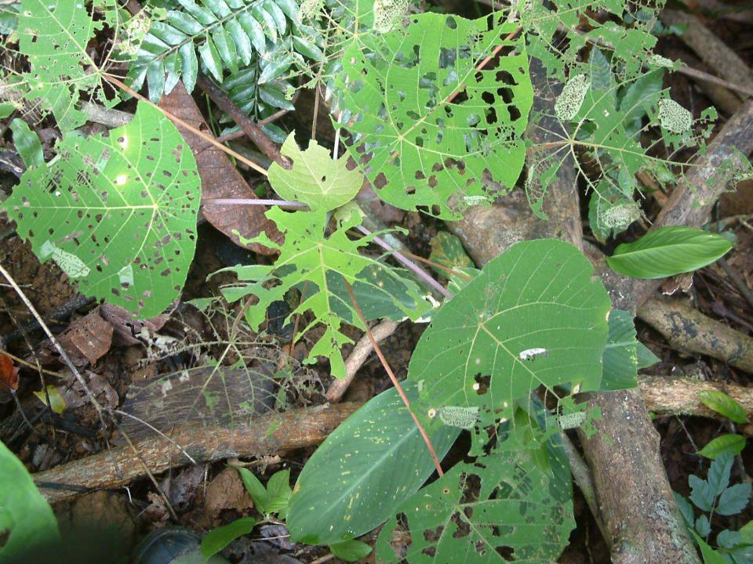

Slide 19
Plant defense
Mechanical
Tough leaves (monocots may be less eaten due to dense venation)
Thorns (against large herbivores)
Hairs (against invertebrates)
Chemical
Crystals (calcium oxalate, calcium carbonate, silicon dioxide)
Latex
Poisons (non-protein aminoacids, alcaloids, phenolic acids, terpenes, cyanogenic compounds)
Stingy hairs (againts vertebrates)
Biological
Mutualism with ants (domatia, extrafloral nectaria)
Plant volatile compounds (attract predators of herbivores)

Slide 20
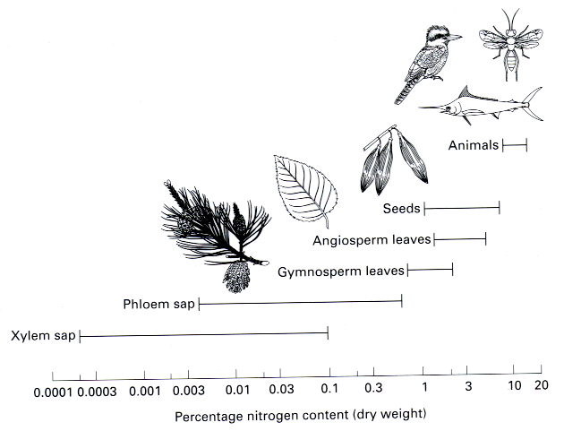
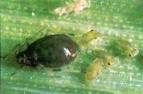
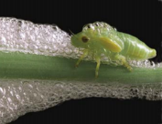
First line of defense:
plant body is constructed from very different materials than that of their herbivores

Slide 21
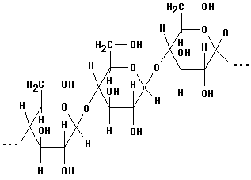
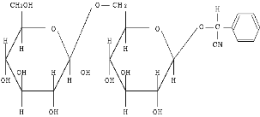
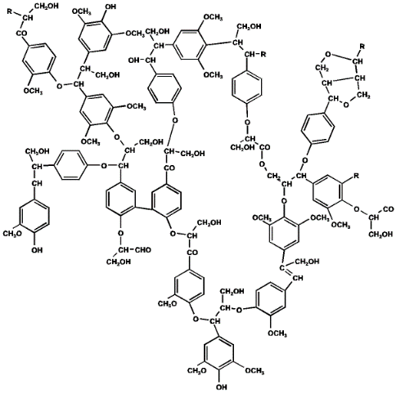
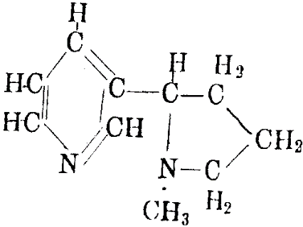
Chemical defense compounds:
quantitative vs. qualitative
amygdalin
(cyanogenic glycosides)
cellulose
nicotine
(alkaloids)
lignin

Slide 22
Ecological correlates of qualitative x quantitative mode of defense
quantitative
qualitative
Examples
cellulose
hemicellulose
lignins
tannins
silica
alkaloids
toxic amino acids
cyanogens
glucosinolates
terpenoids
Ecological traits
large polymer molecules
immobile
costly to produce
effective in large doses
present in long-lived tissues
present in apparent plants
effective against most herbivores
small toxic molecules
mobile
cheap to produce
effective in small doses
present in growing tissues
present in unapparent plants
effective against generalists

Slide 23
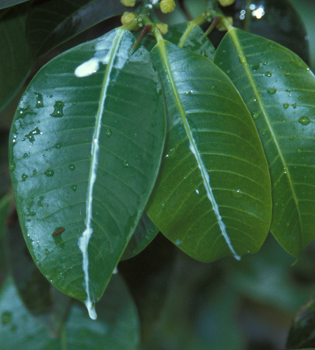
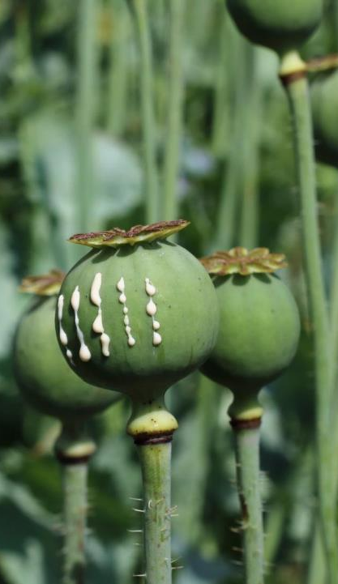
Latex – mechanical and/or toxic defense

Slide 24
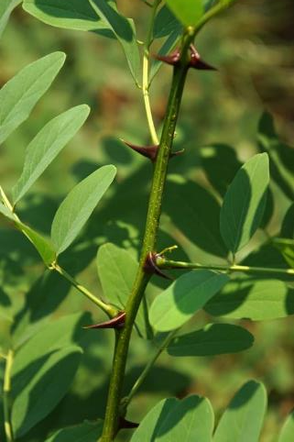
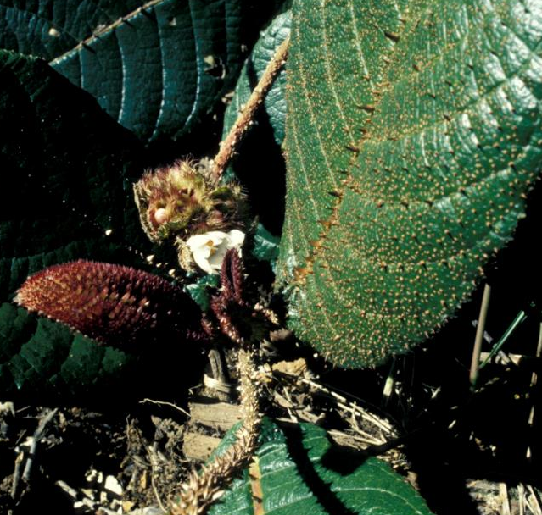
Thorns – mechanical defense

Slide 25
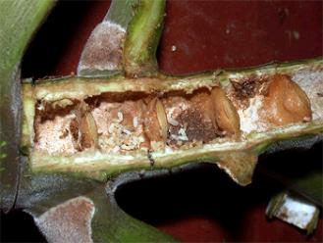
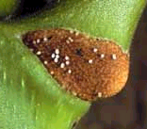
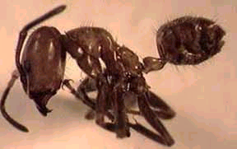
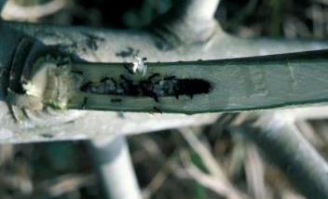
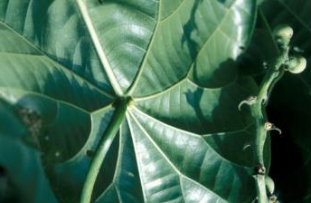
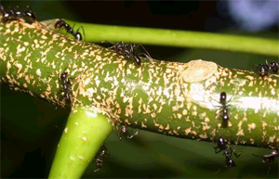
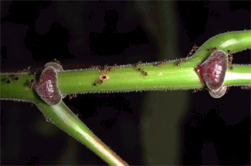
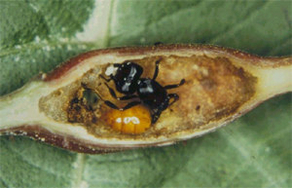
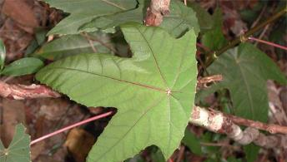
Cecropia plants - Azteca ants, America; glykogen-rich Müllerian bodies
Endospermum plants - Camponotus ants, New Guinea
Macaranga plants - Crematogaster ants, South East Asia
Mutualistic ants: biological defense

Slide 26
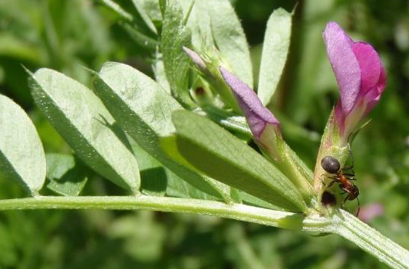
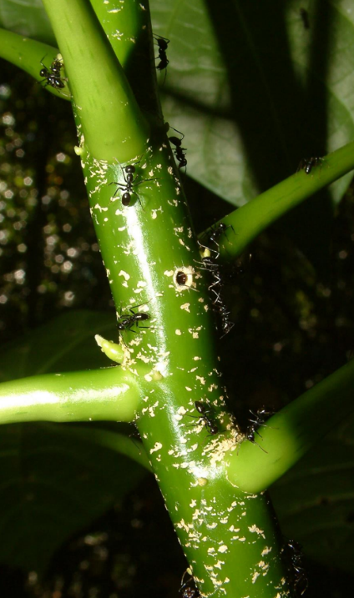
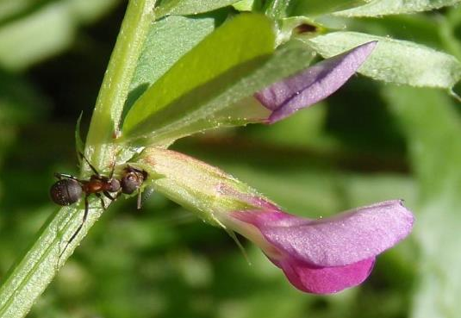
Mutualistic ants: biological defense
www.blanokridlivpraze.cz

Slide 27
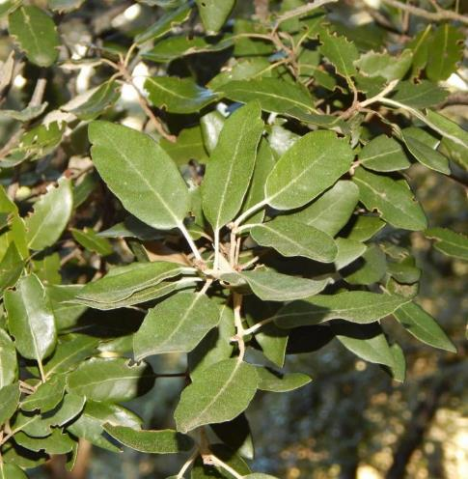
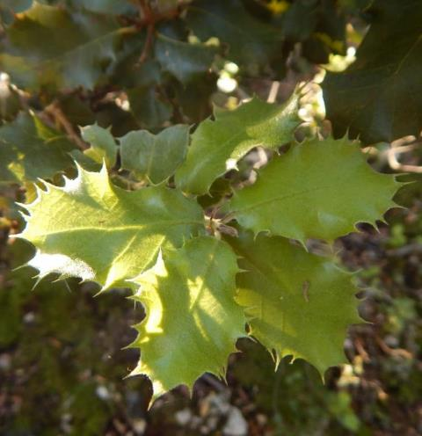
Plastic response
Quercus ilex – photo of the same individual
Lower branches with thorns (within the reach of herbivores)
Upper branches without thorns

Slide 28
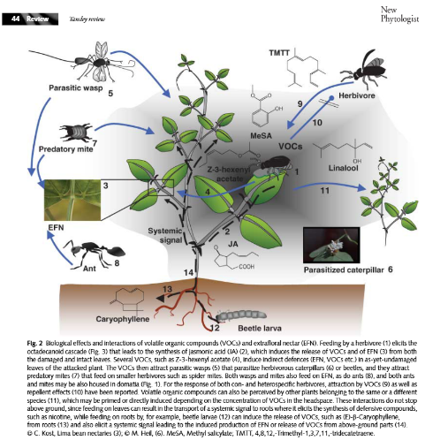
Volatile organic compounds (VOC)
VOC produced when plant is attacked
Not much is known, experimental results are inconsistent
Likely function:
Directly suppress microbial activity
Attract herbivore's predator (parasitoids, birds)
Inform other branches, individuals or species

Slide 29
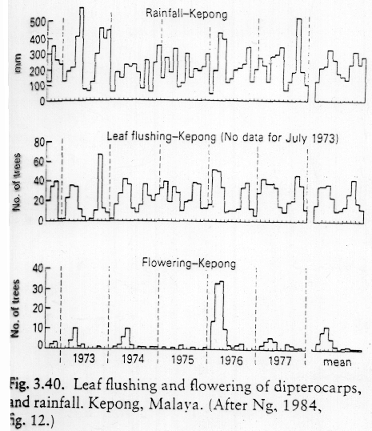
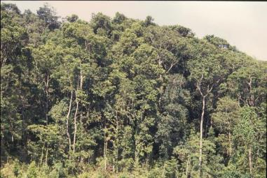
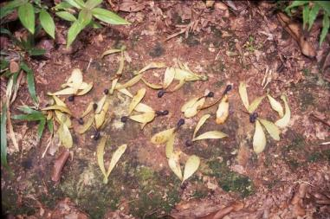
Escape in time Defense by herbivore saturation
Dipterocarpus: mass flowering at irregular intervals of 2-10 years

Slide 30
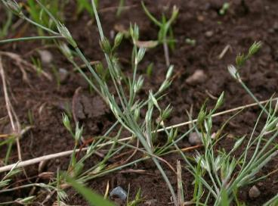

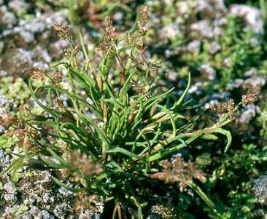
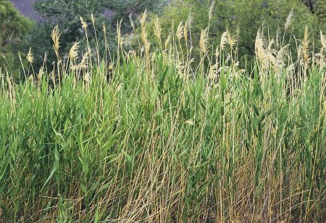
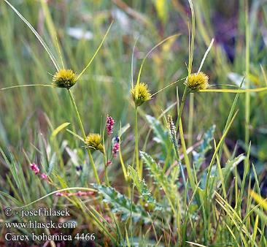
Apparent vs. unapparent plants
Juncus bufonius
Coleanthus subtilis
Phragmites communis
Carex bohemica

Slide 31

Three plant strategies:
high investment in growth and low in defense in resource-rich environment
-- unapparent plants: escape from herbivory in time or space
-- apparent plants: tolerance to herbivory
low investment in growth and high in defense in resource-poor environment

Slide 32
“Weirdly“ feeding plants vascular plants which feed on other organisms
(hemi-)parasites,
mycoheterotrophs,
carnivorous plants

Slide 33

Parasitic plants
Even vascular plants can parasitise

Slide 34
Types of plant parasites
Holoparasites – no photosynthesis, get all resources from host, including asimilates
Hemiparasites – perform photosyntesis, gain mainly water and mineral nutrients (but a bit of asimilates as well)
Both types can be connected (using haustoria) to vascular bundles in roots or stems.
Stem vs. root parasites – canopy or ground

Slide 35

It is difficult to recognize hemiparasites in the field – they are green, just their roots are very small.
Root hemiparasite Rhinanthus minor Orobanchaceae

Slide 36

Root hemiparaistes
Rhinanthus, Melampyrum (Orobanchaceae)

Slide 37


Root hemiparaistes
Pedicularis (Orobanchaceae)
Root hemiparaistes
Bartsia (Orobanchaceae)

Slide 38


Mistletoes - woody stem hemiparaistes
Viscum (Santalaceae)
Root hemiparasites
Thesium (Santalaceae)

Slide 39

Mistletoes
woody stem hemiparaistes
Dendrophthoe curvata (Loranthaceae)

Slide 40


Root hemiparasites
Mostly herbs
Can be shrubs or large trees, larger than host
Santalum acuminatum, Nuytsia floribunda
http://www.parasiticplants.siu.edu/Santalaceae/images/SantalumAcuminatum1RH.jpg
https://www.australiangeographic.com.au/topics/wildlife/2017/05/australias-giant-parasitic-christmas-tree/

Slide 41

Root hemiparasites
Okoubaka aubrevillei (Santalaceae) – 40 m tall tree
http://www.parasiticplants.siu.edu/Santalaceae/images/OkoubakaHabit1.jpg

Slide 42

Root hemiparasites
Belowground – parasites
gain water and nutrients from xylem of host
some organic carbon and secondary metabolites
Aboveground – competitors for light

Slide 43
Host specificity Holoparasites
Usually specialists – difficult to attack phloem
Necessary to convince phloem cells
Usually need chemical clue to find out that host is nearby, so that it is worth for the seed to germinate

Slide 44

Host specificity Hemiparasites
Usualy generalists
it is easier to connect to xylem (hemiparasites try to attack any roots, some can defend and some not)
hosts of different quality
It is more efficient to steel from a rich one
best hosts are legumes (good source of nitrogen) and grasses (extensive root system)

Slide 45


Cascading effect on community
Specialization leads to different effect on hosts – can change competitive ballance in community
If dominants are preferred hosts (and thus most suppressed), it is supposed to increase diversity
Rhinanthus is used in grassland restoration:
no parasite with parasite after two years

Slide 46

Parasites vs. diversity
Parasites tend to occurr in diverse communities
... but also in less productive communities, and productivity is correlated with diversity
Do parasites decrease productivity of community (and thus make space for increased divesity)?
Or are they simply outcompeted in productive less diverse communities?
Těšitel et al. 2024

Slide 47

Hemiparasites vs. productivity
It is worth to steal only resource which is in shortage
Host should be strong enough so that it is possible to steal from him, but not too strong to outcompete me for light.

Slide 48

Luxury use of resources
If parasites have surplus of stolen resources, they can affor unusual behaviour.
Permanently open stomata
Plants normally close stomata to save water during dry spells and at night
Hemiparasites often do not close stomata
gain water permanently
transpiration keeps cool – resistence to overheating
Total biomass (incl. hemiparasite) is usually lower compared to non-parasitised community
Rhinanthus pulcher

Slide 49
Luxury use of resources
Xylem contains not just water, but also
organic carbon (only very little, but when lot of xylem is stolen, quite a lot of carbon can be accummulated)
less limited by competition for light
mineral nutrients – more than needed, accumulated in biomass, produce nutrient-rich fast-decomposable litter
Enhance nutrient cycling (substantial in tundra)
Rhinanthus pulcher

Slide 50

Luxury use of resources
Endothermy
Raflesiaceae parasites display warm flower (by up to 9°C than surrounding air), increased CO₂ concentration, smell.
Simulate excrements or fresh carcases and attract insects to lay eggs.
Partial endothermy (high respiration) is demanding, only parasites can afford it.
Rhizanthes – even hairy like a carcase
http://www.parasiticplants.siu.edu/Rafflesiaceae/images/Rhizanthes.flw1.JPEG

Slide 51



How to model hemiparasites
Interesting model
Dual relationship with host
below ground – parasitism
partially selective – change competition equilibria of hosts and non-hosts
above ground – competition for light
Fast population dynamics
most of our species are annual
short-lived seed bank – heavily rely on seed production
Rhinanthus minor

Slide 52
How to model hemiparasites
Fibich P., Lepš J. & Berec L. (2010). Modelling the population dynamics of root hemiparasitic plants along a productivity gradient. Folia Geobotanica 45: 425-442.
Parasite + host
Parazitism (parasite harms) + competition (host is stronger)
Model based on model of predation, with added competition
Can lead to stable cycles
High host density may lead to eradication of hemiparasite (unlike in predator-prey model)

Slide 53


Mycoheterotrophic plants
hosts – fungi
Typical for non-green orchids – gain organic carbon from fungi (which likely gets it from other plants)
Gradient from mutualists to parasites
Limodorum abortivum
Neotia nidus-avis
www.lublin.lasy.gov.pl/image/

Slide 54
Carnivorous plants
Catch animals using various kinds of traps
Do not get energy from the prey, but mainly nitrogen compounds
similar as in hemiparasites
Photosynthetize on their own
Advantageous where nutrients are not available – peatbogs, epifytes…

Slide 55


Pinguicula alpina
(Lentibulariaceae)
Pinguicula vulgaris

Slide 56

Drosera rotundifolia
Foto Vladimír Šimek

Slide 57


Nepenthes - Papua New Guinea
Utricularia australis
(Lentibulariaceae)

Slide 58



Non-consumer "parasitisms"
Services are provided for free
energy is not obtained but saved
Structural parasites (epiphytes, climbers)
do not consume the host, but harm it
Exozoochory
beneficial for plants, annoying for animals
Deceptive flowers
colourful flowers without nectar
…

