Slide 1
Predation
(in its broad sense)
One consumes another one (i.e. + – relationship)
resource - consumer dynamics,
where resource is a population able to grow
Traditionally, population ecology studies only some of the relationships and omits others which are difficult to study or model.

Slide 2
Classification of
Begon, Townsend, Harper
Taxonomic: carnivores, herbivores (+ omnivores + fungi…)
Functional
Unintuitive assignment to categories: blood-sucking insect – grazer; leaf-eating catterpilar – parasite; plancton-eating whale – predator, carnivorous plant – predator, seed-eating rodent – predator
No classification is perfect.
 | individuals of prey eaten | prey killed
true predators | many | yes
grazers | many | no
parasitoids | one | yes
parasites | one | no

Slide 3
Predator and prey are animals (carnivory)
Predator - prey: prey is catched and eaten; predator is mostly bigger than prey (or at least of the same size); prey is more abundant.
Parasite - host: host is slowly used, not killed (the strategy is to save the host for longer). Host is usually bigger than parasite, parasite can be more abundant.
Parasitoid – saves the host first, but finally kills it.
Grazer – blood-sucking insects or bats…

Slide 4
Predator is animal, prey is plant (herbivory)
Functional difference: vertebrates vs. invertebrates
Different types of eating in invertebrates (guilds)
  chevers, suckers, miners…
What is eaten – leaves, stems, roots – always harmful
  fruits, seeds, nectar – can be useful
Grazers – eat just part of plant, attack many individuals
  vertebrates, more mobile invertebrates, pollinators, nectar robbers
Parasites – usually called just insect herbivores
  If caterpillar eats only single individual (e.g. galls, but also other)
Predators – eaten plant sometimes dies
  small annuals, seedlings, seeds – „seed predators“

Slide 5
Predator is plant
Carnivorous plants – kill many prey
  but they gain nutrients, not energy
Parasitic plants
  holoparasites – gain energy
  hemiparasites – gain water and mineral nutrients
Mycoheterotrophic plants
  gradient from mycorrhizal mutualists to mycoparasites
Predator is something else
Fungal, bacterial or other infections of plants or animals (parasitism, but traditionally studied by (phyto)patology, we just briefly mention epidemiology
The list is not complete

Slide 6
Effect on prey
For individual – always harmful
For population itself – eaten individuals are often weak, sick, less protected (non-random selection), so not necesarilly a big harm for population. Selection pressure. Depends on intensity and selectivity.
For population in community (of competitors)
– if my competitors are eaten or harmed more than me, the outcome can be positive

Slide 7
Carnivorous predators
Classical example, a bit of modelling first...

Slide 8
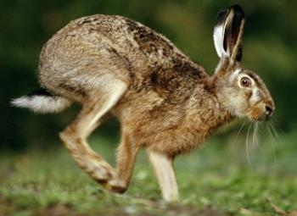
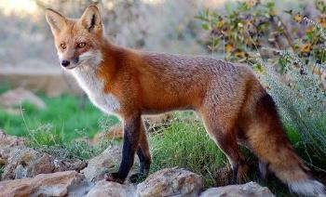
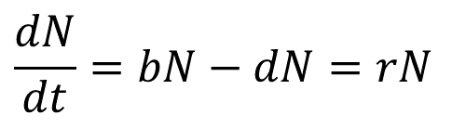
Lotka-Voltera continuous predator-prey models
N – prey; P – predator; b – birth rate; d – death rate
dN/dt = b_{N}N - d_{N}N = r_{N}N
dP/dt = b_{P}P - d_{P}P = r_{P}P
Prey: natural growth rate is constant,
additional mortality is proportional to predator abundance:
dN/dt = r_{N}N - cPN (c: rate at which food is consumed)
Predator: mortality is constant,
natality is proportional to prey density („numerical response“):
b_{P} = gcN (g: conversion efficiency of catched prey to predator progeny)
dP/dt = gcNP - d_{P}P
Probability that prey individual will be eaten is linearly dependent on the predator density
$$\frac{dN}{dt}=bN−dN=rN$$

Slide 9
dN/dt = r_{N}N - cPN
dP/dt = gcNP - d_{P}P
Assumptions (to be corrected):
Amount of catched prey is proportional to its abundance. The predator‘s natality is also proprotional, and the predator is never satiated (it can eat as much as is offered, its natality can grow linearly; if fox chatches 10× more hares, it gives birth to 10× more progeny).
No density dependence
Implications:
In absence of predator, prey grows exponentially
In the absence of prey, predator goes exponentially extinct
–> Neutral stability (stable oscilations)

Slide 10
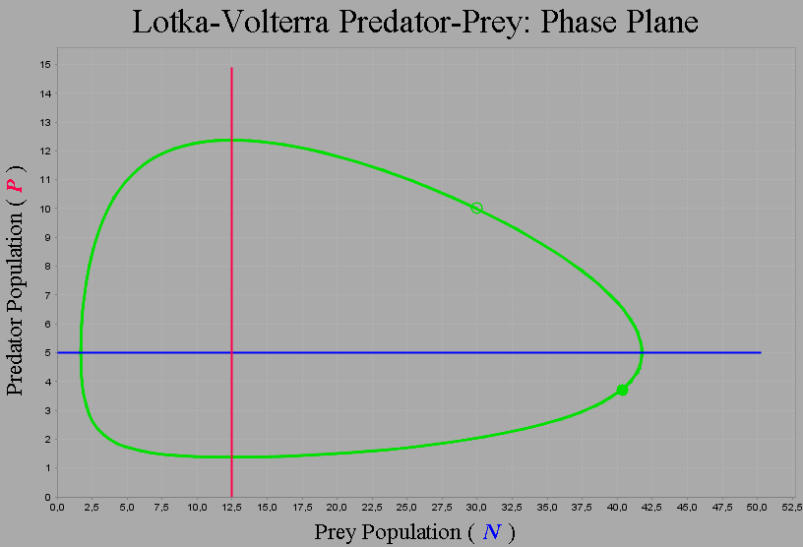
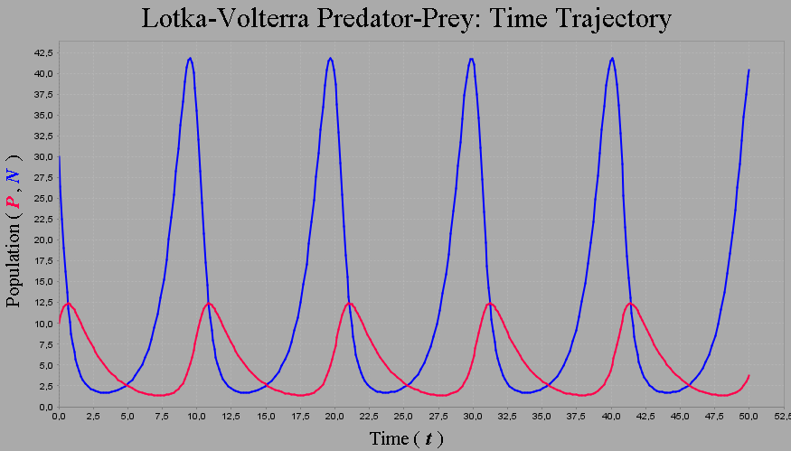
Neutral stability
(stable oscilations)
Magnitude of oscilations is given by initial abundaces

Slide 11
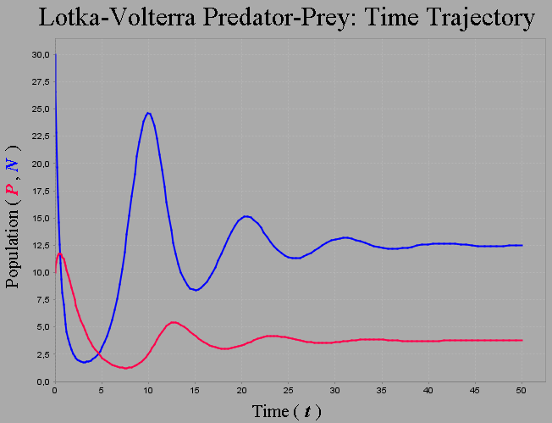
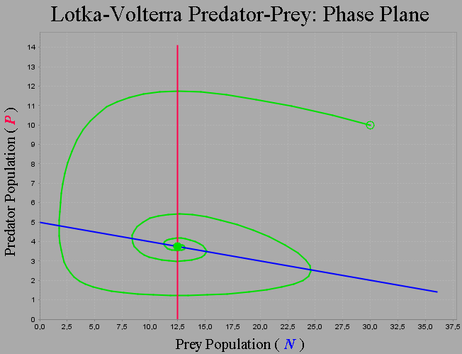
Density dependent growth rate of prey:
dN/dt = r_{N}N(1-N/K_{N}) - cPN
dP/dt = gcNP - d_{P}P
Damped oscilations, stable equilibrium
Density dependence of prey is enough for stabilisation

Slide 12
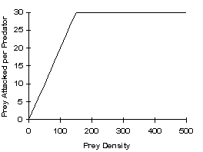
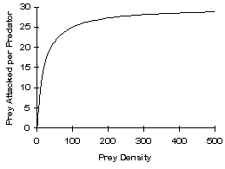
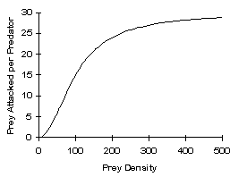
Functional response of predator
Predator gets satiated (no density-dependency yet)
Holling‘s types:
I – linear growth to a limit.
II – gradual satiation; combination of time needed for finding the prey, and for processing the prey (catch, eat, digest)
(Holling‘s disc equation)
III – at small prey density, they can all hide.
in L-V unlimited constant increase
Prey attacked
per predator
Prey density

Slide 13
Functional response – Holling type II
T – total time (or energy) spent by hunt; T = T_{s} + T_{h}
T_{s} – time for searching; decrease with increasing prey density
T_{h} – time for handling; independent of prey density
cN = cN/(1+chN)
c – attack rate
h – handling time
dN/dt = r_{N}N - cN/(1+chN)P
dP/dt = gcN/(1+chN)P - d_{P}P
affects how much is the respose curved (h=0 leads to linear increase – no satiation)
Prey attacked
per predator
Prey density
Notes:
Zisk z lovu maximalizuje příjem energie na jednotlu času, čili součet času potřebného pro nalezení a zpracování kořisti. Přidání nové kořisti je výhodné pokud energie na jednotku času pro její zpracování je alespoň stejně velká jako poměr energie na jednotku času pro zpracování a nalezení stávající kořisti. Je tomu tak proto, že čas strávený hledáním stávající kořisti muže být bez dalšího zpoždění využit také k hledání nového druhu kořisti, proto S nemusí být na levé straně rovnice. Hledání vzácné kořisti, kde S nabývá velkých hodnot, tedy vede k tomu, že je výhodné spektrum kořisti rozšířit, protože hodně dalších druhů kořisti bude vyhovovat požadované rovnici.

Slide 14
Optimal foraging strategy
Should I be specialist or should I enrich my diet?
E – energy in the prey; T_{s} – time for searching; T_{h} – time for handling
Yield from prey = E/T_{h}
E₁ / T_{h1} > E₂ / T_{h2} (i.e. prey1 is better)
Yield from hunt = E/(T_{s}+T_{h})
If E₁ / (T_{s1} + T_{h1}) ≤ E₂ / T_{h2} (i.e. T_{s2}→0),
it is worth to include species 2
I can eat also other species if I find them
during the search for the preferred one
Generally:
T_{s} << T_{h2} – specialised diet
T_{s} >> T_{h2} – rich diet, generalists
Notes:
Zisk z lovu maximalizuje příjem energie na jednotlu času, čili součet času potřebného pro nalezení a zpracování kořisti. Přidání nové kořisti je výhodné pokud energie na jednotku času pro její zpracování je alespoň stejně velká jako poměr energie na jednotku času pro zpracování a nalezení stávající kořisti. Je tomu tak proto, že čas strávený hledáním stávající kořisti muže být bez dalšího zpoždění využit také k hledání nového druhu kořisti, proto S nemusí být na levé straně rovnice. Hledání vzácné kořisti, kde S nabývá velkých hodnot, tedy vede k tomu, že je výhodné spektrum kořisti rozšířit, protože hodně dalších druhů kořisti bude vyhovovat požadované rovnici.

Slide 15
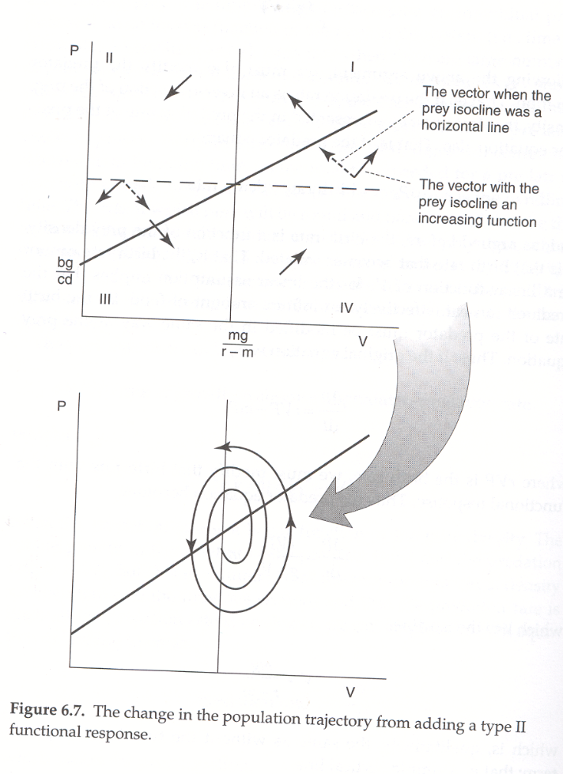
Type II alone leads to destabilisation
Clearly nonsense behaviour
– it can happen that introduction of correct assumption to the model can even worsen its behaviour

Slide 16
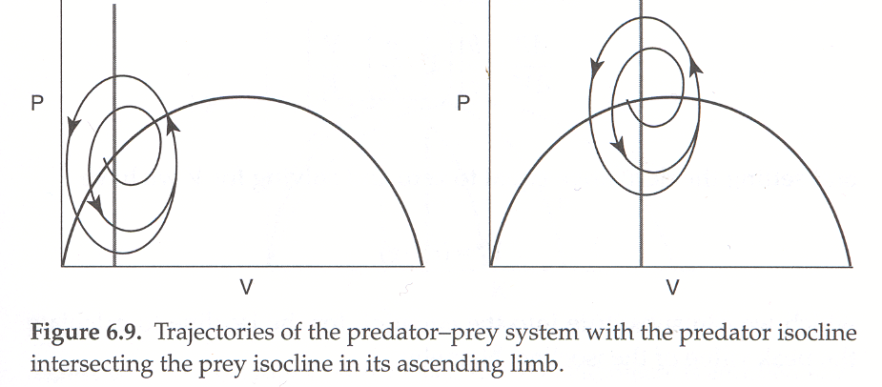
Joint application of Density dependence and Functional response
Stable oscilations, independent from initial conditions

Slide 17
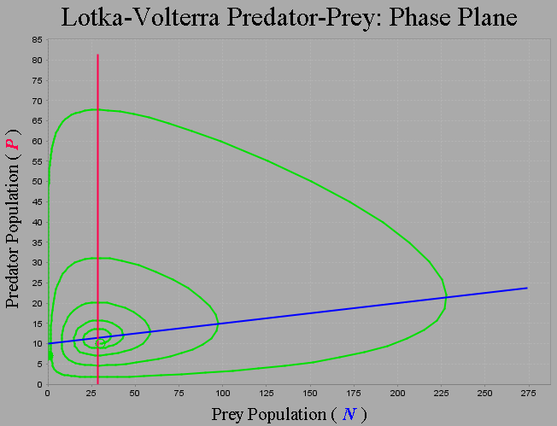
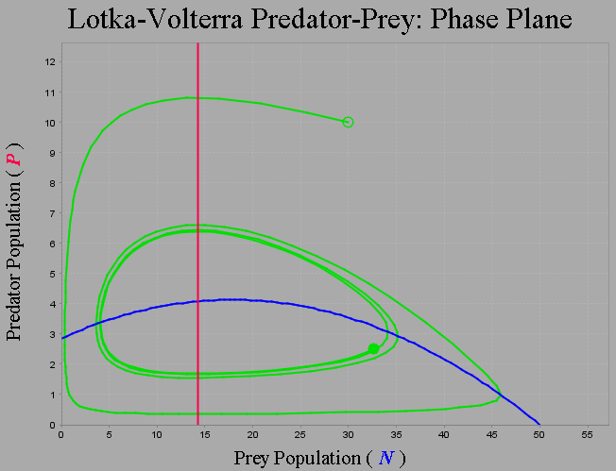
Joint application of Density dependence and Functional response
Stable oscilations, independent from initial conditions
Type II functional response + density dependence of prey
K

Slide 18
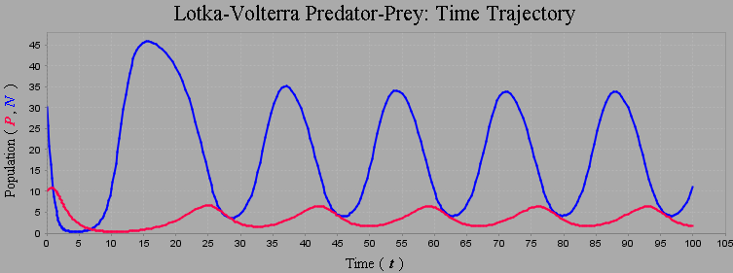
Regular cycles in nature
They surely exist
Many possible explanations
How important is the predator-prey dynamics?

Slide 19
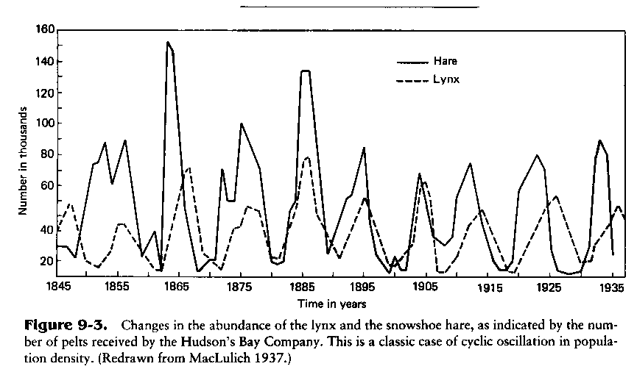
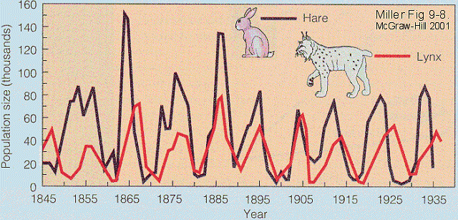
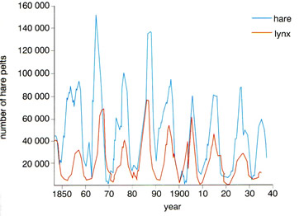
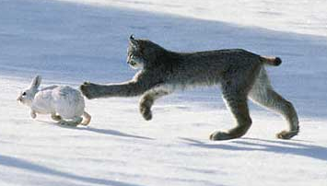
Classical data – hare and lynx in Canada
90 years long time series, population size estimated based on the hunted individuals, used in many publications

Slide 20
Classical data – hare and lynx in Canada
No one doubts that the dynamics of lynx population is largely determined by amount of available prey
But hare may not be the only prey
It is not clear if hares are suppressed by lynx to the extent to see such cycles. There may be other enemies: other large animals, or diseases.
Hares are also likely limited by other trophic level, i.e. their food source
But the model fits nicely ☺

Slide 21
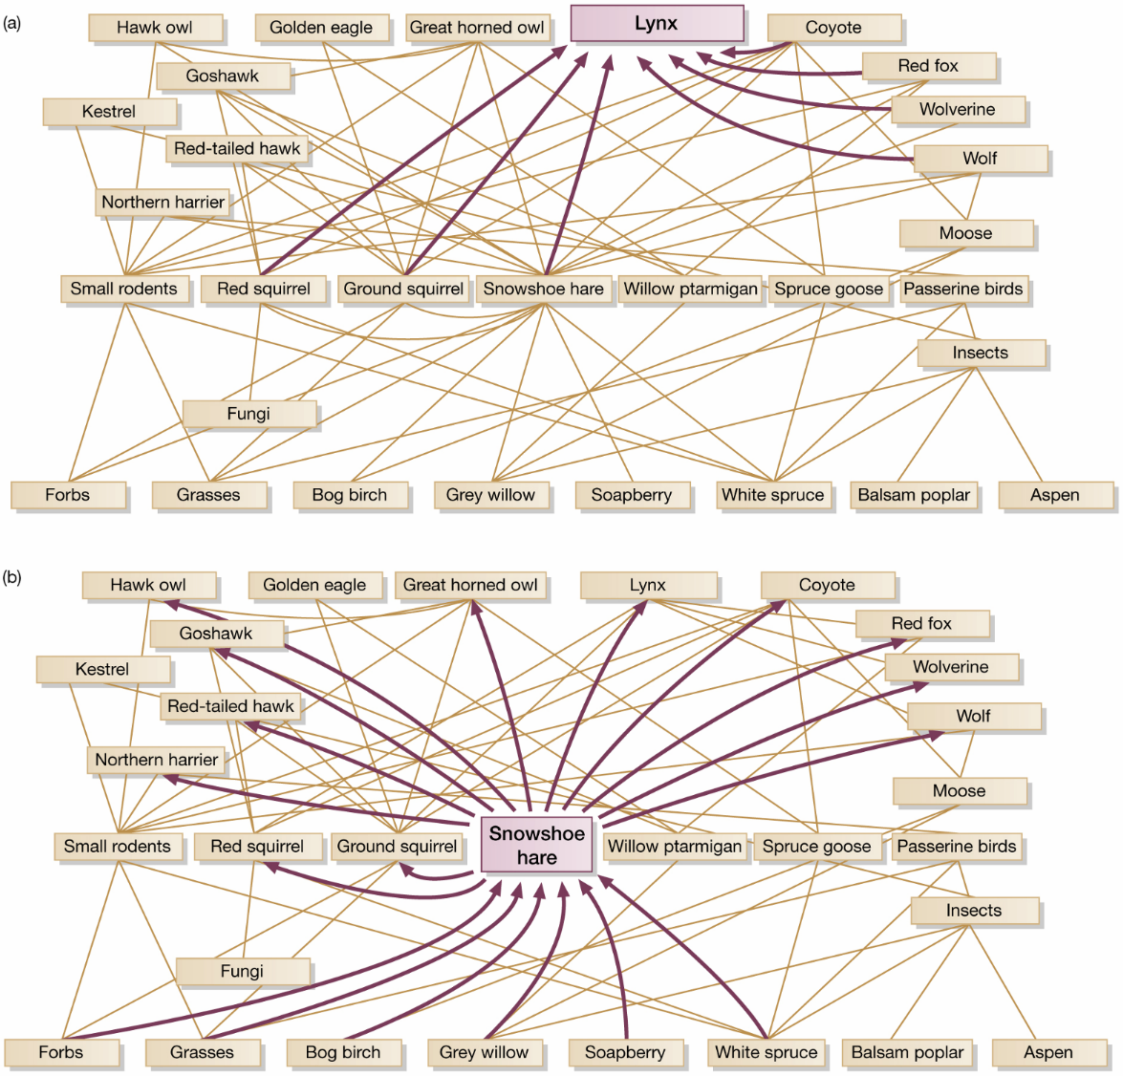
(BTH)

Slide 22
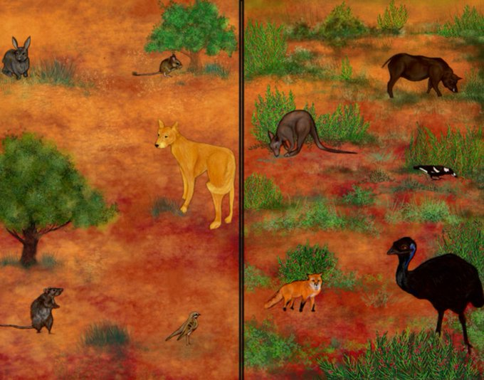
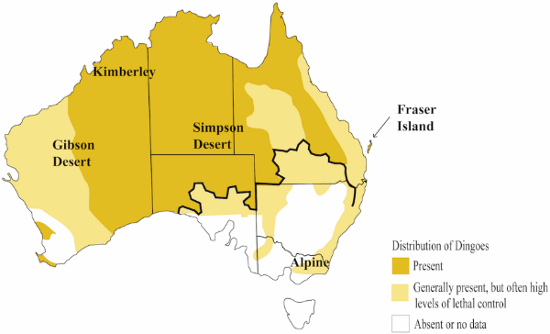
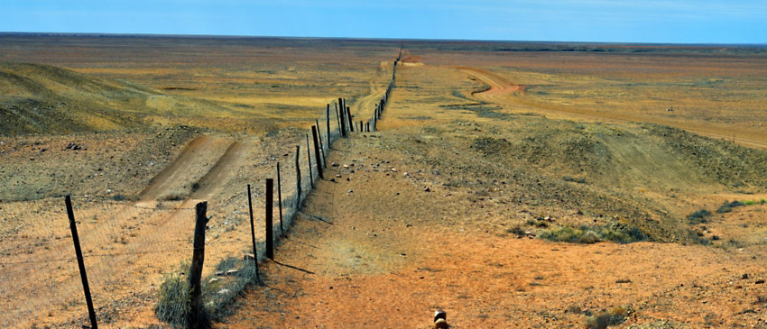
Cascade effect
Dingo fence in Australia
Culling dingos to save sheep
Release of cangaroos
–> overgrazed vegetation
–> sheep starve
Release of cats and foxes
–> decrase of small mammal herbivores
–> more shrubs –> taller dunes…
Charlotte Mills et al.
wikipedia
www.gct.com

Slide 23
Biological aspects of predation
Almost each animal species eats someone,
but is eaten at the same time.
Behaviour must be optimized
to maximize amount of catched prey,
and minimize probability of being eaten.
How not to be eaten?

Slide 24
How not to be eaten
Be hidden (in time or space)
Not to be seen (cryptic colouration)
Be noxious (toxic, stinging, disgusting) and aposematic.
  not deadly toxic, so that informed predator would not make free space for another uninformed one
Be similar to someone noxious (mimicry)

Slide 25
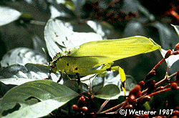
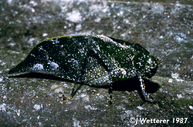
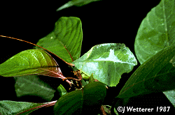
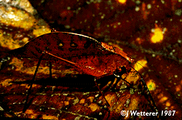
Cryptic colouration
(or camouflage)

Slide 26
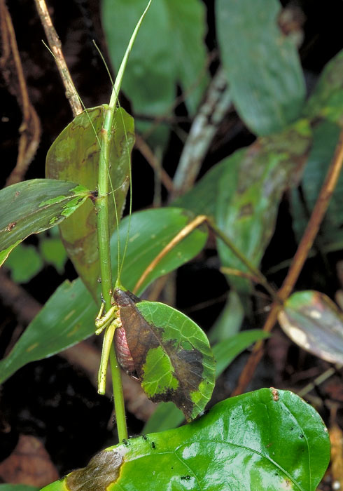
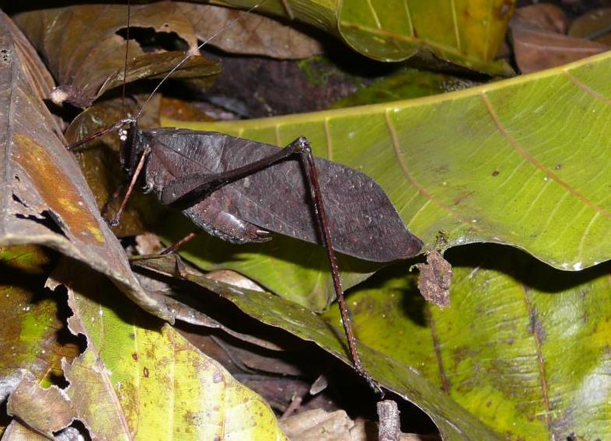

Slide 27
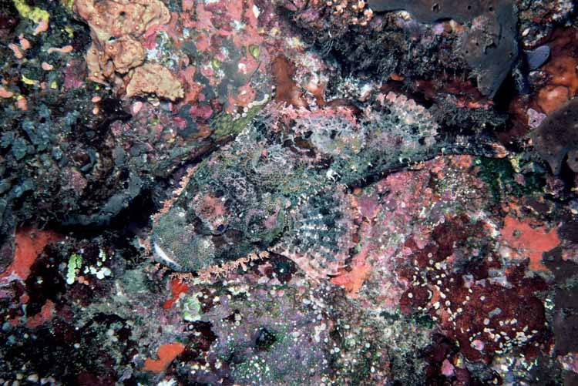

Slide 28
Mimicry
Müllerian – both are noxious
  predator learns fast
  advantageous for both, especially if they do not compete
  even multiple species
Batesian – an edible species mimics a noxious one
  predator learns slowly – mimics harm the model
  mimic should be less abundant than model
Mertensian – deadly species mimics a noxious one,
which serves for learning
Automimicry – e.g. make the predator attack the tail instead of head
or make predator think the prey is watching
or make the predator believe the prey can escape fast
Aggressive mimicry – predators try to seem harmless

Slide 29
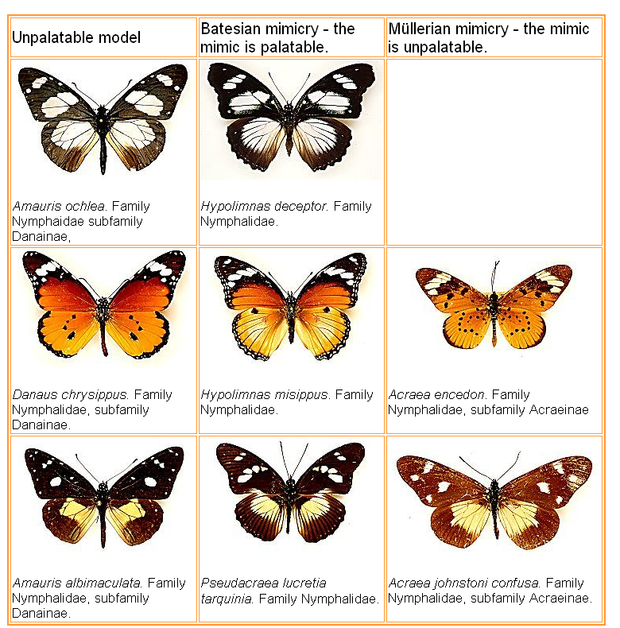
Danainae
– poisonous
– often eat poisonous Asclepiadaceae and accummulate their secondary metabolites originally aimed at protection against herbivory.

Slide 30
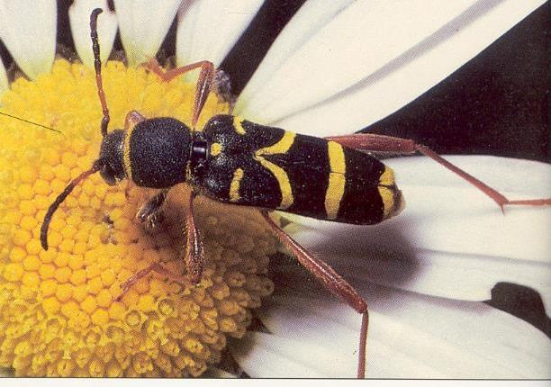
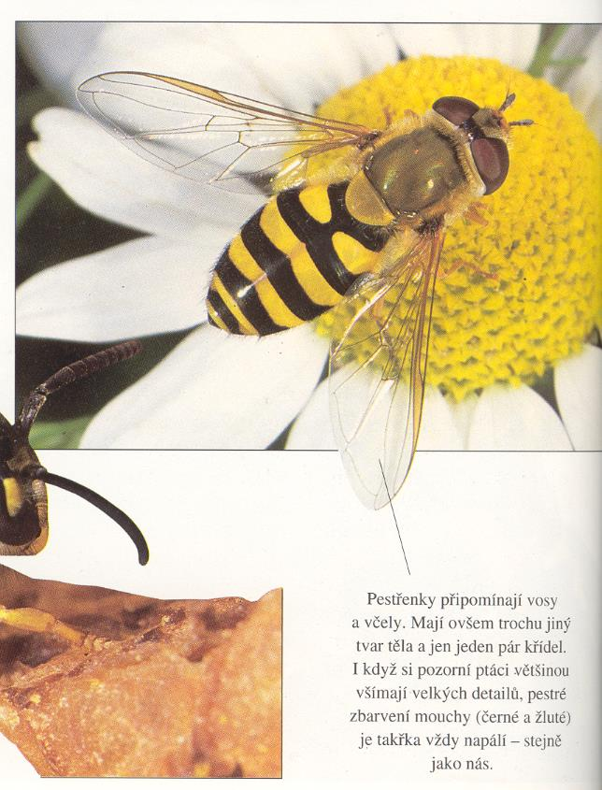
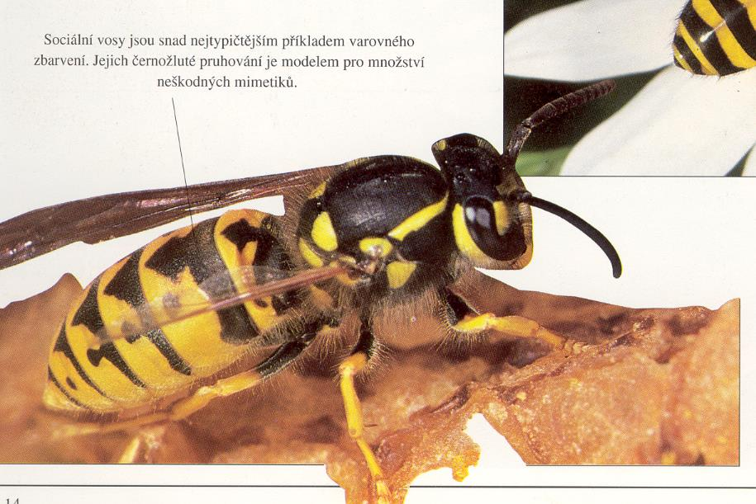
Longhorn beetle
Hoverfly
Wasp

Slide 31
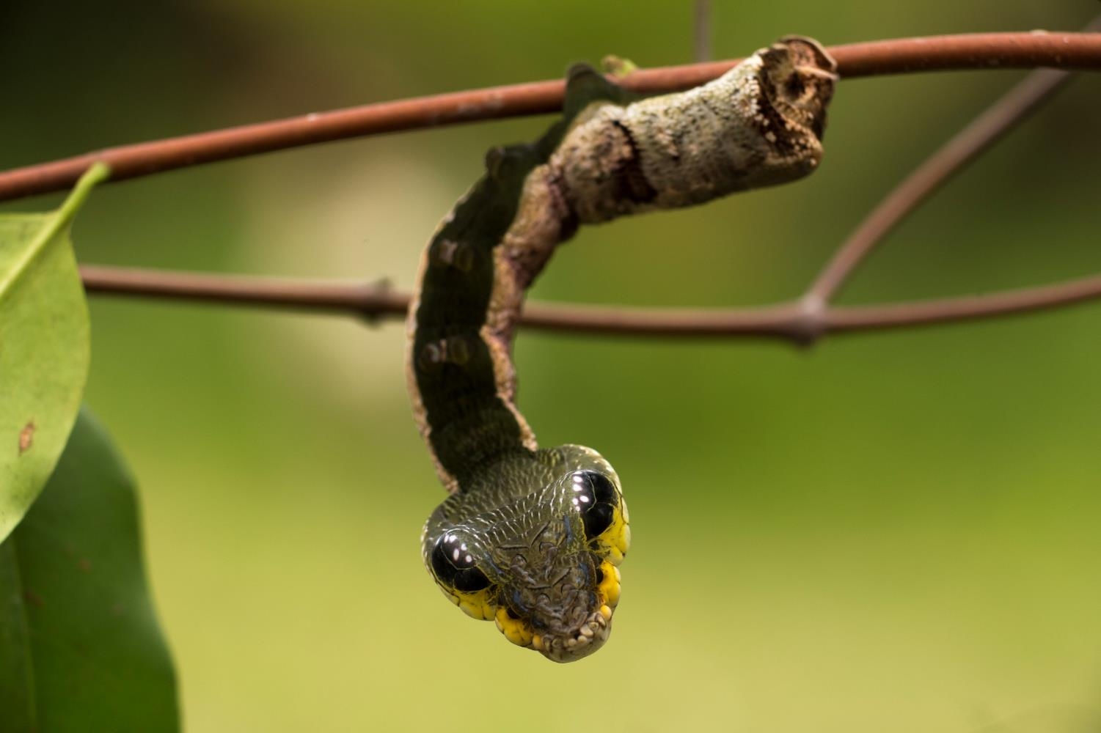
Caterpillar Hemeroplanes triptolemus mimics snake
https://www.biographic.com/snake-fake/

Slide 32
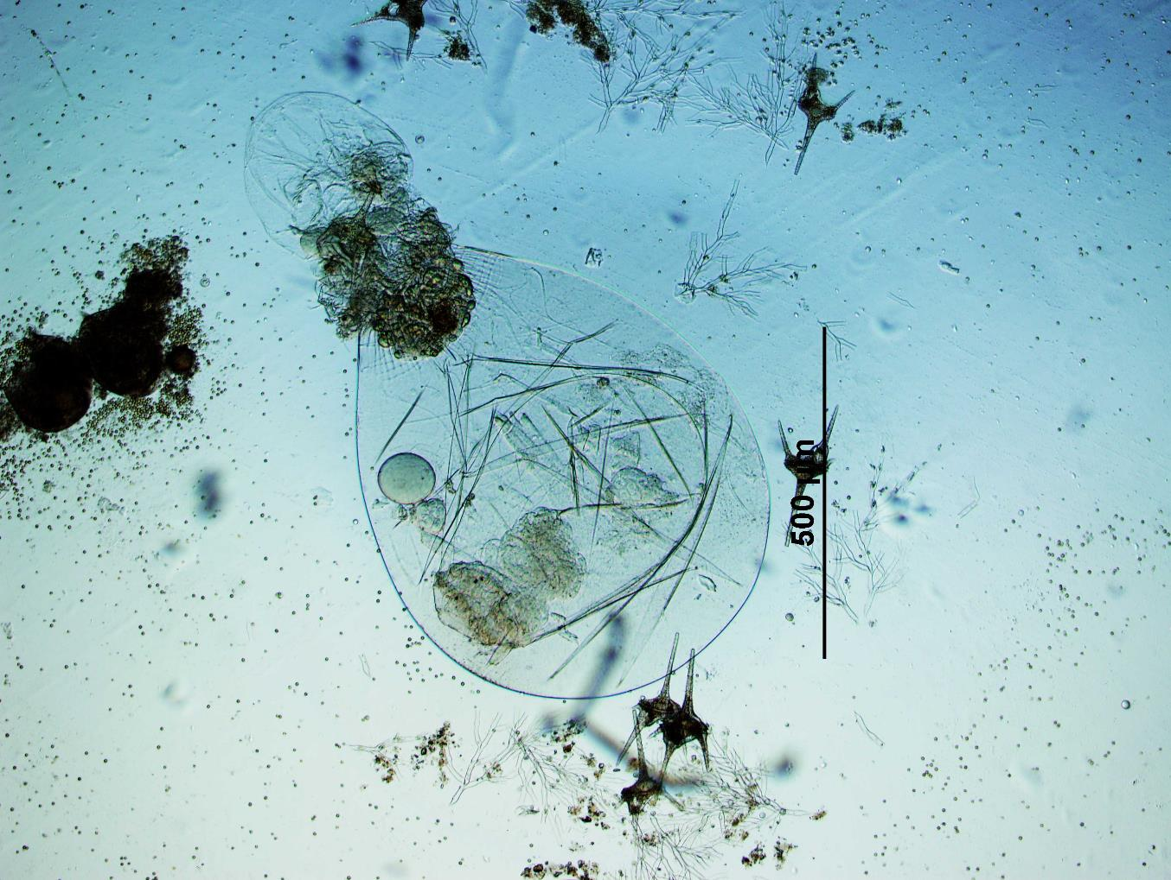
Defense mechanisms can be found in much smaller organisms as well
Rotifer Asplanchna with a dinoflagellate Ceratium stuck in its mouth
Foto Lepšová

Slide 33
Intraspecific predation (cannibalism)
Probably more common than expected
Especially common in aquatic ecosystems
(reportedly up to 80% of organisms)
Advantageous for population under special conditions
Problems:
the phylogenetically closer organisms are consumed,
the higher risk of specialized diseses
  (incl. prions – kuru, BSE)
  conspecific individuals are phylogenetically very close

Slide 34
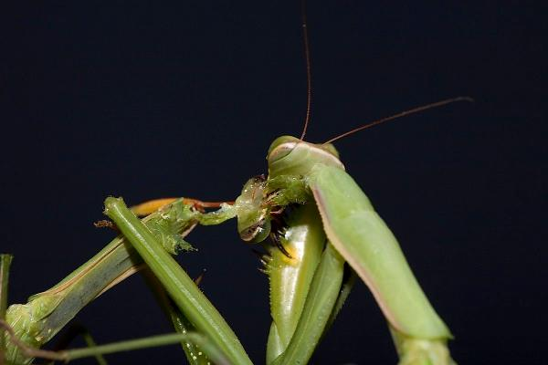
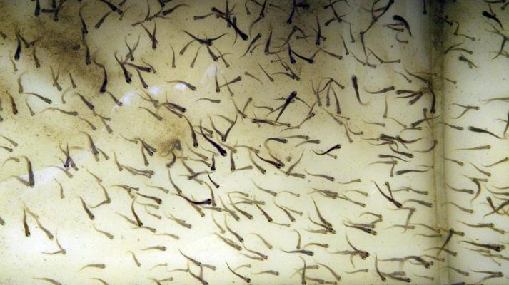
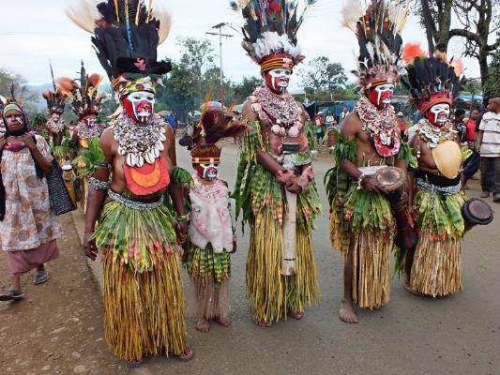
Types of cannibalism
Sexual – female eats male after copulation
  praying mantis, black widow spiders…
Size-structured
  large stages eat small stages – fish
  intrauterine – sharks – larger embryos eat smaller ones
  infanticide accompanied by cannibalism
Cultural – people

Slide 35
Cannibalism
different evolutionary causes
  food – support remaining part of population
    Prevent wasting of own biomass in favour of other predators
    Enables the small vulnerable stages to grow faster
    Prevent even larger losses in extreme conditions
      Related to formulas for optimal foraging strategy
  other – remove weak individuals
      cultural

Slide 36
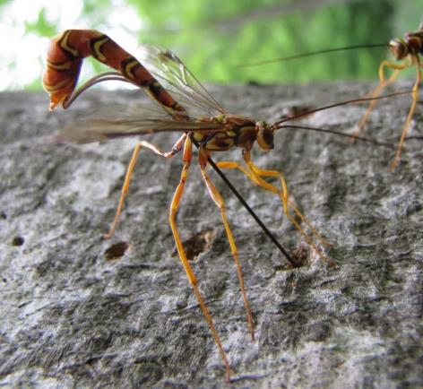
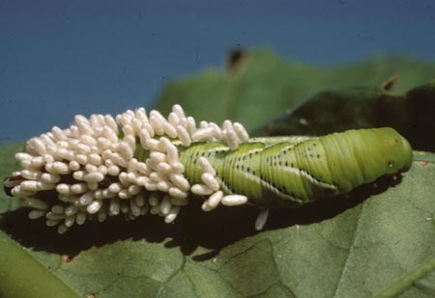
Parasitoids
Insects laying eggs into (or on) their hosts
The larvae use the living host,
and eventually kill the host
May influence host behaviour
Usually highly host-specific
Predator-prey models are often based on parasitoids
Hyperparasitism – several levels of parasitoids in a sequence
Very abundant (10% of insects),
evolved in many lineages

Slide 37
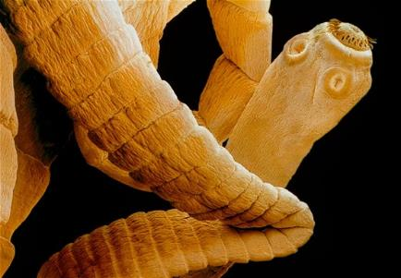
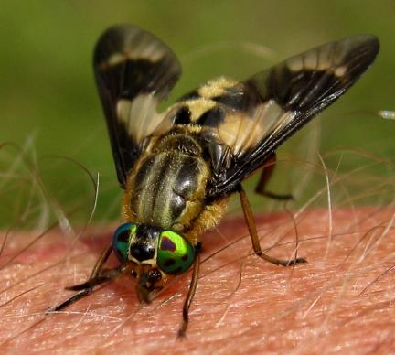
Parasitoids
wikipedia
modelled as true predators
Parasites
Parasitology (often complex life cycles)
Epidemiology (Šuspa‘s lecture on SIR models)
Indirect effects may be worse than the
adverse direct effect (transmission of disease)
Grazers
Strange term, but they exist.
Cannot be modelled as true predators, neither as parasites.
Vectors of diseases

Slide 38
Other non-animal parasites
E.g. fungal parasites of plants or animals
Microbial infections
...
When parasite is very small and closely bound to host - Epidemiology
Parasite or microbe is not modelled as population, but population of host is divided into unaffected (susceptible), and and affected (infected), in some cases also resistant (SIR models).
Models differ if the transmission is direct or mediated via another host. Transmission rate is important parameter.
Some ideas can be applied to specialized insect herbivores.

Slide 39
Herbivory
grazers – typically cow on a pasture, deer in a forest,
but also birds or mobile invertebrates, also mowing
  not much specialized –> pairwise interactions irrelevant
  Community ecology studies the effect of grazing
  on community of competitors,
    competition of plants via shared grazer – adaptations to grazing
    competition of grazers for resources (in general)
  More complex relationships
    frugivorous birds, pollinators: herbivory or dispersal?
  predators – seed predators (kill whole individual)
    Similar effect as grazers

Slide 40
Herbivory
parasites – a tree infected by caterpillars
(or various other small herbivores, galls, aphids...)
  Usually called just invertebrate herbivores, distinction from grazers often not clear, depends on mobility, size, level of specialization, research focus…
  The term may sound strange,
  but it may really be useful to quantify number of infected trees (like in models of epidemy) rather than number of individual herbivores.

Slide 41
Herbivory
Different consequence for individual and population
Killing a seedling
  Fatal for individual
  Negligible for population – it would most likely die anyway
Partial defoliation of adult plant
  Individual can recover
  Seed production of population can be significantly reduced
The importance of losses depends on the life cycle and life history characteristics of the eaten species
  remember sensitivity and elasticity analysis in matrix models
In many cases, the adverse effect is larger than proportional to the removed biomass (e.g. trunk damage, infection)

Slide 42
Herbivory and mutualism
Seed dispersal and pollination (detailed in next lecture on mutualism)
Consumed biomass is a cost for the service
  Dispersal can be haphazard or targeted to suitable sites / flowers
  Many seeds, but just one successful is enough to keep stable population
Clear adaptations – fleshy fruits, elaiosomes, nectar
Dubious adaptations
– seeds and other parts are eaten, but some seeds are dispersed far
  Quite high cost, but may still be worth for the dispersal
  Seedlings germinated in cattle excrements may have an advantage
  Squirrel always forgets some nuts (post-dispersal seed predation)
Pre-dispersal seed predation
  efficient for herbivore (seeds are the best before ripening), very bad for plant

Slide 43
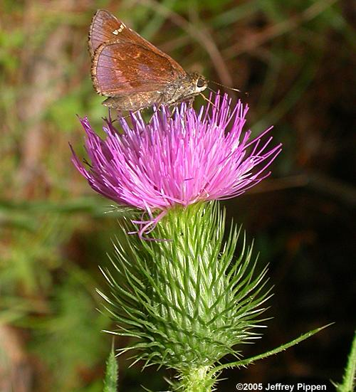
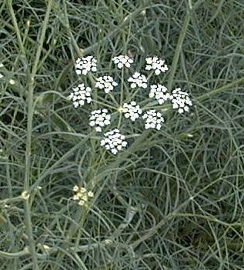
Herbivory and mutualism
Seed dispersal and pollination
Plant needs pollinators to find the flowers,
but not those which would eat the seeds.
Consequences on compactness of inflorescence:
Asteraceae Apiaceae

Slide 44
Seed predation
Mostly harmful, especially invertebrate seed predators.
  Escape in time – seed production just in some years
  Escape in space – Janzen-Connel hypothesis

Slide 45
Herbivory
Plant mostly survives, but the fitness is decreased
Eating can be accompanied with trasmission of patogens
– as well as „grazers“ of animals
Herbivory is almost always harmful for plants. If species is harmed less than its competitors, the effect can be positive. Also positive effects on dispersal.

Slide 46
What and how can be eaten
Roots (e.g. aphids, rodents)
Leaves and/or stems
  Large herbivores
  Guilds of invertebrate herbivores
  – chewers
  – suckers (phloem, xylem)
  – skeletonizers
  – miners
  – galls
Reproduction structures (flowers, ovaries, seeds)
Seedlings

Slide 47
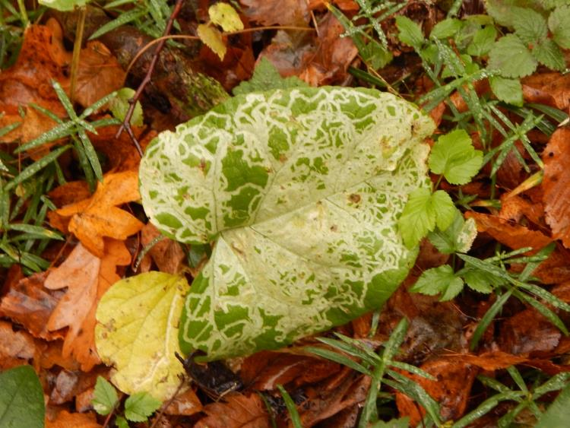
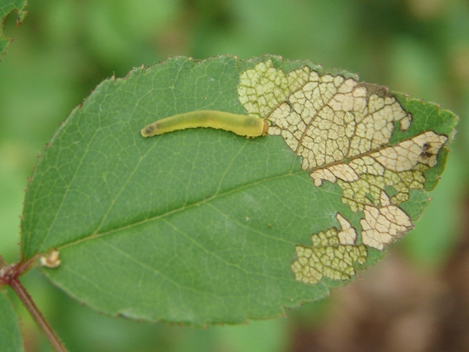
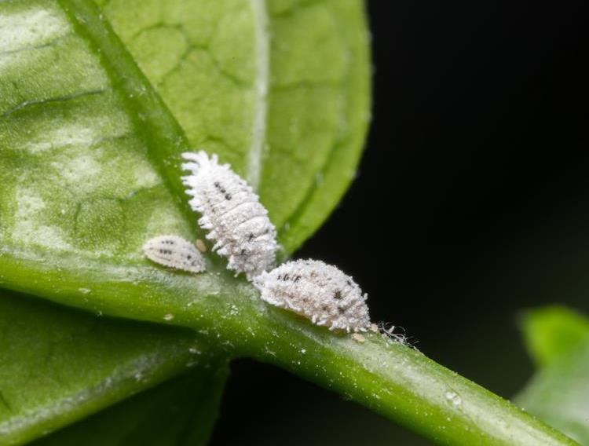
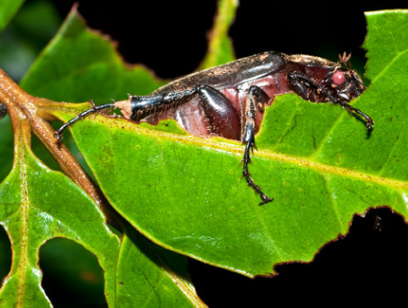
https://bugguide.net/node/view/51362
https://www.beefcentral.com/production/the-small-sap-sucking-insect-that-could-be-causing-pasture-dieback/
https://news.psu.edu/story/314397/2014/05/02/research/leaf-chewing-links-insect-diversity-modern-and-ancient-forests

Slide 48
How to study food specialization
Observations in nature:
  Data of Vojtech Novotny from Papua New Guinea
    Food webs
Experiments:
  Each individuum gets just one type of food and record fitness
  Cafeteria experiments – offer more kinds of food
Various indices of food specialization

Slide 49
How to study food specialization
Food web: links of herbivores and plants:
  chewers – generalists
  miners and gallers – specialists
Volf et al. 2017

Slide 50
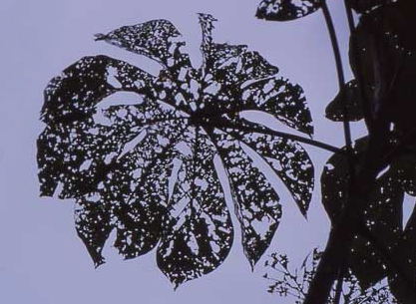


Plant response
Tolerance – compensation, regrowth
    Some leaves are eaten, but other grow up fast
Avoidance
  Defense
    costly – trade-off
    always present (depends on herbivorous pressure)
    permanent vs. plastic – produce more thorns only if eaten
  Escape in space or time
    population level, not individual
    get seeds beond (current) reach of herbivore
    Seed or biomass production in certain years only

Slide 51
Tolerance – compensation
In resource rich environment, high competition for light
Storage sugars are mobilized after biomass removal
Dormant buds can be activated (trees or clonal plants)
Eaten leaves reduce shading
– the rest of „leaf population“ photosynthetizes more (intra-individual competition for light).
Controversy: is there overcompensation?
  if so, then only at the cost of storage

Slide 52


Apparent pioneers: tree species
leaves are large, thin, designed for maximum photosynthesis, short-lived and palatable to herbivores.
Macaranga sp., Euphorbiaceae, New Guinea, pioneer species
Mora gonggrijpii, Fabaceae, Guyana, primary species

Slide 53

Pioneer trees: fast growth is what matters, and they grow VERY fast
Homalantus novoguineensis 4 years after planting a 1.5 m sapling (New Guinea)

Slide 54

Pioneer apparent plants: the main enemy is other plants;
the herbivores are thus “ignored” (and tolerated)

Slide 55



… although herbivory is still costly.

Slide 56


Slide 57
Plant defense
Mechanical
Tough leaves (monocots may be less eaten due to dense venation)
Thorns (against large herbivores)
Hairs (against invertebrates)
Chemical
Crystals (calcium oxalate, calcium carbonate, silicon dioxide)
Latex
Poisons (non-protein aminoacids, alcaloids, phenolic acids, terpenes, cyanogenic compounds)
Stingy hairs (againts vertebrates)
Biological
Mutualism with ants (domatia, extrafloral nectaria)
Plant volatile compounds (attract predators of herbivores)

Slide 58



First line of defense:
plant body is constructed from very different materials than that of their herbivores

Slide 59




Chemical defense compounds:
quantitative vs. qualitative
amygdalin
(cyanogenic glycosides)
cellulose
nicotine
(alkaloids)
lignin

Slide 60
Ecological correlates of qualitative x quantitative mode of defense
quantitative
qualitative
Examples
cellulose
hemicellulose
lignins
tannins
silica
alkaloids
toxic amino acids
cyanogens
glucosinolates
terpenoids
Ecological traits
large polymer molecules
immobile
costly to produce
effective in large doses
present in long-lived tissues
present in apparent plants
effective against most herbivores
small toxic molecules
mobile
cheap to produce
effective in small doses
present in growing tissues
present in unapparent plants
effective against generalists

Slide 61

Latex – mechanical and/or toxic defense

Slide 62

Thorns – mechanical defense

Slide 63









Cecropia plants - Azteca ants, America; plants produce glykogen rich muellerian bodies
Endospermum plants - Camponotus ants, New Guinea
Macaranga plants - Crematogaster ants, South East Asia
Mutualistic ants: biological defense

Slide 64


Slide 65


Plastic response
Quercus ilex – photo of the same individual
  Lower branches with thorns (within the reach of herbivores)
  Upper branches without thorns

Slide 66
Plant volatile organic compounds
Produced when plant is attacked
Function:
  Inform other branches or other species
  Attract herbivore‘s predator?

Slide 67



Escape in time Defense by
herbivore saturation
Dipterocarpus: mass flowering at irregular intervals of 2-10 years

Slide 68





Apparent vs. unapparent plants
Juncus bufonius
Coleanthus subtilis
Phragmites communis
Carex bohemica

Slide 69

Three plant strategies:
high investment in growth and low in defense in resource-rich environment
-- unapparent plants: escape from herbivory in time or space
-- apparent plants: tolerance to herbivory
low investment in growth and high in defense in resource-poor environment

Slide 70
„Weirdly“ feeding plants vascular plants which consume other organisms
(hemi-)parasites,
mycoheterotrophs,
carnivorous plants

Slide 71

Parasitic plants
Even vascular plants can parasitise

Slide 72
Types of plant parasites
Holoparasites – no photosynthesis,
get all resources from host, including asimilates
Hemiparasites – perform photosyntesis,
gain mainly water and mineral nutrients
(but a bit of asimilates as well)
Both types can be connected (using haustoria) to vascular bundles in roots or stems.
Stem vs. root parasites – canopy or ground

Slide 73

It is difficult to recognize hemiparasites in the field
– they are green, just their roots are very small.
Root hemiparasite
Rhinanthus minor Orobanchaceae

Slide 74

Root hemiparaistes
Rhinanthus, Melampyrum (Orobanchaceae)

Slide 75

Root hemiparaistes
Pedicularis (Orobanchaceae)

Slide 76

Root hemiparaistes
Bartsia
(Orobanchaceae)

Slide 77

Root hemiparasites
Thesium (Santalaceae)

Slide 78

Mistletoes
woody stem hemiparaistes
Viscum
(Santalaceae)

Slide 79

Mistletoes
woody stem hemiparaistes
Dendrophthoe curvata (Loranthaceae)

Slide 80
Host specificity
Holoparasites
Usually specialists – difficult to attack phloem
  Necessary to convince phloem cells
Usually need chemical clue to find out
that host is nearby,
so that it is worth for the seed to germinate

Slide 81
Host specificity
Hemiparasites
Usualy generalists (it is easier to connect to xylem), but there are hosts of different quality
It is more efficient to steel to a rich one – bests hosts are legumes (good source of nitrogen) and grasses (extensive root system), but there are exceptions.
It is possible to attach conspecific individuals – intraspecific interaction
– usually by chance

Slide 82




Defense
Functional haustorium
Mechanical defense (lignification, lysis…) at contact with new haustoria
Cameron & Seel (2007) New Phytologist

Slide 83


Effect on community
Specialization leads to different effect on hosts
– can change competitive ballance in community
If dominants are preferred hosts (and thus most suppressed), it is supposed to increase diversity
Rhinanthus is used in grassland restoration:
no parasite with parasite after two years

Slide 84
Root hemiparasites
Belowground – parasites – gain water and nutrients from xylem of host
Aboveground – competitors – light
Also gain organic carbon from host
(there is a bit of it in xylem),
as well as secondary metabolites

Slide 85
Parasites vs. productivity
Hadač 1969: data from Dolina siedmich prameňov (Slovakia)
Community biomass and abundance of parasites is often correlated
Do parasites decrease productivity of community?
Or are they outcompeted in productive communities?

Slide 86

Parasites vs. productivity
It is worth to steal only resource which is in shortage
Host should be strong enough so that it is possible to steal from him, but not too strong to outcompete me for light.

Slide 87

Parasites vs. productivity
Holoparasites are not limited by competition – no need to photosynthesize
(Orobanche on Petasites)
http://parasiticplants.org/i3m5a2g8e/ipps_photos/Photo_Orobanche_flava_Toth.jpg

Slide 88

Root holoparasite Cystanche cf. tubulosa (Negev desert)

Slide 89


Root hemiparasites
Mostly herbs
Can be shrubs or large trees, larger than host
Santalum acuminatum, Nuytsia floribunda
http://www.parasiticplants.siu.edu/Santalaceae/images/SantalumAcuminatum1RH.jpg
https://www.australiangeographic.com.au/topics/wildlife/2017/05/australias-giant-parasitic-christmas-tree/

Slide 90

Root hemiparasites
Okoubaka aubrevillei (Santalaceae) – 40 m tall tree
http://www.parasiticplants.siu.edu/Santalaceae/images/OkoubakaHabit1.jpg

Slide 91

Luxury use of resources
If parasites have surplus of stolen resources,
they can affor unusual behaviour.
Permanently open stomata
Plants normally close stomata to save water
during dry spells and at night
Hemiparasites often do not close stomata
  gain water permanently
  transpiration keeps cool
  – resistence to overheating
Total biomass (incl. hemiparasite)
is usually lower compared to
non-parasitised community
Rhinanthus pulcher

Slide 92
Luxury use of resources
Xylem contains not just water, but also
organic carbon (only very little, but when lot of xylem is stolen, quite a lot of carbon can be accummulated)
secondary metabolites from host
mineral nutrients – more than needed,
accumulated in biomass, produce
nutrient-rich fast-decomposable litter
  Enhance nutrient cycling (substantial in tundra)
  Inoculates litter of other species,
  which also decomposes faster
  supports establishment of (host) seedlings
Rhinanthus pulcher

Slide 93

Luxury use of resources
Endothermy
Raflesiaceae parasites display warm flower
(by up to 9°C than surrounding air),
increased CO₂ concentration, smell.
Simulate excrements
or fresh carcases and attract
insects to lay eggs.
Partial endothermy
(high respiration)
is demanding,
only parasites can afford it.
Rhizanthes –
even hairy like a carcase
http://www.parasiticplants.siu.edu/Rafflesiaceae/images/Rhizanthes.flw1.JPEG

Slide 94



How to model hemiparasites
Interesting model
  Dual relationship with host
    below ground – parasitism
      partially selective – change competition equilibria of hosts and non-hosts
    above ground – competition for light
  Fast population dynamics
    most of our species are annual
    short-lived seed bank – heavily rely on seed production
Rhinanthus minor

Slide 95
How to model hemiparasites
Fibich P., Lepš J. & Berec L. (2010). Modelling the population dynamics of root hemiparasitic plants along a productivity gradient. Folia Geobotanica 45: 425-442.
Parasite + host
Parazitism (parasite harms)
+ competition (host is stronger)
Model based on model of predation,
with added competition
Can lead to stable cycles
High host density may
lead to eradication of
hemiparasite
(unlike in predator-prey model)

Slide 96
How to model hemiparasites
Cameron D.D., White A. & Antonovics J. (2009). Parasite–grass–forb interactions and rock–paper–scissor dynamics: predicting the effects of the parasitic plant Rhinanthus minor on host plant communities. Journal of Ecology 97: 1311-1319.
Parasite,
grass (host,
strongest competitor),
other herbs (resistant,
weaker competitor than grass but stronger than parasite)
No winner –> cycles
Several flaws in model,
but appealing behaviour
Notes:
The model leads to extremely fast exponential growth, therefore they present relative abundance only („the superscript indicates that the frequencies are corrected by
the total“).
The time scale is irrelevant.
The wPG parameter is calculated as ratio of parasite biomass with and without grass (without grass, the biomass is very low, so the ratio is very high), but is used to multiply parasite's biomass in previous time step with host.

Slide 97
How to model hemiparasites
Cameron D.D., White A. & Antonovics J. (2009). Parasite–grass–forb interactions and rock–paper–scissor dynamics: predicting the effects of the parasitic plant Rhinanthus minor on host plant communities. Journal of Ecology 97: 1311-1319.
+ spatial structure
+ stochasticity
Stochasticity leads to differenciation between cells, prevents complete stabilisation. Spread to neighbouring cells leads to spatial clusters and overall stabilisation (if some group goes extinct, it can disperse back)

Slide 98


Mycoheterotrophic plants
hosts – fungi
Typical for non-green orchids – gain organic carbon from fungi (which likely gets it from other plants)
Gradient from mutualists to parasites
Limodorum abortivum
Neotia
nidus-avis
www.lublin.lasy.gov.pl/image/

Slide 99
Carnivorous plants
never classified as parasites
  formally – classical predation
Catch animals using various kinds of traps
Do not get energy from the prey,
but mainly nitrogen compounds
  similar as in hemiparasites
Photosynthetize on their own
Advantageous where nutrients are not available
– peatbogs, epifytes…

Slide 100


Pinguicula alpina
(Lentibulariaceae)
Pinguicula vulgaris

Slide 101

Drosera rotundifolia
Foto Vladimír Šimek

Slide 102


Nepenthes
- Papua New Guinea
Utricularia australis
(Lentibulariaceae)

Slide 103
Non-consumer „parasitisms“
Services are provided instead of nutrients
Nesting parasites
Structural parasites (epiphytes, climbers – do not consume the host, but harm it)
Exozoochory – beneficial for plants, annoying for animals
Deceptive flowers – colourful flowers without nectar

Slide 104
Omitted aspects of predation
Spatial structure
Selectivity, specialization, food preference, switching, optimal foraging
Competition of predators and prey
(competition of prey can be affected by predation)
will be in Community Ecology

